Slide 1
Office Hours: Equipping Chambers of Commerce to Engage in Registered Apprenticeship
March 26th, 2025
Safal Partners © 2025

Slide 2
Presenters
Jeremy Faulkner
Alan Dodkowitz
Subject Matter Expert
Safal Partners
Subject Matter Expert
Safal Partners
Safal Partners © 2025

Slide 3
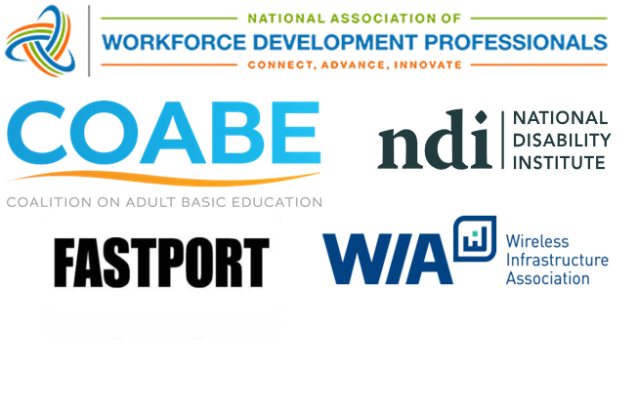
Center of Excellence Overview
U.S. DOL initiative to increase systems alignment across apprenticeship, education, and workforce
Led by Safal Partners; 5 national partners
We provide no-cost services including:
Monthly webinars
Quarterly virtual office hours
Individual compliance assistance and services
Online resources (desk aids, guides, frameworks, etc.)
Visit our website, request assistance
Safal Partners © 2025

Slide 4
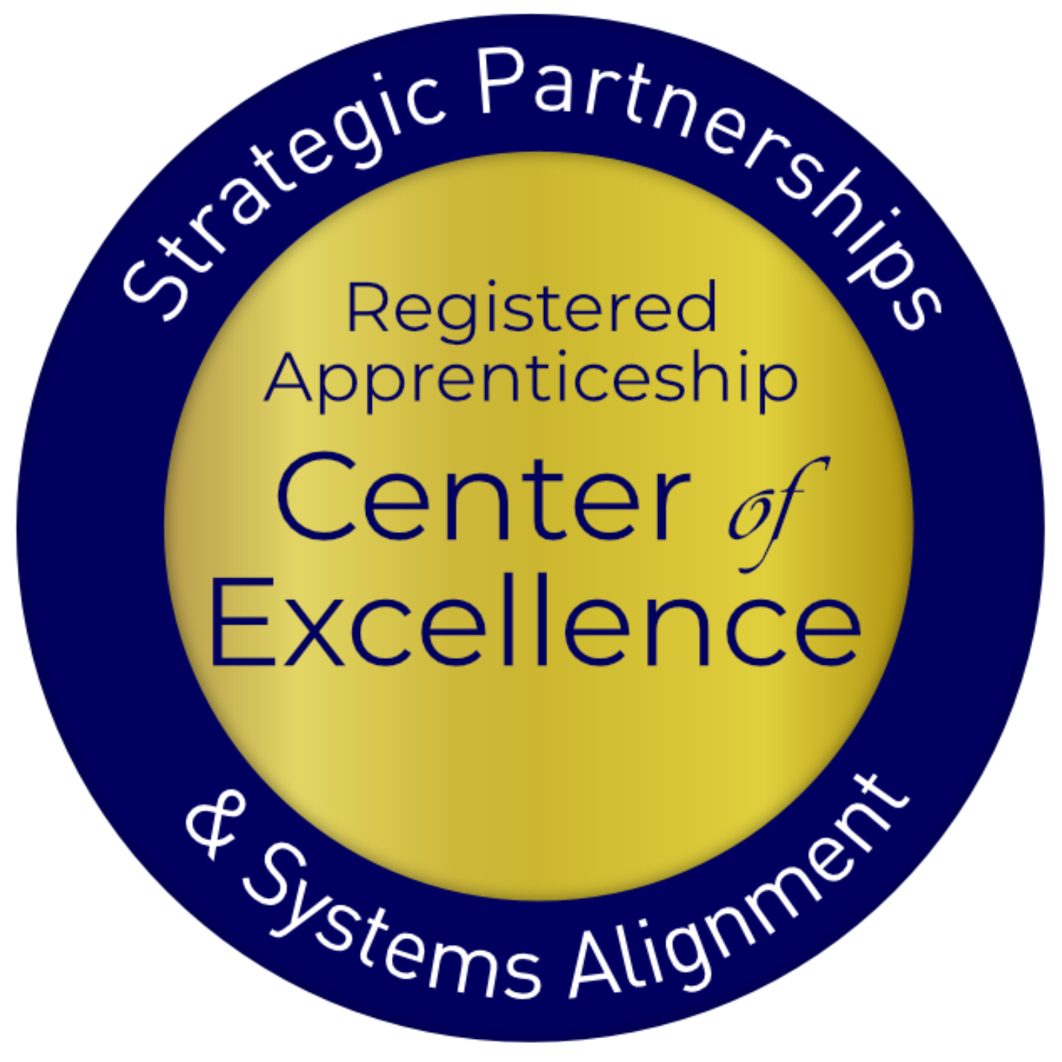
Welcome and Agenda
Center of Excellence Overview
An Overview of Registered Apprenticeship
Why Registered Apprenticeship and Chambers of Commerce Work Well Together
Current Involvement of Chambers in Registered Apprenticeship
Examples of Chamber Involvement
How Chambers can Engage in RA and Leverage Benefits to Enhance Workforce Strategy
Questions
Safal Partners © 2025

Slide 5
Getting to Know You
Are you a….
Chamber of Commerce Executive
Chamber of Commerce Member
Business
Workforce Board Director or Staff
AJC / Career Center Partner
Service Provider
Educational Partner
Board Member
Other?
Safal Partners © 2025

Slide 6
An Overview of Registered Apprenticeship
Safal Partners © 2025

Slide 7
Registered Apprenticeship
Registered Apprenticeship is:
a proven model of job preparation that combines paid on-the-job training (OJT) with related instruction to progressively increase workers’ skill levels and wages;
a proven business-driven model that provides an effective way for businesses to recruit, train, and retain highly skilled workers.
Safal Partners © 2025

Slide 8
Spans All Sectors
Safal Partners © 2025

Slide 9
Five Core Components of Apprenticeship
Employer Involvement
Structured On-the-Job Learning (OJL)
Related Instruction (RI)
Rewards for
Skill Gains
National Occupational Credential
Safal Partners © 2025

Slide 10
Key Organizational Apprenticeship Roles
Sponsor
Employer
RI Provider
Partner
Sponsor: An organization that agrees to operate an apprenticeship program and in whose name the program is registered.
Employer: Hires and provides paid OJL for apprentices under supervision of a designated mentor who is a skilled professional in that occupation.
RI Provider Entity that provides instruction to apprentices in the designated occupation’s core knowledge, skills, and abilities.
Partner Organizations committed to assisting RA programs. They can play one or more roles.
Safal Partners © 2025

Slide 11
Benefits of Registered Apprenticeship
Reduced Turnover: Registered Apprenticeship is estimated to have a 93% retention rate (USDOL)
Accessing Financial Benefits: employers with apprenticeship programs can qualify for federal and state tax credits, workforce funding, and a network of partners to support program implementation
Positive ROI: Employers report earning on average $1.44 for every $1 invested in apprenticeship (USDOL)
Earn and Learn Training Model: Apprentices are paid for the duration of their apprenticeship term, allowing them to earn a wage while learning their new occupation.
Standardized Skillset: Every apprentice that completes an employer’s apprenticeship program becomes fully proficient in the same set of skills, creating a more agile workforce
Safal Partners © 2025

Slide 12
Noteworthy Chambers
Safal Partners © 2025

Slide 13
German-American Chamber of Commerce
Implements German-style Registered Apprenticeship programs across the Midwest and Southern US.
GACC works with 56 employers in fields like advanced manufacturing, pharmaceutical manufacturing, industrial electronics, and business operations (e.g., purchasing, marketing, HR, accounting).
They train company instructors, assist with recruitment and outreach, connect with college providers, and liaise with stakeholders.
Apprentices earn both a USDOL certification and a German journey worker credential.
GACC expands Registered Apprenticeship initiatives based on workforce needs identified by member companies, partnering with workforce development organizations, and aiming to scale programs to a self-sustaining level.
Safal Partners © 2025

Slide 14
Kentucky Chamber Foundation
Partners with over 80 local chambers and 25,000 professionals, they advocate for Registered Apprenticeship programs to address labor shortages and workforce development.
Provides tools and information to help member businesses establish Registered Apprenticeship programs by equipping smaller chambers through the process.
Foster partnerships between educational institutions and the Registered Apprenticeship ecosystem, enabling students to earn both educational credentials and Registered Apprenticeship certificates.
Safal Partners © 2025

Slide 15
Charleston Metro Chamber of Commerce
Promotes Registered Apprenticeship growth through their talent development program.
They helped to expand Registered Apprenticeship to nontraditional industries, recruit employers, arrange interviews, hosted signing days, and contributed private investment for related instruction at the local technical college through Accelerate Greater Charleston to over 200 employers across South Carolina.
The Chamber recruits employers, shares information through outreach events, and aligns regional workforce boards and employers to access WIOA funding to offset training costs.
Safal Partners © 2025

Slide 16
Greater Cleveland Partnership
ABA Category 4 Grant for $5.8 Million
Established a RAP Hub in Greater Cleveland
Used for Staff and for System Support/Growth
GCP serves as the program sponsor and acts as an intermediary to provide mentor training and support, identify and connect to wraparound services, assist with data collection and reporting, and advocate for RA program supported policies at the local, state, and federal level.
14 occupations registered
Safal Partners © 2025

Slide 17
How Can You Get Involved
Safal Partners © 2025

Slide 18
What Role Do or Could You Play in RA?
Convener
Partner
Sponsor
Engage the community to share information about RA and maintain working knowledge of available resources.
Actively promote RA, host events for RA stakeholders to present information, support through special initiatives.
Register a group program and manage the related administrative duties for employers.
Safal Partners © 2025

Slide 19
Key Actions to Progress Forward
Understand current state apprenticeship efforts.
Engage with apprenticeship ecosystem.
Find out where and how related apprenticeship funding is accessed.
Get to know the industries and employers who are already involved and are using RA.
Safal Partners © 2025

Slide 20
Questions and Discussion

Slide 21
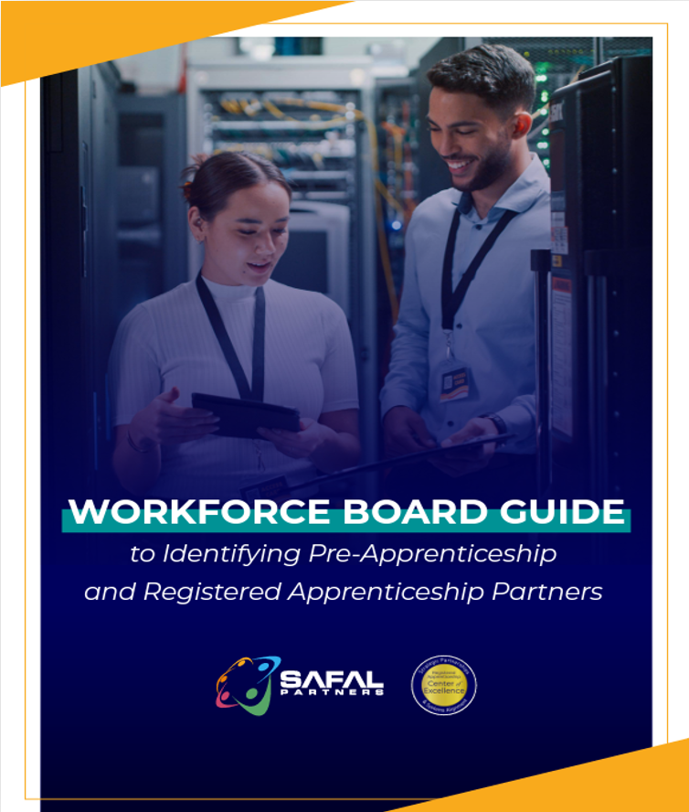
No-Cost Resources
Guide to Identifying Partners
Safal Partners © 2025

Slide 22
Become a Center Partner
Scan for Partner Form
Receive no-cost expert services, including materials and support
Network with potential partners nationwide
Be nationally recognized for your work
Safal Partners © 2025

Slide 23
Email us your questions at RA_COE@SafalPartners.com
For more information, visit: dolcoe.safalapps.com
Safal Partners © 2025

