Slide 1
Braiding Grants and Workforce Funding for Apprenticeship Supportive Services
November 30, 2023

Slide 2
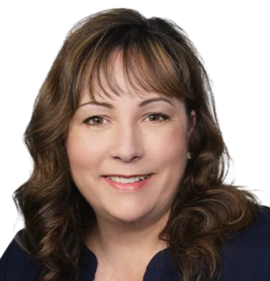
Presenters
Katie Adams
Angela Baker
Chief Delivery Officer
Safal Partners
Registered Apprenticeship Subject Matter Expert
Safal Partners
Safal Partners © 2023

Slide 3
Welcome and Agenda
Center of Excellence Overview
Funding Sources to Support Registered Apprenticeship (RA)
Braiding Funds for RA
Spotlight: Special School District of St. Louis County’s Adult CTE Department
Scenarios
Questions and Discussion
Safal Partners © 2023

Slide 4
Center of Excellence Overview
U.S. DOL initiative to increase systems alignment across apprenticeship, education, and workforce
Led by Safal Partners; 5 national partners
We provide no-cost TA including:
Monthly webinars
Quarterly virtual office hours
Individual TA/coaching sessions
Online resources (desk aids, guides, frameworks, etc.)
Visit our website, request TA

Slide 5
Funding Sources, Supportive Services for RA
Safal Partners © 2023

Slide 6
Five Components of RA
Employer Involvement
Structured On-the-Job Learning (OJL)
Related Instruction (RI)
Rewards for
Skill Gains
National Occupational Credential
Safal Partners © 2023

Slide 7
Supportive Services
Community services
Transportation
Dependent care
Housing
Needs-related payments
Educational testing
Accommodations for disabilities
Legal aid services
Referrals to health care
Work attire and work tools
Necessary items for postsecondary education classes
Payments and fees for employment and training-related applications, tests, and certifications.
Safal Partners © 2023

Slide 8
A World of Funding Options
Workforce System
Workforce Innovation and Opportunity Act (WIOA)
Non-WIOA Funding
Federal Funding
State-Based Funding
Private Funding
Safal Partners © 2023

Slide 9
WIOA - In School Youth (Ages 14-21)
Eligibility
Funding Sources
Age: 14 to 21
Attending school
One or more barriers:
Low income
Basic skills deficient
English language learner
Justice system-involved
Homeless
Parenting
Has a disability
Paid Work Experience
On-the-Job Learning (OJL) reimbursement
Supportive Services
25% WIOA Youth Funding – IS Youth
Safal Partners © 2023

Slide 10
WIOA - Out of School Youth (Ages 16-24)
Eligibility
Funding Sources
Age: 16-24
Not attending school
One or more barriers to employment
Occupational Skills Training
Related Instruction (RI) tuition
Paid Work Experience (OJL reimbursement)
Supportive Services
75% WIOA Youth Funding – OOS Youth
Safal Partners © 2023

Slide 11
WIOA – Adult (Age 18+)
Eligibility
Funding Sources
Age: 18 or older
U.S. citizen or authorized to work in the U.S.
Selective Service Registration, as required
Occupational Skills Training (RI tuition)
On-the-job Training (OJL reimbursement)
Supportive Services
Safal Partners © 2023

Slide 12
WIOA – Additional Sources
Dislocated Worker
Incumbent Worker
Available to certain laid off or unemployed workers
Could provide occupational skills training costs, on-the-job training costs, and/or supportive services
Designed to meet requirements of an employer to retain a skilled workforce or avert a layoff
Commitment from employer to retain workers trained
Safal Partners © 2023

Slide 13
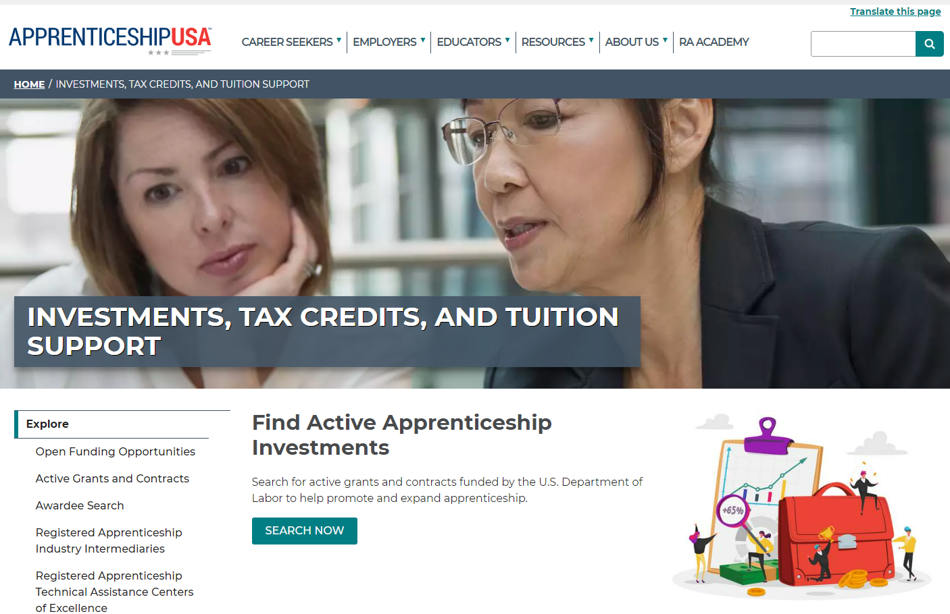
DOL Grants and Contracts
Types
Industry Intermediary, Youth Contracts
H-1B, OA RA Grants (ABA, CSG, Scaling Apprenticeship)
Sources of Support
Incentive funding
Program sponsorship
Related Instruction
Technical Assistance
Safal Partners © 2023

Slide 14
State Funding, Private Sources
Increasing number of states providing:
Direct incentive (per apprentice) funding
Tuition subsidy to offset RTI costs
Grants to support program start-up, expansion, sustainability
Private foundations increasingly supporting RA and youth RA
Safal Partners © 2023

Slide 15
Spotlight: Special School District (SSD) of St. Louis County’s Adult CTE Department
Safal Partners © 2023

Slide 16
SSD Adult Technical Education
Healthcare S.T.A.R.S (Successful Training pre-Apprenticeship with Resource Support) Program
Funding:
Previous - Missouri Apprentice Ready (MAR)
covered program costs and limited supportive services
Current - Gateway Apprenticeship Hub – ABA Grant
covers certain costs and related/approved supportive services
Safal Partners © 2023

Slide 17
SSD Adult Technical Education 2
Certified Nurse Assistant (CNA) Apprenticeship Program, Multiple Occupations
Funding:
WIOA Title 1B – Individual Training Account (ITA) – Related Instruction
National Industry Intermediaries
Missouri Apprentice Ready (MAR)
Health Careers Advancement Program (HCAP)
Urban Institute, covers youth apprentices ages 16-21
Safal Partners © 2023

Slide 18
RA Program Outcomes
74 Percent Completion Rate
Program outcomes prior to supportive services funding
78 Percent Completion Rate
Program outcomes after supportive services funding
Safal Partners © 2023

Slide 19
Braiding Funds to Support RA
Students
WIOA
Veterans Benefits
SNAP/TANF
Tuition
Fees
Supplies
Wrap-Around Services
Institution
State/Federal Grants
DOL – Apprenticeship Grants
State Workforce Grants
Adult Ed Grant Funds
Safal Partners © 2023

Slide 20
Example of Braiding Funding
Julie - $6000 income/yr, 1 child, single, 20yo
Goes to the American Job Center
Says she wants to be a Nurse (CNA)
LWC looks at the ETPL
Is co-enrolled in WIOA Title 1 and an RA program
Now she qualifies for supportive services
HCAP
MAR Grant
Youth – Urban Institute
Supportive Services
Pre-Apprenticeship
Transportation Assistance
Registered Apprenticeship
SNAP/TANF
Child-Care
Rent Assistance
Transportation
WIOA Individual Training Account (ITA)
Safal Partners © 2023

Slide 21
Key Points for Braiding Funding
Safal Partners © 2023

Slide 22
Can You Braid Funding to Support Your Students?
Identify most likely supportive service needs of students
Identify potential funding sources
Create a plan for each funding source
Coordinate with the organizations providing funding
Allocate funds from each source according to your program's budget
Ensure compliance with the regulations of each funding source
Maintain clear and accurate financial records
Safal Partners © 2023

Slide 23
Next Steps
Safal Partners © 2023

Slide 24
Workforce Collaboration Scenario
Scenario:
Work with LWB to get on ETPL
Work with AJC to co-market program
LWB can do on-site pre-eligibility screening at program event
Initial WIOA or non-WIOA determination
Enroll students for supportive services
LWB can go onsite to do soft skills training, career building work
Safal Partners © 2023

Slide 25
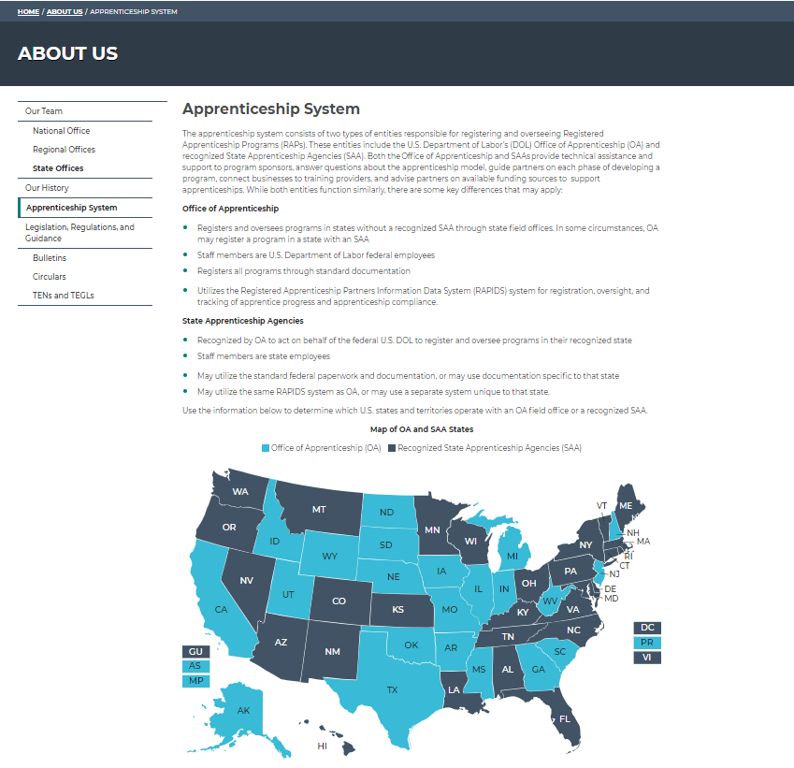
Suggested Next Steps
Meet with LWB to discuss:
funding opportunities
board’s support of RA programs, policies
getting on ETPL
Meet with local apprenticeship training representative (ATR)
Identify local/regional apprenticeship networks
Safal Partners © 2023

Slide 26
Questions and Discussion

Slide 27
Contact Us, Become a Partner
Scan for Partner Form
Katie Adams
Chief Delivery Officer
Safal Partners
Katie.Adams@SafalPartners.com
Angela Baker
Subject Matter Expert
Safal Partners
Angela.Baker@safalpartners.com

Slide 28
Email us your questions at RA_COE@SafalPartners.com
For more information, visit: dolcoe.safalapps.com
Safal Partners © 2023

