Slide 1
Aligning Workforce and Registered Apprenticeship: Key Components for Success
CWA Workcon 2025
Wednesday, April 30th
Safal Partners © 2025

Slide 2
Presenters
Katie Adams
“Mel”issa Aguilar-Southard
Chief Development Officer
Senior Project Director
Safal Partners © 2025

Slide 3
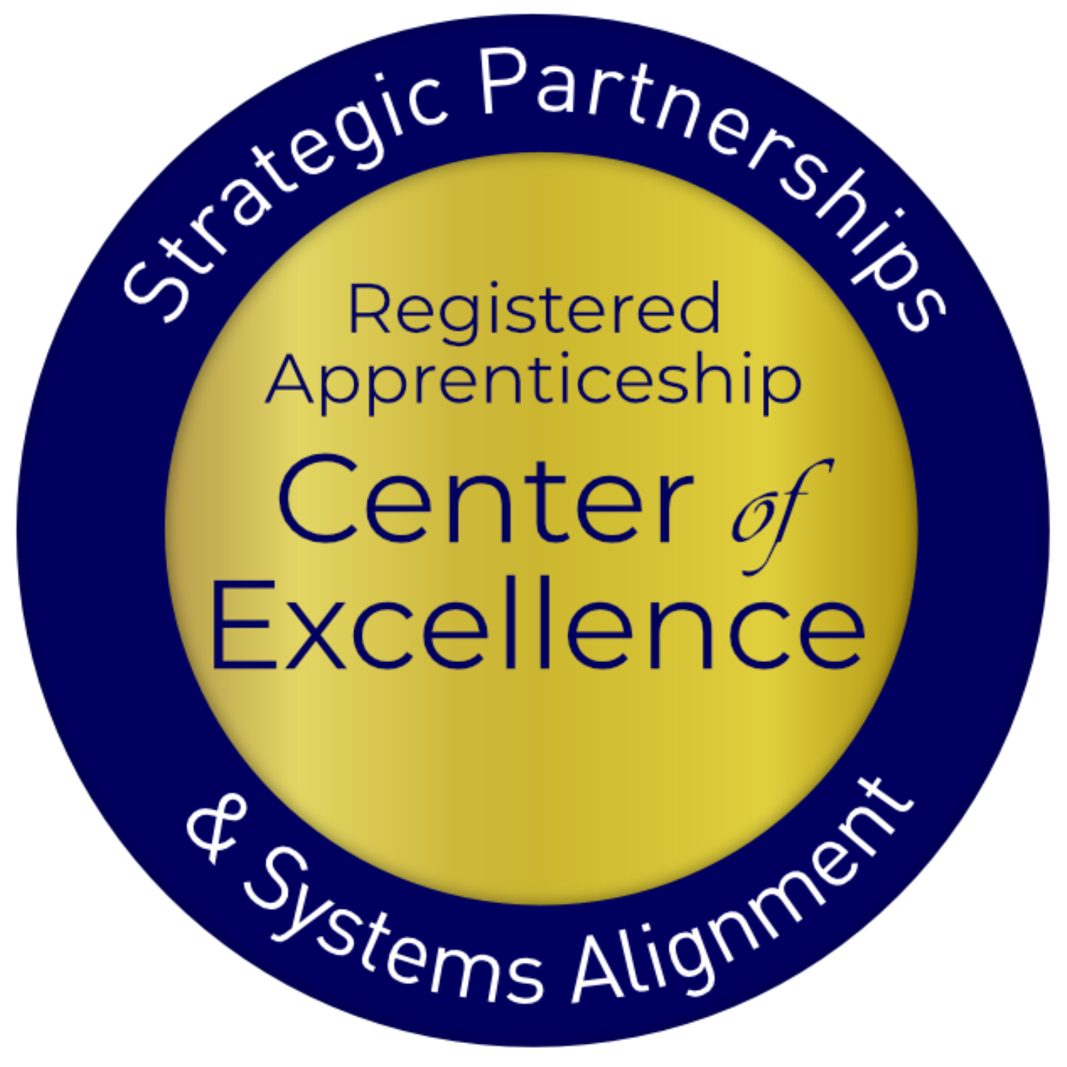
Welcome and Agenda
Center of Excellence Overview
Basic Building Blocks of Registered Apprenticeship
Six Core Components of Registered Apprenticeship Alignment
Action Planning and Next Steps
Q&A
Safal Partners © 2025

Slide 4
Center of Excellence Overview
U.S. DOL initiative to increase systems alignment across apprenticeship, education, and workforce
Led by Safal Partners; 5 national partners
We provide no-cost services including:
Monthly webinars
Quarterly virtual office hours
Individual compliance assistance and services
Online resources (desk aids, guides, frameworks, (etc.)
Visit our website, request assistance
Safal Partners © 2025

Slide 5
Basic Building Blocks of
Registered Apprenticeship

Slide 6
Getting to Know You 1
How would you describe your level of knowledge of and experience with Registered Apprenticeship programs?
Advanced
Emerging
At Square One

Slide 7
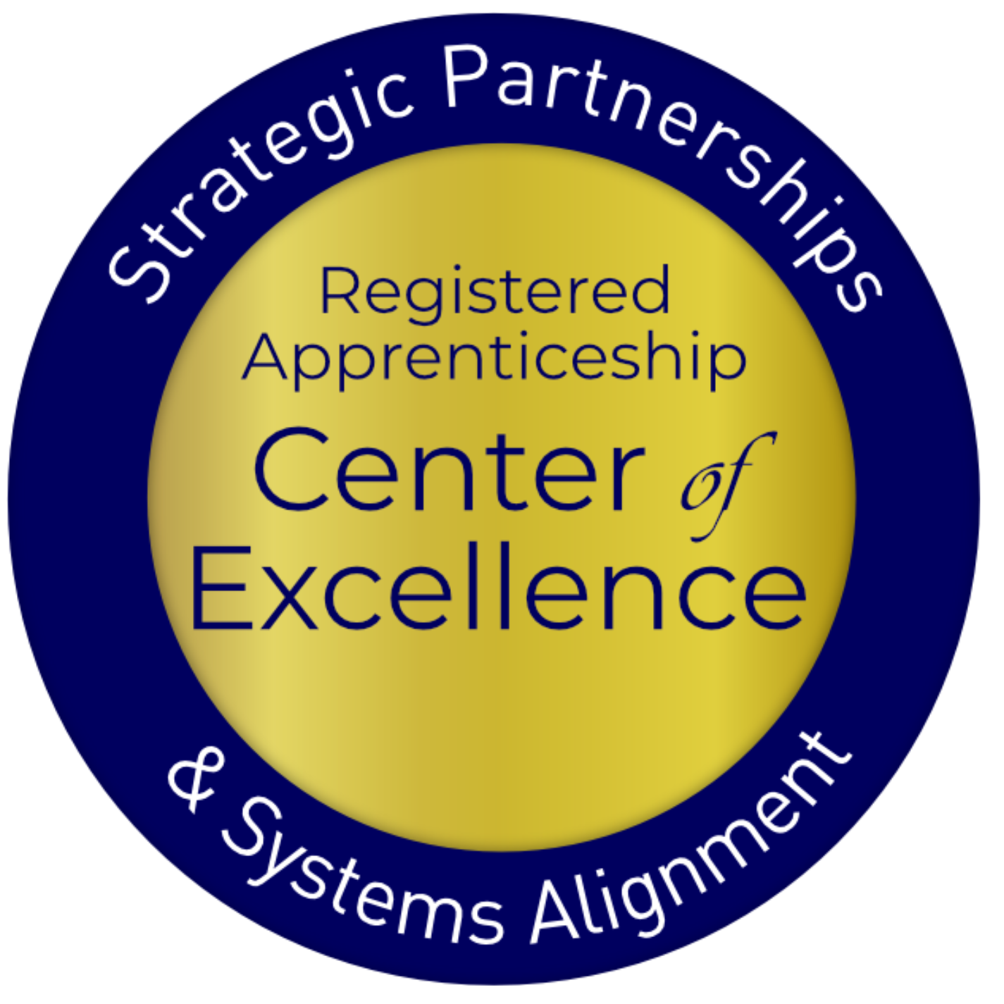
Registered Apprenticeship
Registered apprenticeship is:
Registered apprenticeship is
Proven model of job preparation
that combines paid on-the-job training (OJT) with related instruction to progressively increase workers’ skill levels and wages;
Proven business-driven model that provides an effective way for businesses to recruit, train, and retain highly skilled workers.

Slide 8
Five Core Components of Apprenticeship
Industry Led
Paid Job
Structured On-the-Job Learning (OJL)/ Mentorship
Supplemental Education
Credentials
Safal Partners © 2025
Notes:
Recently updated verbiage on apprenticeship.gov - https://www.apprenticeship.gov/employers/registered-apprenticeship-program
1. Industry Led – Programs are industry-vetted and approved to ensure alignment with industry standards and that apprentices are trained for highly skilled, high-demand occupations.
2. Paid Job – Registered Apprenticeships are jobs! Apprentices earn progressive wages as their skills and productivity increase.
3.Structured On-the-Job Learning/Mentorship – Programs provide structured on-the-job training to prepare for a successful career, which includes instruction from an experienced mentor.
4.Supplemental Education – Apprentices are provided supplemental classroom education based on employers’ unique training needs to ensure quality and success.
5.Credentials – Apprentices earn a portable, nationally recognized credential within their industry.

Slide 9
A WIDE RANGE OF INDUSTRIES
Agriculture
Healthcare
Cybersecurity
Biotechnology
Transportation
Construction
Energy
Hospitality
Advanced Manufacturing
Critical Supply Chain
Telecommunications
Financial Services
Information Technology
Education
Infrastructure
Engineering

Slide 10
Apprenticeship Stakeholders
Sponsor
RI Provider
Employer
Partner
An organization that agrees to operate an apprenticeship program and in whose name the program is registered.
Entity that provides instruction to apprentices in the designated occupation’s core knowledge, skills, and abilities.
Hires and provides paid on-the-job learning (OJL) for apprentices under
supervision of a designated mentor who is a skilled professional in
that occupation.
Organizations
committed to assisting RA programs. They can play one or more roles.
Safal Partners © 2024

Slide 11
Six Key Components of Workforce System Alignment with RA

Slide 12
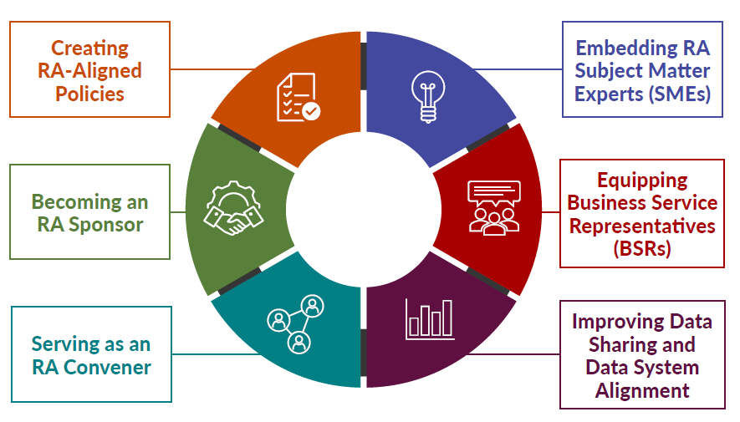
New Tool
Key Components of Workforce System Alignment with Registered Apprenticeship
Safal Partners © 2025

Slide 13
Creating RA-Aligned Policies
State and Local WDBs often have state and local policies and procedure frameworks that align and guide development of work to support RA program implementation.
Criteria and policies for board membership ensure appropriate representation for RA
Policies/procedures prioritize the use of RA as a service strategy for WIOA Title I and may provide funding to support RA programs
Local WDBs’ AJC operators have clear policies/procedures and support for RA and WIOA/RA co-enrollment processes and training towards frontline case managers
Funding-related policies ensure use of available funds to support RA expansion
ETPL policy/procedures provide automatic inclusion of RA programs on ETPLs
Business services policies/procedures include implementation of RA through OJT/IWT
Safal Partners © 2025

Slide 14
Creating RA-Aligned Policies 3
Actionable Items for Success: What Steps Lead to Strong System Alignment
Seek out Registered Apprenticeship representatives from WDB membership from labor and non-labor
Review and revise policies to ensure Registered Apprenticeship and WIOA alignment and activities internally
Establish state/local Registered Apprenticeship steering committees or connect to committees already established through the SAA or OA
Meet with local ATR and OA or SAA state directors to understand RA program approval process and establish streamlined process to include RA programs on state/local ETPLs
Advocate for dedicated funding allocations for RA activities, including dedicated staff in the AJC and institutionalize this practice in policy
Safal Partners © 2025

Slide 15
New Tool 1
Key Components of Workforce System Alignment with Registered Apprenticeship
Safal Partners © 2025

Slide 16
Embedding RA SMEs
State/LWDBs embed RA expertise in the AJC frontline staff to actively help engage employers and create RA pipeline.
State/LWDB have RA navigators/SMEs within AJCs or region
Case managers purposefully screen and refer job seekers to RAPs
Co-enrollment procedures are used by case managers and partners
Apprentices are supported throughout the RA program
Partners work with AJCs to engage job seekers in RAPs
Outreach to job seekers showing benefits to RA
Training for case managers on RA
Wagner-Peyser staff share RA info to job seekers and employers
Safal Partners © 2025

Slide 17
Embedding RA SMEs 3
Actionable Items for Success: What Steps Lead to Strong System Alignment
Ask a state or local ATR to provide ongoing RA training to AJC staff, particularly those who are customer-facing or hold regular meetings with AJC staff on RA
Explore federal and state funding opportunities to support staffing AJCs with RA expertise
Provide staff with link to Apprenticeship.gov Partner Finder for info on state and local program sponsors and links to State Apprenticeship Agency websites that have program sponsor info
Ensure that state and/or local case management systems capture WIOA Title I co-enrollment with RA so that the data reported in PIRL Element 931 is an accurate reflection of the level of co-enrollment
Safal Partners © 2025

Slide 18
New Tool 2
Key Components of Workforce System Alignment with Registered Apprenticeship
Safal Partners © 2025

Slide 19
Equipping BSRs
Business Services Representatives (BSRs) have the knowledge and expertise to assist employers with adopting RA programs and accessing funding.
BSRs...
Regularly work with ATRs to promote RA programs
Guide employers through the RA process
Create outreach plan based on LMI with RA counterparts
Interact with intermediaries to assist businesses with RA program development
Provide collateral and education to partners
Communicate with case mangers about apprenticeship openings
Assist businesses with leveraging WIOA and other funding
State/Local Rapid Response efforts include RA
Safal Partners © 2025

Slide 20
Embedding BSRs
Actionable Items for Success: What Steps Lead to Strong System Alignment
Train BSRs on RA, including using intermediaries and working with local ATRs
Host roundtables and apprenticeship accelerators for businesses to learn about Registered Apprenticeship
Create and share Apprenticeship.gov materials with businesses on the benefits of Registered Apprenticeship, linking to ATRs when possible
Apprenticeship job fairs, employer events, OJT and IWT support, rapid response and layoff aversion activities
Safal Partners © 2025

Slide 21
New Tool 3
Key Components of Workforce System Alignment with Registered Apprenticeship
Safal Partners © 2025

Slide 22
Improving Data Sharing and Data System Alignment
State apprenticeship and workforce systems align data systems, enabling sharing of data and improving cross-agency access.
Workforce/apprenticeship systems have formal agreements in place to track, monitor, report and share data related to apprenticeship and WIOA metrics
Co-enrollment data is tracked and shared consistently
BSRs capture real-time data on employers’ supply and demand needs, communicate with their local ATR/AN counterparts consistently
State longitudinal and/or external data systems are used to track, understand and share data trends in apprenticeship populations
Data around WIOA/non-WIOA funding support used to tell the story, helping state leadership make informed decisions regarding policy and funding to expand RA
Safal Partners © 2025

Slide 23
Improving Data Sharing and Data System Alignment 1
Actionable Items for Success: What Steps Lead to Strong System Alignment
Establish/modify data sharing agreements to ensure workforce and apprenticeship system inclusion as well as co-enrollment collaboration
Ensure that state/local WIOA plans explicitly include WIOA and RA performance metrics and accurate reporting, etc.
Create/refine a process for collaborative cross-agency analysis and sharing of WIOA and RA performance data to determine performance against each required WIOA metric

Slide 24
New Tool 4
Key Components of Workforce System Alignment with Registered Apprenticeship
Safal Partners © 2025

Slide 25
Serving as an RA Convener
State/LWDBs engage stakeholders to expand RA, build talent pipelines, address workforce shortages, and increase employment and wages for workers.
Engage with stakeholders to development and implement RA programs that can access funding and resources through workforce system
Sector Strategy initiatives include RA as a strategy for building the talent pipeline
Create and maintain a network (hub) of RA programs to accelerate employer participation and to provide technical assistance
Collaborate on high-demand, industry specific RA programs including technical assistance and funding
Collaborative RA efforts include mandatory partners as part of convening activities
Create concise communication and outreach for RA programs
Safal Partners © 2025

Slide 26
Serving as an RA Convener 3
Actionable Items for Success: What Steps Lead to Strong System Alignment
Create Registered Apprenticeship programs that are high-demand industries per local LMI
Engage with ATRs, DOL Industry Intermediaries and state-based Registered Apprenticeship stakeholders to establish Accelerator events that bring together apprenticeship stakeholders and resources to accelerate the further use and adoption of Registered Apprenticeship
Collaborate with ATRs to establish processes to develop Registered Apprenticeship standards for businesses at a local level
Explore federal and state grant opportunities, philanthropic funding, and potential state funding to support industry-specific Registered Apprenticeship initiatives

Slide 27
New Tool 5
Key Components of Workforce System Alignment with Registered Apprenticeship
Safal Partners © 2025

Slide 28
Becoming an RA Sponsor
LWDB becomes a group RA sponsor increasing opportunities for job seekers to access careers in high-demand industries and for businesses to access funding supports for apprentices.
LWDB becomes a RA program sponsor for in-demand occupation(s)
Occupations are regularly added to RA programs based on LMI
Ed system is engaged with LWDB to provide RI
RA sponsorship is sustainable through braided funding
LWDB creates clear path to build pipeline for employers
LWDB provides admin support, training and assistance to employer joining the RA program
LWDB ensures ability to support employers with WIOA funding
Safal Partners © 2025

Slide 29
Becoming an RA Sponsor4
Actionable Items for Success: What Steps Lead to Strong System Alignment
Ask your local ATR/state RA director if there are other workforce board RA sponsors in your state so that you can connect with them to gain insight into the program development needs
Using LMI data, determine high-demand occupations/industries to know which occupations to add to your program standards and guide your employer outreach in program development
Reach out to your local ATR to begin the process of developing program standards for your board to become an RA sponsor
Invite local businesses/employers/education/intermediaries to discuss potential interest in and become involved in RA program design to secure participation agreement

Slide 30
Action Planning and Next Steps

Slide 31
Key Questions for You to Consider
Overall Alignment : Where is your Community?
Does your workforce system have policies in place that promote RA?
What organizations/partners are you already working with? Who else do you need at your table?
What expertise do you have that can be tapped into?
Do you employers understand the benefits of RA? Are there representatives who can convene employers and help them?
How do you intend to work towards alignment? What steps can you take to increase alignment for successful RA program efforts?
What support do you need?
What questions do you have?
Safal Partners © 2025

Slide 32
Questions 1

Slide 33
Become a Center Partner
Scan for Partner Form
Receive no-cost expert services, including materials and support
Network with potential partners nationwide
Be nationally recognized for your work
Safal Partners © 2025

Slide 34
Email us your questions at RA_COE@SafalPartners.com
For more information, visit: dolcoe.safalapps.com
Safal Partners © 2025

