Slide 1
Leveling Up Your Workforce Board's Alignment with Registered Apprenticeship Center of Excellence Office Hours
December 7, 2023

Slide 2
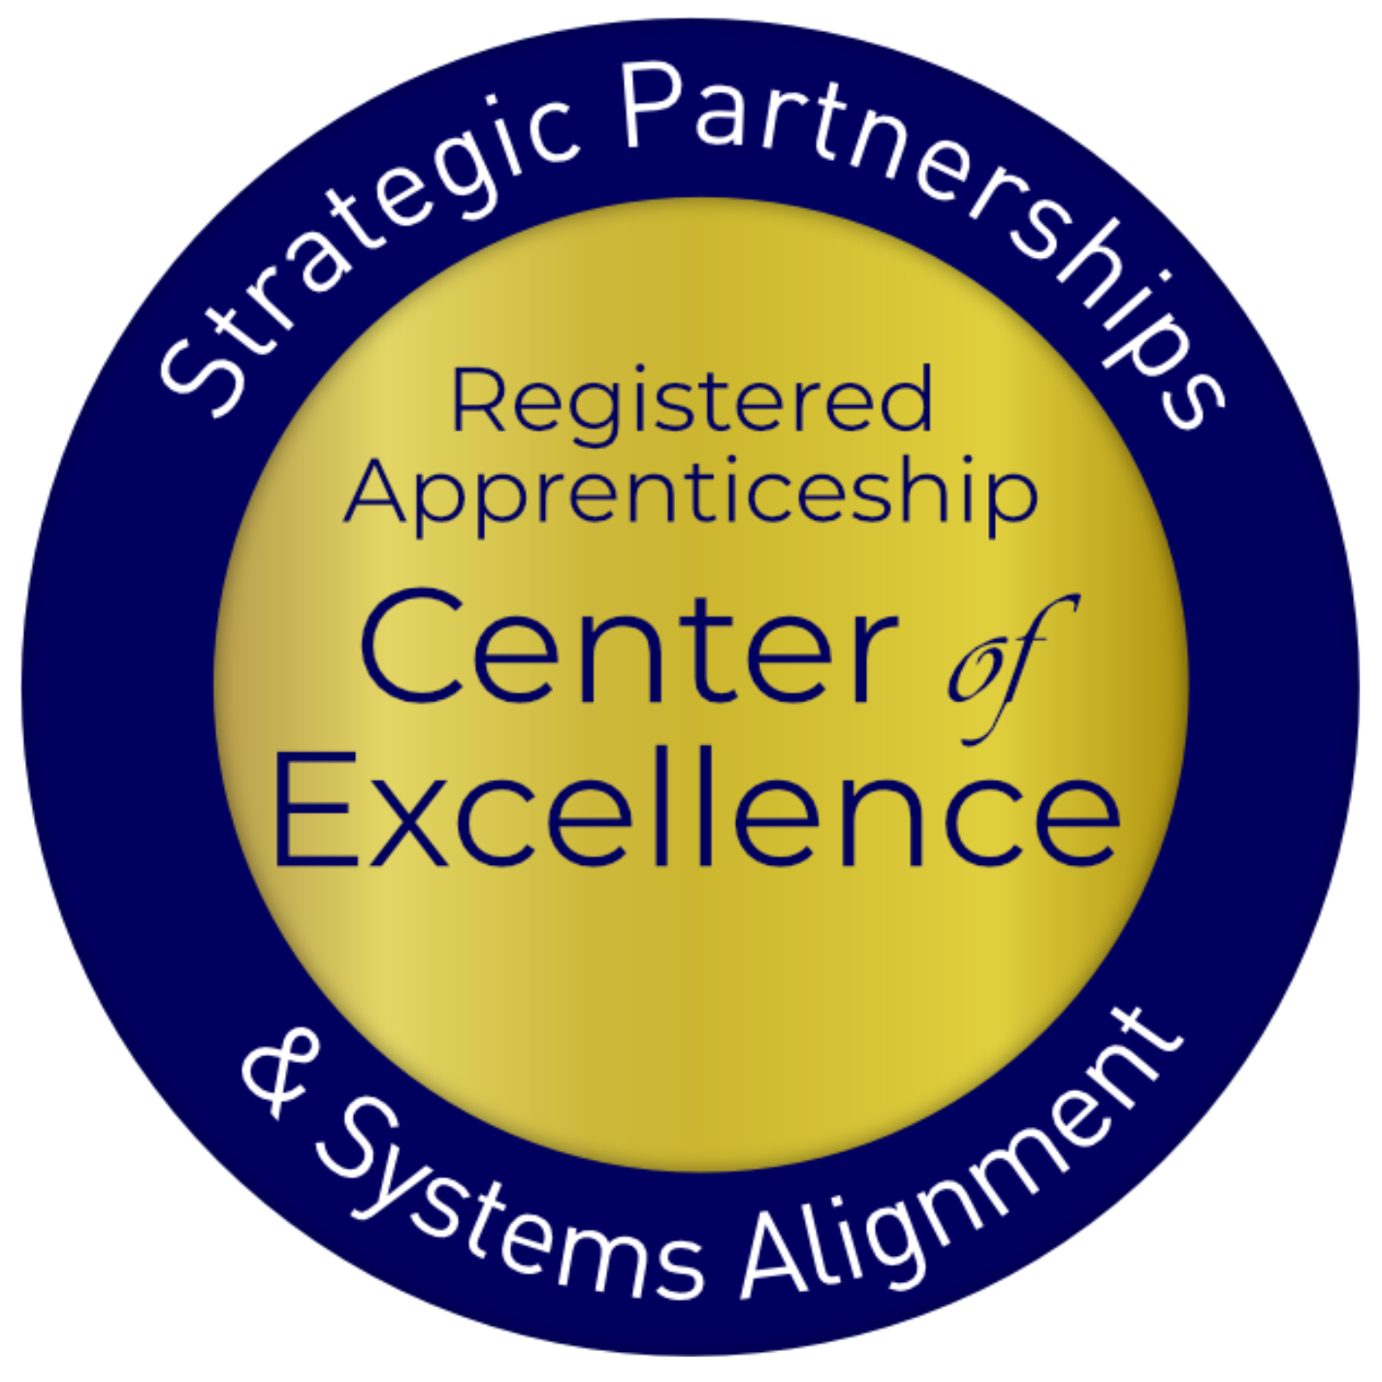
Presenters
Lisa Rice
Jeffrey Smith
Subject Matter Expert
Safal Partners
Workforce Liaison / Program Analyst
Office of Apprenticeship
U.S. Department of Labor
Safal Partners © 2023
Notes:
Jeffrey W. Smith
Workforce Liaison/Program Analyst |Office of Apprenticeship | U.S. Department of Labor

Slide 3
Welcome and Agenda
Center of Excellence Overview
Levels of Alignment Overview
Breakout Rooms
Questions and Discussion
Safal Partners © 2023
Notes:
State-level work group or committee to the SWDB
Apprenticeship Idaho Coalition
Aligning Key Drivers to Lead Together
Apprenticeship Office
Business
Education
Workforce System
Key Stakeholders
Apprenticeship Expertise in AJCs
Florida’s Investment in Local Systems
State Level Guidance and Support
Locals Making it Happen

Slide 4
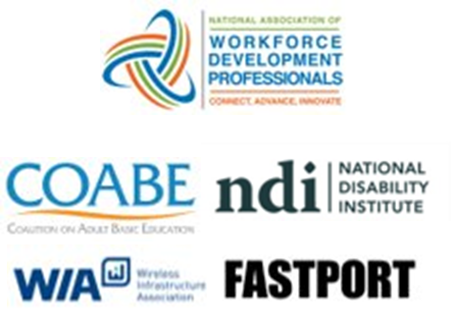
Center of Excellence Overview
U.S. DOL initiative to increase systems alignment across apprenticeship, education, and workforce
Led by Safal Partners; 5 national partners
We provide no-cost TA including:
Monthly webinars
Quarterly virtual office hours
Individual TA/coaching sessions
Online resources (desk aids, guides, frameworks, etc.)
Visit our website, request TA
Notes:
Safal was awarded the opportunity to lead the US DOL Registered Apprenticeship Technical Assistance Center of Excellence for Strategic Partnerships and Systems Alignment in 2021.
We are here to help close the gap between the apprenticeship and workforce systems and accelerate partnerships across education, economic development, and other partners to increase adoption of RA nationwide.
The Center is supported by five national partners including the National Association of Workforce Development Professionals, the Coalition on Adult Basic Education, the National Disability Institute, FASTPORT, and the Wireless Infrastructure Association.
Our national partners were strategically chosen to help us reach specific groups whether on the workforce, education or employer side
California Workforce Association (CWA) is our partner in the state, helping increase workforce system awareness and utilization of RA as a workforce solution for both employers and jobseekers.
The Center of Excellence provides no-cost technical assistance – online, in-person and through hybrid delivery - to accelerate sustainable partnerships and align apprenticeship, workforce and education systems.

Slide 5
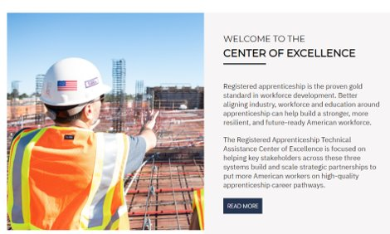
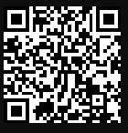
Online Resources, On-Demand TA
Registered Apprenticeship Partner Profile Questionnaire
https://dolcoe.safalapps.com/resources/resourcesandtools
Notes:
Our website is continually updated with relevant news, TA resources and tools including frameworks, case studies, webinars, customizable templates, questionnaires, and more.
Since 2021 more than 3,000 organizations have become no-cost Center partners and utilized our tools – such as the "RA Partner Profile Questionnaire" - to accelerate their organizations' understanding and effective usage of RA.
Link to Questionnaire - https://dolcoe.safalapps.com/sites/default/files/2022-11/Partnership%20Questionnaire.pdf
This questionnaire is intended to help you build a network in your area around Registered Apprenticeship (RA). With the information gathered here, your board should be better able to engage with and convene RA stakeholders to expand RA program opportunities. It is designed to be used in conjunction with the USDOL RA TA Center of Excellence “Workforce Board Guide to Identifying Pre-Apprenticeship and Apprenticeship Partners” publication. This publication and more information on the Center can be found online at dolcoe.safalapps.com﻿

Slide 6
Levels of Alignment
Safal Partners © 2023

Slide 7
Levels of Workforce Engagement in and Utilization of Registered Apprenticeship

Slide 8
DRAFT: Levels of Workforce Engagement in/Utilization of Registered Apprenticeship
Level 1 - Policy | Level 2 - Jobseekers | Level 3 – Sponsors/Businesses | Level 4 - Staffing | Level 5 - Convenor | Level 6 - Sponsor**
Best Practice: State/local RA steering committee, encouraging diversity of RA reps, regular communication protocol between workforce & RA system for ETPL requests | Best Practice: Utilize ITAs to help offset RTI costs, provide supportive services and referrals to other programs for support; co-enrolling WIOA/RA | Best Practice: Host join LWDB/RA System Apprenticeship Accelerators; structured training by RA for BSRs; utilizing OJT contracts to support employers’ apprentice wages | Best Practice: Regular, proactive, collaborative work between workforce RA staff and ATR (for industry, apprentice recruiting) | Best Practice: Create network of RA sponsored programs to accelerate employer participation; serve as fiscal agent for larger network* | Best Practice: Utilizing WIOA and non-WIOA funding (i.e., DOL, state grants) for program administration, employer/apprentice support
Reflected in: ETPLs listing RAPs | Reflected in: WIOA/RA co-enrollment ITA spending Supportive service provision | Reflected in: Increase in RA sponsors OJT contract spending for RA wage reimbursement | Reflected in: Increase in RA sponsors Increase in RA/WIOA co-enrollment Increase in funded services for RA support | Reflected in: Increase in participating employers Increase in apprentice support from WDB (WIOA and non-WIOA funding) | Reflected in: WDB RA sponsorship rates Participating employers Apprentice registrations
Steps to Move to Next Level: Train case managers on RA benefits for job seekers Create/provide tools to local RA sponsors for reverse referrals (for WIOA eligibility certification) | Steps to Move to Next Level: Train BSRs on RA Create/share Apprenticeship.gov materials on RA benefits for employers Review DOL Industry Intermediary list for assistance in employer engagement in high-priority occupations | Steps to Move to Next Level: Explore state models of co-locating RA expertise (i.e. FL, others) Discuss use of Governor’s Set Aside Funds with state board to support embedding RA SME in AJCs | Steps to Move to Next Level: BSRs and AJC RA SMEs coordinate on which employers are responding to/engaged in RA outreach RA SMEs meet regularly and coordinate with ATRs on high-quality program development Co-enrollment training is delivered to case managers on rolling basis | Steps to Move to Next Level: LWDB evaluate local LMI, employer interest in RA LWDB meets with ATR to develop process for gathering information into RA standards LWDB develops strategy for dual-pronged RA implementation: employers to join RAP and employers to hire WIOA-certified job seekers for RA roles
**NOTE: While some LWDBs may move more quickly to become an RA program sponsor prior to embedding RA in AJCs or becoming a local and regional convener/hub, many boards view program sponsorship as a higher-level commitment because it requires dedicated funding and resources for overall program administration. In some cases, having access to non-WIOA funding (e.g., federal or state grant funds, philanthropic support and donations) may influence a board’s decision whether or not to serve as a sponsor earlier in the system alignment process.

Slide 9
Questions and Discussion

Slide 10
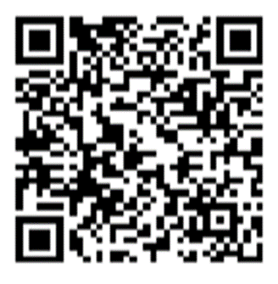
Contact Us, Become a Partner
Scan for Partner Form
Receive no-cost expert TA, materials, and assistance
Network with potential partners nationwide
Be nationally recognized for your work
Notes:
Doug will introduce panel

Slide 11
Email us your questions at RA_COE@SafalPartners.com
For more information, visit: dolcoe.safalapps.com
Safal Partners © 2023

