Slide 1
Effective Outreach for Case Managers: Promoting the Value of Registered Apprenticeships to Career Seekers
Fastport Webinar
Wednesday, May 21st, 2025
Safal Partners © 2025

Slide 2
Center of Excellence Overview
U.S. DOL initiative to increase systems alignment across apprenticeship, education, and workforce
Led by Safal Partners; 5 national partners
We provide no-cost services including:
Monthly webinars
Quarterly virtual office hours
Individual compliance assistance and services
Online resources (desk aids, guides, frameworks, etc.)
Visit our website, request assistance
Safal Partners © 2025

Slide 3
Welcome and Agenda
Center of Excellence Overview
Basic Building Blocks of Registered Apprenticeship
Role of a Local Workforce System Case Manager
Fastport Overview
Benefits of Registered Apprenticeship for Career Seekers
Effective Outreach Strategies to Connect with Career Seekers
Q&A and Closing
Safal Partners © 2025

Slide 4
Basic Building Blocks of
Registered Apprenticeship

Slide 5
Assessing Your RA Knowledge
Basic
I know what it means, but I don’t know how to utilize it and don’t have significant experience with it.
Intermediate
I understand RA, I’ve had experience with RA in some capacity, and I feel comfortable educating internal and external stakeholders about it.
Expert
I have extensive knowledge and relevant experience developing and implementing programs and standards, recruiting apprentices, and convening stakeholders.
Safal Partners © 2025

Slide 6
What is Registered Apprenticeship?
Registered Apprenticeship (RA) is a proven, customizable, and industry-relevant and US Department of Labor-approved model for organizations to find, train and retain new talent as well as upskill current workers in critical occupations.
Safal Partners © 2025

Slide 7
Five Core Components of Apprenticeship
Industry Led
Paid Job
Structured On-the-Job Learning (OJL)/ Mentorship
Supplemental Education
Credentials
Safal Partners © 2025

Slide 8
A WIDE RANGE OF INDUSTRIES
Agriculture
Healthcare
Cybersecurity
Biotechnology
Transportation
Construction
Energy
Hospitality
Advanced Manufacturing
Critical Supply Chain
Telecommunications
Financial Services
Information Technology
Education
Infrastructure
Engineering

Slide 9
The Roles of Case Managers
Safal Partners © 2025

Slide 10
Roles of a Local Workforce System Case Manager
Career Counseling
Job Search Assistance
Training Referrals
Real-time Labor Information
Reporting and Documenting
Safal Partners © 2025

Slide 11
Additional Responsibilities
Individualized Support
Resource Management
Advocacy
Access to Resources
Safal Partners © 2025

Slide 12
Barriers to Work Addressed by Registered Apprenticeships
Registered Apprenticeship (RA) programs are structured to address many barriers to work.
Potential Barrier
RA Solution
Financial
Paid training
Lack of formal education/credentials
Focus on skills/competencies
Limited access to career pathways
Structured training and advancement
Additional supports
Mentorship, housing and childcare assistance, transportation aid
Safal Partners © 2025

Slide 13
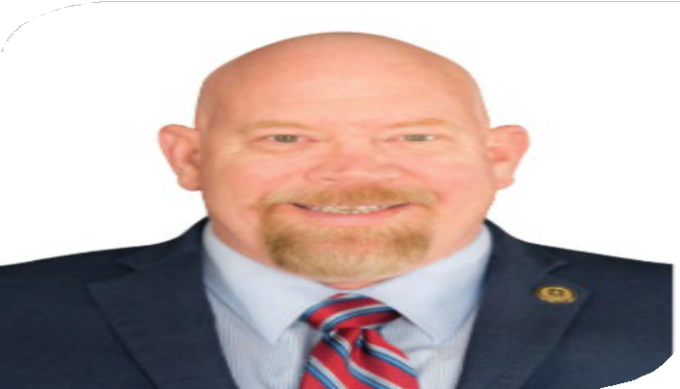
Guest Presenters
Dave Harrison
Scott Ellsworth
Executive Director of Workforce Development & Government Relations
Fastport
Member of the Fastport Team, Principal & Owner
Sherpa Management Solutions

Slide 14
Introduction to Fastport
As a U.S. DOL Industry Intermediary, Fastport supports workforce development initiatives by:
Acting as an accelerator for Workforce Development
Supporting workforce grant applicants
Connecting industry and candidates
Focusing on earn-and-learn career opportunities
Learn more about Fastport
Safal Partners © 2025

Slide 15
Strategy for Workforce Development2
Simplify apprenticeship creation
Expand and accelerate programs
Build national apprenticeship models
Liaison between government and business
Safal Partners © 2025

Slide 16
Accelerating Career Seeker Success3
Streamlines talent acquisition
Advances candidate careers
Bring experience across 45+ industries
Leverages 200+ years of combined expertise
Reduces turnover costs
Increases workforce productivity
Safal Partners © 2025

Slide 17
Snapshot of Success
Fastport’s achievement to goal ratio for DOL contract deliverable
Fastport's programs have helped to successfully hire over 26,000 Registered Apprentices into TDL occupations
Created Registered Apprenticeship programs through Fastport (includes both associations and employers)
Registered Apprenticeship occupations developed
Safal Partners © 2025

Slide 18
Introducing RA to Your Career Seekers
Safal Partners © 2025

Slide 19
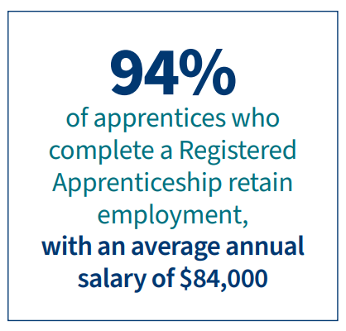
Benefits of RA to Career Seekers
Earn While You Learn
Structured Training and Certification-Earned Credential
Mentorship and Guidance
Career Advancement
Job Opportunities
Alternative to Traditional Education
Increased Retention and Job Satisfaction
Competitive Advantage
U.S. Department of Labor: Apprenticeship 101 Factsheet
Safal Partners © 2025

Slide 20
Communication Tips for Case Managers
Tailor Your Pitch
Keep it Simple
Highlight Career Pathways and Long-term Growth
Safal Partners © 2025

Slide 21
Effective Outreach Strategies
Leverage one-on-one interactions
Use plain language and real success stories
Tailor messaging to career seekers
Host or attend local career fairs
Promote RA programs through AJC digital channels
Safal Partners © 2025

Slide 22
Effective Outreach Strategies 2
Share printed and digital materials
Connect with local partners
Utilize existing RA tools
Support targeted outreach campaigns (e.g., National Apprenticeship Day)
Track career seeker interest in RA
Safal Partners © 2025

Slide 23
Effective Outreach Strategies 1 2
Industry sector specific campaigns
Real world testimonies/success stories
Recorded outreach material engagement
Safal Partners © 2025

Slide 24
Questions

Slide 25
Share Promising Practices
Submit your promising practice here:
Safal Partners © 2025

Slide 26
Become a Center Partner
Scan for Partner Form
Receive no-cost expert services, including materials and support
Network with potential partners nationwide
Be nationally recognized for your work
Safal Partners © 2025

Slide 27
Email us your questions at RA_COE@SafalPartners.com
For more information, visit: dolcoe.safalapps.com
Safal Partners © 2025

