Slide 1
Local Workforce Development Boards: Forging the Future of Workforce through Alignment with Registered Apprenticeship
Missouri Association for Workforce Development 2025:
Forging the Future
April 23rd-25th, 2025
Safal Partners © 2025

Slide 2

Presenter
Haylie Schuster
Engagement Manager
Safal Partners
Safal Partners © 2025

Slide 3
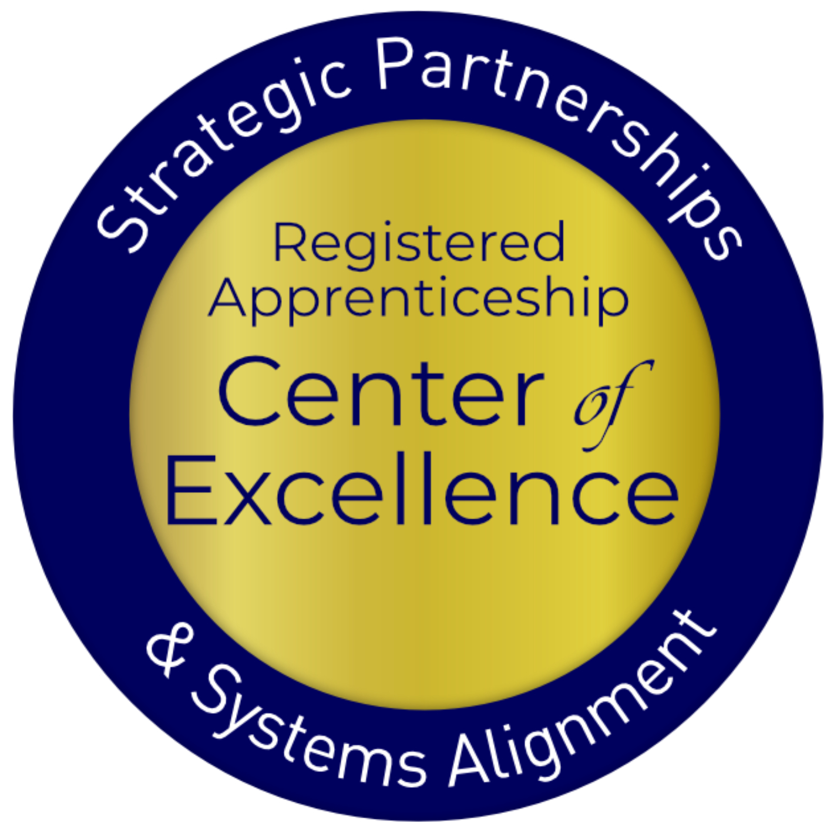
Welcome and Agenda
Center of Excellence Overview
Overview of Registered Apprenticeship (RA)
Benefits of Aligning Workforce Systems with RA
Five Essential Components for the Successful Alignment of RA & Local Workforce Systems
Overview of Key Components of Workforce System Alignment with Registered Apprenticeship
Q & A
Safal Partners © 2025

Slide 4







Center of Excellence Overview
U.S. DOL initiative to increase systems alignment across apprenticeship, education, and workforce
Led by Safal Partners; 5 national partners
We provide no-cost services including:
  Monthly webinars
  Quarterly virtual office hours
  Individual compliance assistance and services
  Online resources (desk aids, guides, frameworks, etc.)
Visit our website, request assistance
Safal Partners © 2025

Slide 5

Getting to Know You
Are you a….
  Workforce Board Director or Staff
  Service Provider Staff
  Educational Partner
  Vocational Rehabilitation Partner
  Apprenticeship Navigator
  Business
  Board Member
  Other?
Safal Partners © 2025

Slide 6
Assessing Your RA Knowledge
Basic
I know what it means, but I don’t know how to utilize it and don’t have significant experience with it.
Intermediate
I understand RA, I’ve had experience with RA in some capacity, and I feel comfortable educating internal and external stakeholders about it.
Expert
I have extensive knowledge and relevant experience developing and implementing programs and standards, recruiting apprentices, and convening stakeholders.
Safal Partners © 2025

Slide 7
Getting Started: RA Basics
Safal Partners © 2025

Slide 8

Registered Apprenticeship
Registered apprenticeship is:
  a proven model of job preparation
  that combines paid on-the-job training (OJT) with related instruction to progressively increase workers’ skill levels and wages;
  a proven business-driven model that provides an effective way for businesses to recruit, train, and retain highly skilled workers.
Safal Partners © 2025

Slide 9












A WIDE RANGE OF INDUSTRIES
Agriculture
Healthcare
Cybersecurity
Biotechnology
Transportation
Construction
Energy
Hospitality
Financial
Services
Information
Technology
Education
Advanced
Manufacturing
Critical
Supply Chain
Infrastructure
Engineering
Telecommunications

Slide 10
Forged through Partnerships
Sponsor of program
Provide on-the-job training
Deliver related instruction at job site
Sponsor of the program
Provide on-the-job training
Recruit and screen apprentices
Contribute training funds for related instruction
Provide supportive services to apprentices
Develop curriculum for related instruction
Safal Partners © 2025

Slide 11
Forged through Partnerships 1
Provide on-the-job training
Sponsor of program
Provide on-the-job training
Deliver related instruction
Deliver related
instruction
Recruit and screen apprentices
Provide basic skills training
Contribute funds for on-the-job training
Run pre-apprenticeship program
Sponsor of program
Safal Partners © 2025

Slide 12



Five Core Components of Apprenticeship
Employer Involvement
Structured On-the-Job Learning (OJL)
Related Instruction (RI)
Rewards for
Skill Gains
National Occupational Credential
Safal Partners © 2025

Slide 13
The Partnership – Let’s Start with the “Why”
Safal Partners © 2025

Slide 14
The Benefits
Businesses
Supports recruitment of highly-skilled workforce
Improves productivity and retention
Reduces turnover
Averts layoffs
Job Seekers & Apprentices
Earn while you learn
Receive a nationally recognized credential
Career pathway to self-sufficiency
Wage growth
Address barriers to employment such as child-care and transportation
WIOA & Other Partner Programs
Facilitates strong program performance results – progressive wage increases, skill gains, performance goals and nationally recognized credentials
Aligns with WIOA’s vision for business-focused, work-based training
Safal Partners © 2025

Slide 15

The Benefits
Proven ROI: Employers report on average $1.47 for every $1 invested in RA – highly cost effective in the long term
Diversify Workforce: With a training plan in place from day one, employers can take a skills-based approach to hiring which creates much larger, more diverse talent pipeline
Cost: Much less costly for apprentice than traditional college
Retention Rate: 93% of apprentices who complete a Registered Apprenticeship retain employment
Credential: Culminates in a national occupational credential
Wages: Apprentices typically earn $300,000 more over their careers than peers
Safal Partners © 2025

Slide 16
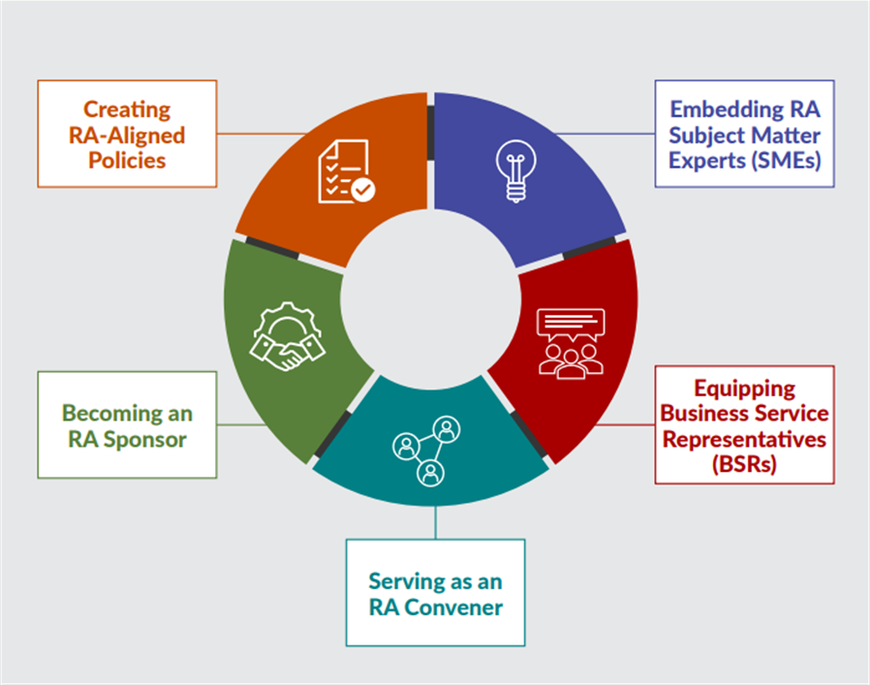
Components of Alignment
Key Components of Workforce System Alignment with Registered Apprenticeship
Safal Partners © 2025

Slide 17
Components of Alignment - Policies
Key Components of Workforce System Alignment with Registered Apprenticeship
Safal Partners © 2025

Slide 18

Creating an RA-Supportive Policy
To carry out WIOA's strategic emphasis, local boards create a framework of policies and procedures that supports and promotes workforce and RA alignment.
This institutionalizes RA-supportive practices and processes.
Safal Partners © 2025
Notes:
The state and local boards create the policys- they need to be RA Friendly

Slide 19
Supporting RA Framework
Define criteria
Customizable policy
Partnership
Funding
Notes:
All the components need to be defined- who is doing what. Roles and responsibilities. Then you can customize to fit the framework, develop partnerships, and establish funding (partners and other funding available).

Slide 20
Embed RA Subject Matter Experts
Key Components of Workforce System Alignment with Registered Apprenticeship
Safal Partners © 2025

Slide 21




Embed RA Expertise
To grow RA in your local workforce system and/or in your own RA eco-system,
you need experts in RA.
Who are the experts in your system?
Federal and State OA Office
Safal Partners © 2025

Slide 22

Embed RA Expertise
Expertise exists in USDOL and
the Office of Apprenticeship (OA)
Connect with OA’s Apprenticeship Training Representatives (ATRs) and key staff at DAS.
Request training and education AND provide training and education.
Invaluable expertise at your finger tips!
Safal Partners © 2025

Slide 23
Embed RA Expertise 1
Integration of RA expertise into the local AJC
Who can/should have RA expertise?
  State and local boards
  Staff engaged with businesses and business services
  Staff at front desk and in the Resource Room of the AJC
  Case managers / career counselors from all partner programs
  Who else?
How do you achieve it?
On-going training and education in partnership with DOL OA leaders and staff, RA stakeholders
Safal Partners © 2025
Notes:
They don't have to be SME, but they need to know the basics so they can promote it and recommend it to participants and employers

Slide 24

Embed RA Expertise 2
Case Managers / Career Coaches are Key!
They assess career seekers for readiness/appropriateness for RA programs.
Build Individual Employment Plans that accurately indicate enrollment in both WIOA and RA, when applicable.
Populate the local case management system with the relevant data around program enrollment(s).
Determine if WIOA can fund one or more of the components of the RA program and execute accordingly.
Know the RA programs on your Eligible Training Provider (ETP) List and educate job seekers on those programs to facilitate informed choice.
Safal Partners © 2025
Notes:
Make sure they are clicking 931 box for co-enrollment and understand that they are required to do that to report the co-enrollment
Are they on the ETPL and are the programs on the ETPL actually accepting participants. Confirm availability of the programs.

Slide 25

Embed RA Expertise 3
Business Services Representatives (BSRs) are Key!
Include RA programs on their menu of services when meeting with businesses
Participate in Rapid Response (RR) events or educate RR teams
Regularly work with DOL OA and ATRs to promote RA programs
Guide employers through the RA process
Create outreach plan based on LMI with RA counterparts
Interact with intermediaries to assist businesses with RA program development
Provide collateral and education to partners
Assist with exploration of the Eligible Training Provider List to find providers of Related Instruction
Communicate with case mangers about apprenticeship openings
More to come on BSRs…
Safal Partners © 2025

Slide 26

Embed RA Expertise 4
Together….Case Managers & BSRs
Publicize RA program openings and screen candidates.
Encourage your organization to host RA job
fairs – specific to open RA positions in your area.
Connect potential apprentices to other resources available within the community
Create an RA work group with local DOL OA staff
Share your knowledge with leadership, BSRs, other Case Managers
Safal Partners © 2025

Slide 27
Equipping BSRs
Key Components of Workforce System Alignment with Registered Apprenticeship
Safal Partners © 2025

Slide 28

The Value of Business Services
Delivering business services
through the public workforce system is a
valuable means of addressing
business talent needs, enhancing the existing workforce, and boosting the global competitiveness of the business.
Safal Partners © 2025

Slide 29

Business Services – Key Tenets
The one-stop delivery system serves both job seekers and businesses.
Just as services for job seekers are most effective when tailored to job seeker needs, business services must be customized to support the unique needs and interests of employers.
Business services should be provided without overwhelming businesses with multiple, uncoordinated points of contact.
Safal Partners © 2025

Slide 30
Services Offered by BSRs
WIOA Required:
Additional:
Labor exchange activities
Provision of labor market information
Establishment of relationships and networks with large and small businesses
Development and implementation of industry or sector partnerships
Screening and referral of qualified job seekers
Customized recruitment events including targeted job fairs
Customized assistance or referral for assistance in the development of RA programs
Developing and delivering innovative workforce services and strategies
Facilitating access to funding through the workforce system
Assistance to area businesses in managing reductions in force with rapid response and layoff aversion services
Safal Partners © 2025

Slide 31
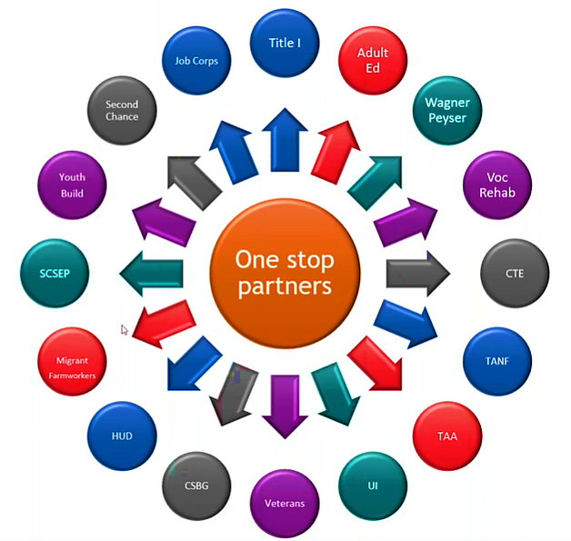
Business Services Staffing Structure
Business Services Team:
A formalized team representing the
AJC system and responsible
for ensuring the coordination and
delivery of business services. The team is made up of cross-agency, cross-programmatic groups, comprised of representatives of each of the core partner agencies, economic development organizations, and other partners as appropriate.
Safal Partners © 2025

Slide 32
Business Services Staffing Structure 1
Individual Partner Program Liaisons
Teams of Partner Program Representatives
Contracted individual or Organization
Remember local discretion to best meet the needs of the businesses in the
local workforce area.
Safal Partners © 2025
Notes:
If you have individual partners- they all need to come together to build a team. Then they can meet the needs of the businesses- but we are overwhelming businesses with outreach instead of talking togher. Examples would be roundtable or something similar where all BSR's and similar roles are discussing the opportunites and who they talk to.

Slide 33

BSRs as a Bridge
While staffing and services may vary depending on the organization, region, or specific objectives, a BSR serves as the bridge between business and workforce development, aiming to create mutually beneficial partnerships that enhance employment opportunities and support economic growth.

Slide 34
Structuring Delivery of Business Services:
The BSR Approach
“Let no
encounter with a
business go to waste”
ASSET KNOWLEDGE
Know what assets your organization can provide to businesses and what assets can be provided by your partners. Remember, take advantage of each others' strengths.
BUSINESS RELATIONSHIPS
Create and maintain productive business relationships with your employers. Once you demonstrate your value as a BSR, you will become a trusted and valuable resource to your customers.
NETWORKS
Develop and maintain a strong partnership network with an adaptive and responsive approach.
PARTNERSHIPS
Formulate strong partnerships to provide comprehensive, coordinated solutions. No one organization can provide a business solutions to all their challenges.
STRUCTURED PROCESS
Use this process in your interactions with Employers. Every step in this process is important to the success of your business interactions and to building strong relationships with business customers.
Notes:
How do you get in and talk to the business.
Fact finding is the listening- what do they need
Then recommend a solution- may be RA may be OJT or other programs
Help them implement it- what partners and that someone will need to monitor
Follow-up- see it through- continue to nurture

Slide 35
Structuring Delivery of Business Services:
The BSR Approach 1
Entry
Your introduction to a new employer or initiating a project with an existing customer.
Consider:
How do you contact them/get in the door?
What is the goal of outreach and potential partnership?
Fact Finding
The discovery process to understand an employer's needs and bridging to solutions design.
Consider:
Ask "why?"
What does the business need?
What are their pain points?
Solutions Design
The recommended solution presented to the business by you and relevant partners.
Consider:
What is the best solution for this employer/project?
What relevant assets could be provided by you and your partners?
Implementation
Your detailed plan for successful implementation of the proposed solution.
Consider:
What steps are involved?
Who is the lead contact?
What are each partner's responsibilities?
What is the monitoring process?
Follow-Up
Establishes ongoing business relationships, promotes sustained success and encourages process improvement.
Consider:
What happened?
What was the result?
Where might you improve for future projects?
What happens next?

Slide 36

Equipping BSRs with RA Expertise
By equipping a BSR with knowledge and expertise in RA programs, they can incorporate this highly effective service model into their menu of services for businesses, resulting in positive outcomes for all parties involved.

Slide 37

Making the Business Case for RA
RA offers a proven, high caliber
training strategy for workers to learn the skills that employers need for American businesses to grow and thrive in a competitive global environment.
Safal Partners © 2025

Slide 38


American Apprenticeship Initiative (AAI) Evaluation
Improved pipeline of skilled workers
91%
Improved co-worker productivity
87%
Improved company culture
96%
Improved employee loyalty
91%
Reduced turnover
81%
Product
or process innovation
78%
Future manager development
76%
More
on-time delivery
74%
Reduced downtime
68%
Safal Partners © 2025

Slide 39

Business Services
Want to learn more about WIOA provisions for business services?
eCFR :: 20 CFR 678.435
Safal Partners © 2025

Slide 40
Serving as an RA Convener
Key Components of Workforce System Alignment with Registered Apprenticeship
Safal Partners © 2025
Notes:
Can you bring it together? Could be OA, CC, LWB, Voc Rehab
Someone has to bring it all together- WFB are natural conveners

Slide 41

Examples of Convening Partners
WORKFORCE SYSTEM
Contributes funds for OJT
INDUSTRY ASSOCIATON
Sponsor of program
COLLEGES
Create Related Instruction
Deliver Related Instruction
BUSINESS
Provides OJT
Provides Mentor
Safal Partners © 2025

Slide 42




Local Boards as RA Conveners
Successful apprenticeships are born from collaboration among partners. Leverage partners to identify the resources needed to design your apprenticeship program, and recruit apprentices.
This is your first step in executing new RA programs….
successfully convening key stakeholders
Not a top-down or bottom-up strategy – rather it is a collaborative network strategy.
Safal Partners © 2025

Slide 43

Local Boards as RA Conveners 1
Engage partners from Day One!
Create an RA Committee
Host regular meetings for the Committee
Provide education, especially on the benefits of RA, to partners
Showcase successful efforts of peers
Safal Partners © 2025

Slide 44
Serving as an RA Convener 1
Sector strategy initiatives
Engage a variety of stakeholders
Collaborate with RA providers
Network hub
Safal Partners © 2025
Notes:
Sector strategy- if you have one in place figure out how to embed it in RA
Continue to discuss- Network hub- could be a board having a RA committee- discusses openly the resources and what is going on
To keep RA going, you need to talk about it and work on it- That is the conveners role

Slide 45

Convening Outcomes
Increase awareness
Significant impact across key areas
New and repeat business
Increase WIOA outcomes
Safal Partners © 2025

Slide 46
Becoming an RA Sponsor
Key Components of Workforce System Alignment with Registered Apprenticeship
Safal Partners © 2025

Slide 47

Becoming an RA Sponsor 1
Examples of Sponsors:
  Colleges and CTE
  Workforce boards
  Employers
Safal Partners © 2025
Notes:
They administer and operate the RA programs-Rapids
Partner finder tool to allow you to find sponsors in your state or area

Slide 48
Local Boards as RA Sponsors
The Local Workforce Development Board:
Becomes an approved group RA program sponsor for in-demand occupation(s);
Convenes, or identifies a convener, to create the RA ecosystem of partners;
Provides administrative support, training and assistance to business(es) joining the RA program;
Ensures the availability of funding sources to sustain RA programs; and
Ensures compliance with federal, state and local laws, regulations and policies.
Link: apprenticeship-requirements-reference-guide
Safal Partners © 2025

Slide 49

Sponsorship Benefits
Sustainable programs
with funding options
Co-enrollment
Increase demographics
RA support
Safal Partners © 2025

Slide 50

Putting it all together
What do we do now that we know all of the key components?
Safal Partners © 2025

Slide 51




Start Here!
Partner with key players in your local area to develop the program
      State Apprenticeship Agency Director; educational institutions; industry associations or labor organizations; other key community organizations
With your partners, explore the industry to identify key businesses for participation
      Employers are the foundation of every apprenticeship program and the skills needed by their workforce are at the core. Businesses must play an active role in building the program and be involved in every step in designing the apprenticeship.
With your state apprenticeship office, develop standards (as needed) a OJL plan and register your standards.
Begin to train apprentices.
Safal Partners © 2025

Slide 52



Through the Process
Stay connected to and engaged with your state apprenticeship office.
      Your apprenticeship representative is an important resource who will be there to provide ongoing support and technical assistance when you need help.
As the program continues, track your apprentices’ progress as they advance through the apprenticeship and increase their skills.
Assess and continuously improve. It’s your apprenticeship program! Continue to assess its performance and continuously improve to meet your changing needs.
Share your success. Share your best practices and tell your story.
      New employers can follow your path when you highlight your success. Tell us about media coverage of your apprenticeship program or post a resource online at the Registered Apprenticeship Community of Practice.
Safal Partners © 2025

Slide 53
Questions 1 2

Slide 54


Become a Center Partner
Scan for Partner Form
Receive no-cost expert services, including materials and support
Network with potential partners nationwide
Be nationally recognized for your work
Safal Partners © 2025

Slide 55
Email us your questions at RA_COE@SafalPartners.com
For more information, visit: dolcoe.safalapps.com
Safal Partners © 2025

