Slide 1
RA TA Center of Excellence Office Hours
Providing Supportive Services and Training Through WIOA Funds

Slide 2
Welcome and Agenda
Center of Excellence: Quick Overview
Today’s Topic: Providing Supportive Services and Training Using WIOA Funds
Pulse Poll #1
Voices from the field
Pulse Poll #2
Questions and Challenges Discussion

Slide 3
Center of Excellence Overview
Led by Safal Partners (grant awarded July 2021), national partners include NAWDP, COABE, NDIC, FASTPORT and WIA
Focus: Building sustainable partnerships, supporting system alignment of workforce and education systems to accelerate Registered Apprenticeship (RA).
Three primary tasks:
Providing assistance on a National Scope
Engaging Key Stakeholders
Coordinating with Federal and State Investments
Safal Partners © 2023

Slide 4
Supportive Services & Training Using WIOA Funds
In response to National Workforce System Registered Apprenticeship Baseline Knowledge Assessment findings:
44%
33%
do not understand what programs pay for the components of registered apprenticeship
do not understand how to use WIOA supportive services to serve apprentices

Slide 5
Poll Question:
At what stage of using WIOA funds for Registered Apprenticeship do you consider your organization?

Slide 6
A Voice from the Field
Linda Angel, PhD
Deputy Executive Director, Workforce Solutions of Central Texas
lindaa@workforcelink.com

Slide 7
Workforce Solutions of Central Texas

Slide 8
7 Counties & 1 Military Installation
Total Counties Population – 449,641
Authorized Military Population – 36,121
Military Family Population – 48,496
Total Population – 534,258
6,500 sq. miles
Bringing People and Jobs Together
Notes:
Doesn’t Include:
Active Military
Full time National Guard and Reserves
Military Spouses Living on Fort Hood
Federal Employees

Slide 9
Workforce Services for Dislocated Workers, Transitioning Military, Military Spouses, Veterans, and Dislocated Civil Service Employees
Information About Local High-Demand, High-Skill Jobs, Careers, and Wages
Child Care Assistance
Financial Support for Vocational Training, Short-Term Training with Credentials, Fellowships, Internships, and Supportive Services
One-on-One Career Counseling and Guidance
Resume Prep and Job Search Assistance
Connection to Employment
Bringing People and Jobs Together

Slide 10
Shared Costs and Responsibilities
III Corps & Fort Cavazos – Vets Employers and Training Providers for Career Skills Programs
Transition Assistance Program – Manages Career Skills Programs Through Commanders, Tracks Outcomes, Coordinates GI Bill and Related Resources
Army Community Service Employment Readiness Branch – Outreach
Texas Workforce Commission - Funding
Texas Veterans Leadership Program - Outreach
Employers and Their Selected Training Providers – Tuition, Training and Work Experience, Employment
Workforce Solutions of Central Texas – Tuition, Training and Work-Related Expenses
Bringing People and Jobs Together

Slide 11
Advantages – Cohort Based Training
Employer Can Prescreen and Commits to Hire Graduates
Trainees Know the Employer They will be Working for Prior to Starting Training
Trainees Receive Stackable, Industry-Recognized Credentials
Trainees Paid While in Training
ETPS Not Required
Training Not Eligible for Pell Grants or Student Loans

Slide 12
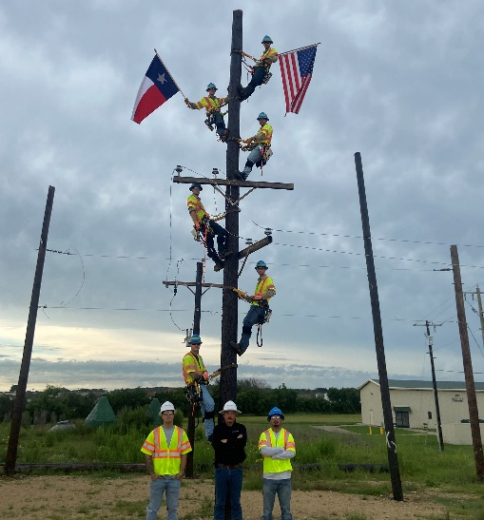
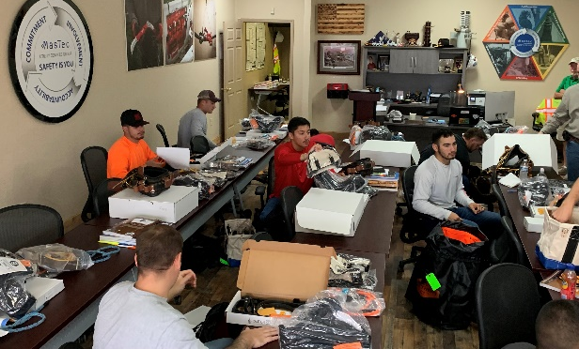
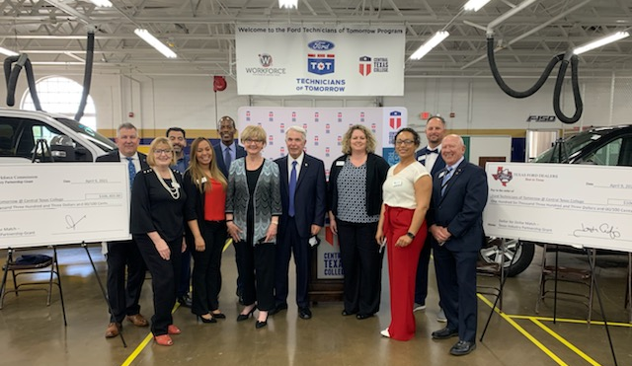
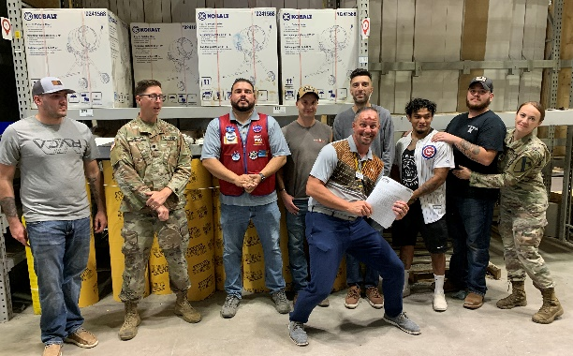
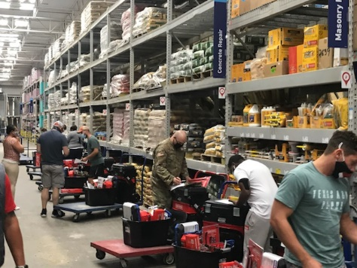
Real Results
Bringing People and Jobs Together

Slide 13
On-the-Job Training
Local Board’s Perspective
Workflow Process of the Registered Apprentice (RA)
Competency and Hours
Mentor
Follow Local Policy
Monitoring

Slide 14
Discussion

Slide 15
Supportive Services Resources for RA
WIOA Registered Apprenticeship Program (RAP) Desk Reference
Best Practices in Retention & Supportive Services for Women in the Construction Industry
Code of Federal Regulations re: How Supportive Services can be used to Support Registered Apprenticeship

Slide 16
Access Center Resources
https://dolcoe.safalapps.com
Become a Center partner and….
Receive no-cost expert assistance and materials
Network with potential partners nationwide
Be nationally recognized for your work
Open Phone and Scan

Slide 17
Email us your questions at RA_COE@SafalPartners.com
For more information, visit: dolcoe.safalapps.com

