Slide 1
Office Hours: Workforce System Alignment with Registered Apprenticeship - Promising Practices for State & Local Boards
May 22nd, 2025
Safal Partners © 2025

Slide 2
Center of Excellence Overview
U.S. DOL initiative to increase systems alignment across apprenticeship, education, and workforce
Led by Safal Partners; 5 national partners
We provide no-cost services including:
Monthly webinars
Quarterly virtual office hours
Individual compliance assistance and services
Online resources (desk aids, guides, frameworks, etc.)
Visit our website, request assistance
Safal Partners © 2025

Slide 3
Quick Pulse Poll
Are you a….
Workforce Board Staff
Service Provider Staff
Educational Partner
Vocational Rehabilitation Partner
Employer
Board Member
Registered Apprenticeship Staff
Other
Safal Partners © 2025

Slide 4
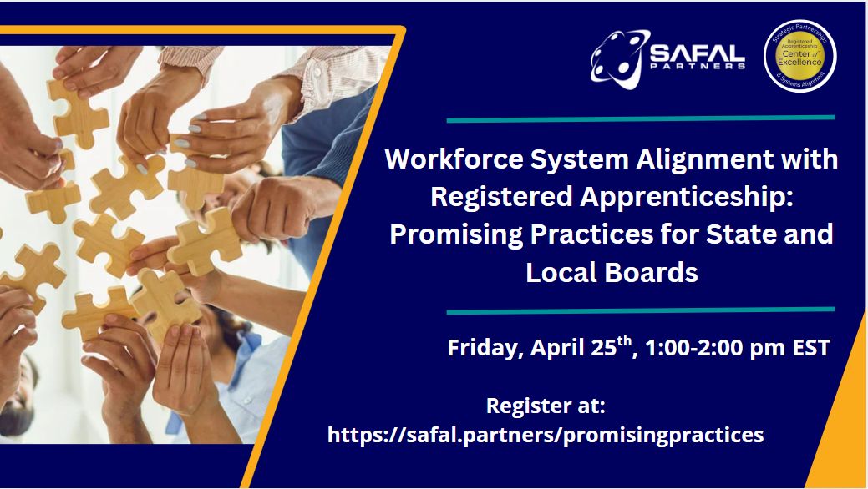
Quick Pulse Poll #2
Did you attend our April 25th webinar?
Link to webinar recording:
Safal Partners © 2025

Slide 5
Discussion Leaders
Alan Dodkowitz
James Disbro
Senior Subject Matter Expert, Safal Partners
Senior Director, Regional Alignment & Programs Development CareerSource Suncoast

Slide 6
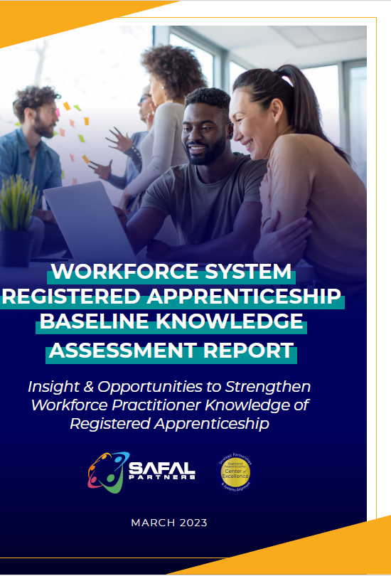
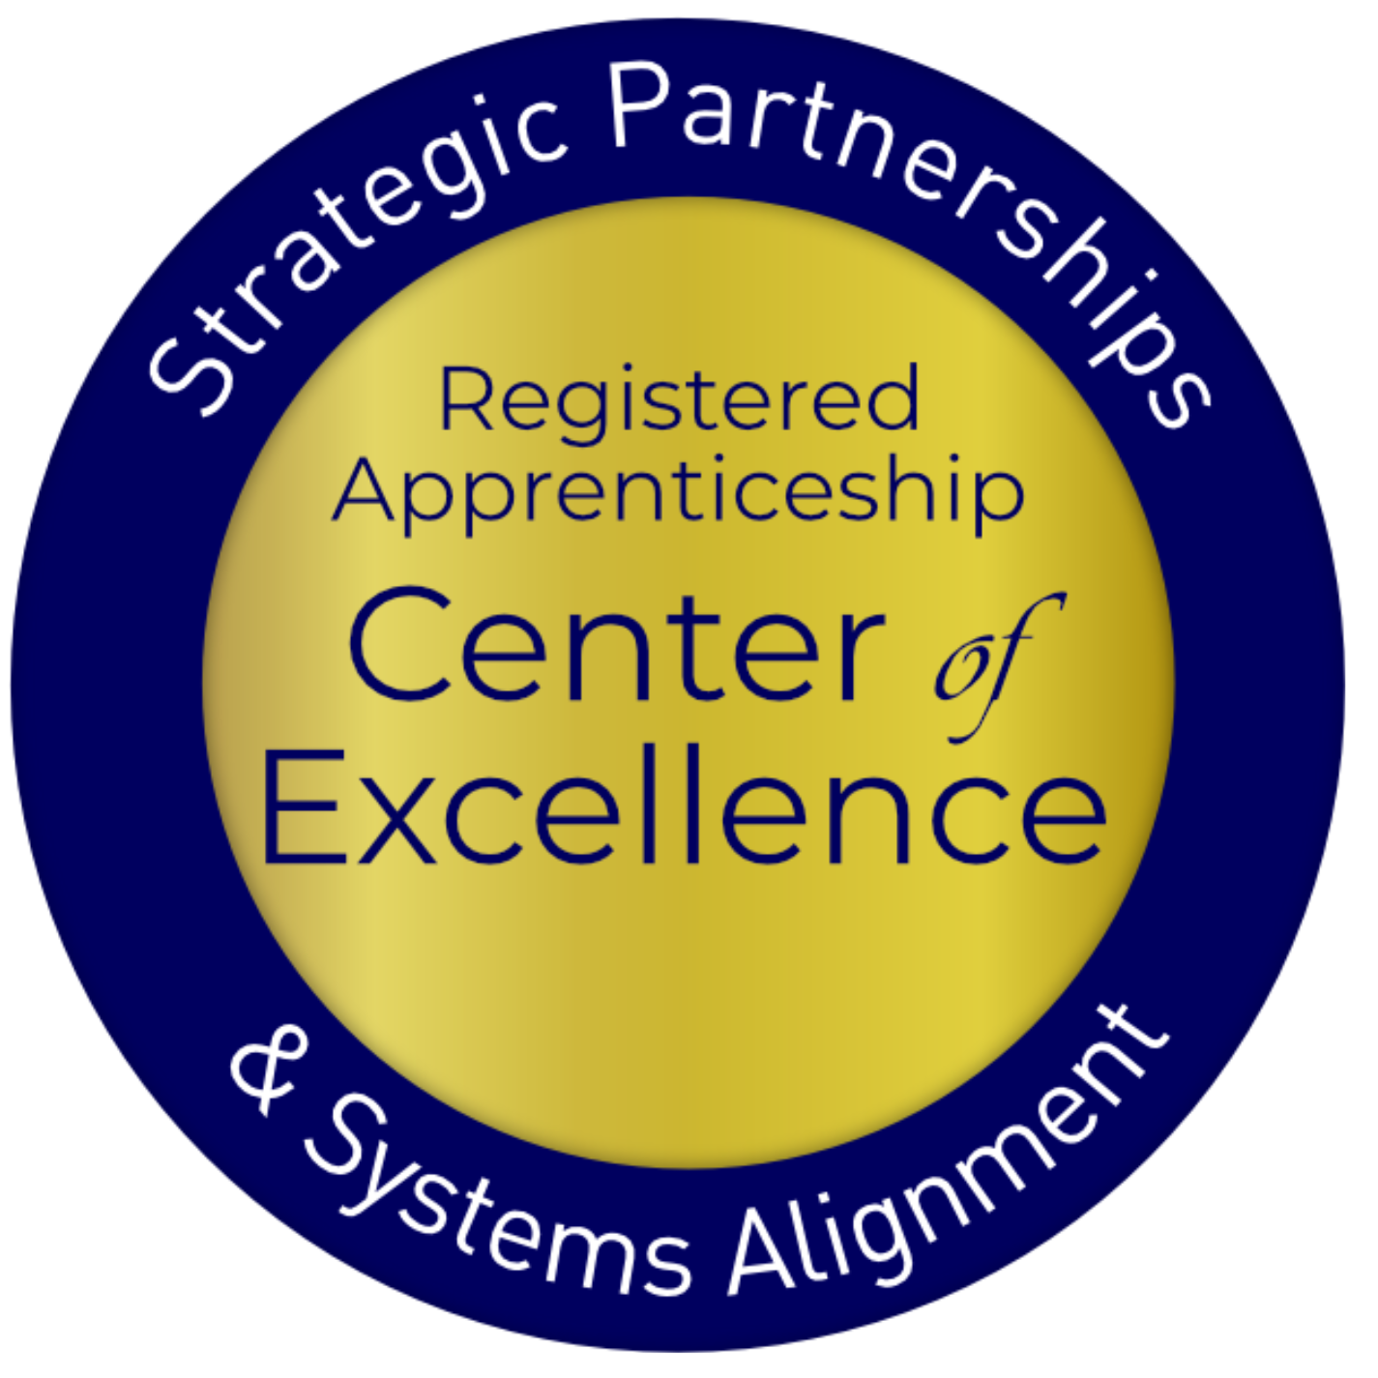
First: Understanding the Field
Deep dive into system understanding of RA
Multiple methodologies: data analysis, interviews, partner surveys, working groups, TA participant feedback, literature review
First analysis of national, state WIOA/RA co-enrollment data
First analysis of WIOA State Unified and Combined Plans for RA
First national assessment, "Workforce System RA Baseline Knowledge Assessment Report"
First national assessment of Title II RA engagement, “Expanding RA through WIOA Title I and Title II Partnerships Report”
First landscape scan, analysis of Apprenticeship Networks across the US
Safal Partners © 2025

Slide 7
Re-thinking Assumptions
Workforce system stakeholders aren't as engaged in or strategically planning for RA inclusion as initially thought.
Misalignment seen across multiple areas:
State planning to local implementation
WIOA funding utilization to policy development …and more
Safal Partners © 2025

Slide 8
WIOA State Plans: 7 Indicators of Alignment
Apprenticeship mentioned as workforce strategy
Plans to apply for/utilize federal grants to expand apprenticeship
Apprenticeship articulated specifically in strategies to meet State Plan vision
State level apprenticeship work group or committee to State Workforce Board
Specialist expertise embedded into the American Job Centers
State-level initiative for RA expansion (i.e. investment of additional resources, statutes to incentivize/scale RA programs)
Specific objectives, goals for increased # of apprentices or RA programs
Safal Partners © 2025

Slide 9
Support at Top, Dropoff in Planning
RA Alignment Indicator | # of State Plans Included | % of States | # of Territories
1. Apprenticeship acknowledged as workforce strategy | 50 | 100% | 6
2. Plans to apply for/utilize federal grants to expand apprenticeship | 42 | 84% | 4
3. Apprenticeship articulated specifically in strategies to meet State Plan vision | 17 | 34% | 3
4. State level apprenticeship work group or committee to SWDB | 17 | 34% | 1
5. Specialist expertise in AJCs | 16 | 32% | 1
6. State level Initiative (e.g., investment of additional resources, statute designed to incentivize or encourage establishment of apprenticeships) | 15 | 30% | 2
7. Specific objectives and goals for increased # of apprentices or apprenticeship programs | 7 | 14% | 0
Safal Partners © 2025

Slide 10
Field-Informed TA: Creating New Tools
Creating cross-system, responsive TA and training to drive outcomes. Products include:
First national ATR/BSR training (5-part series, capstone)
First series of WIOA State Planning webinars on RA inclusion
First Adult Education / IET Pre-Apprenticeship RA Framework
First state level CTE RA Bootcamp, replicable model
First Intermediary Assessment tool to assist states in RA expansion
First WIOA/RA Co-Enrollment Dashboard
Safal Partners © 2025

Slide 11
State Progress: Interest, Investments
Provided intensive TA, customized tools at request of 12 states on wide range of alignment topics including:
Cross-system collaboration
WIOA funding uses for RA, supportive services
WIOA State Plan development
Braiding funding
High school youth apprenticeship/CTE alignment
Pre-apprenticeship
AJC case manager/BSR training
Increase in state-level support for RA expansion
28 states have enacted RA-supportive legislation in ‘23, ‘24
Employer incentives and tax credits – drive employer demand
Grant programs – LWDBs will seek $$ over/in addition to WIOA
Restructuring governance: RA and Workforce Systems alignment/consolidation (i.e. Virginia, Iowa, Vermont)
Safal Partners © 2025

Slide 12
Field Needs, Responds to Centers’ TA
Data shows .03% national WIOA/RA
co-enrollment rate….
242% increase in WIOA/RA
co-enrollment in targeted states served by Center
Have produced 82 webinars with 5,000+ attendees….
95% participants “strongly agreed” TA was of high value and planned to implement
Initial goal of 200 partners in system alignment….
3,000 organizations have committed to developing new strategic RA partnerships
Safal Partners © 2025

Slide 13
Questions

Slide 14
Share Promising Practices
Submit your promising practice here:
Safal Partners © 2025

Slide 15
Become a Center Partner
Scan for Partner Form
Receive no-cost expert services, including materials and support
Network with potential partners nationwide
Be nationally recognized for your work
Safal Partners © 2025

Slide 16
Email us your questions at RA_COE@SafalPartners.com
For more information, visit: dolcoe.safalapps.com
Safal Partners © 2025

