Slide 1
Aligning Workforce and Registered Apprenticeship: Key Components for Success
2025 NAWDP Annual Conference
May 2025
Safal Partners © 2025
Notes:
JF Thank NAWDP for the opportunity to participate
a critical piece of making Registered Apprenticeship work—whether that’s aligning policies, embedding staff expertise, or improving data sharing. It’s all about removing friction from the system so that businesses can adopt RA more easily and job seekers can move through the pipeline with fewer barriers.

Slide 2
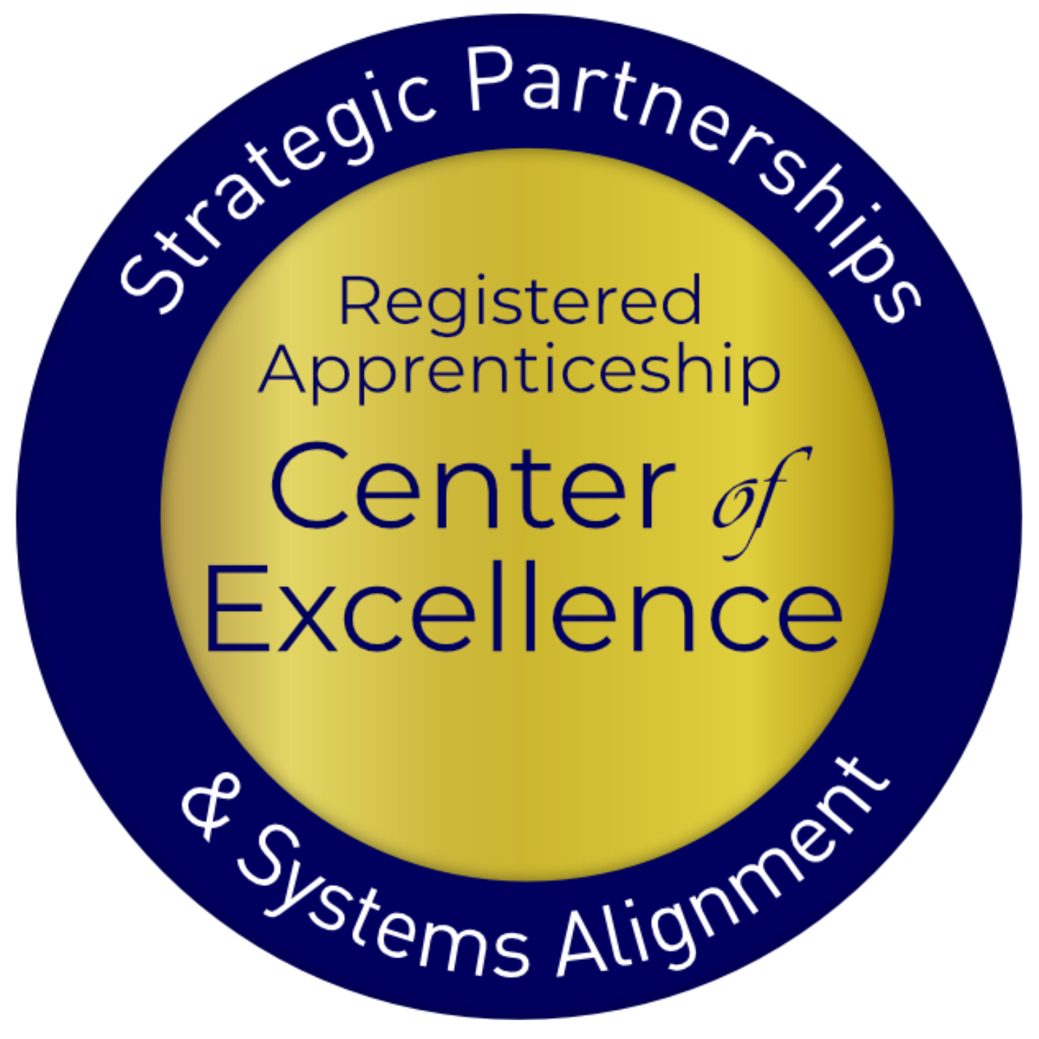
Welcome and Agenda
Center of Excellence Overview
Basic Building Blocks of Registered Apprenticeship
Six Core Components of Registered Apprenticeship Alignment
Action Planning and Next Steps
Q&A
Safal Partners © 2025
Notes:
Today’s agenda is designed to move from the big picture to concrete action. We’ll start with the foundational elements of RA, explore six key components of alignment, and finish with a planning session to map next steps.

Slide 3
Center of Excellence Overview
U.S. DOL initiative to increase systems alignment across apprenticeship, education, and workforce
Led by Safal Partners; 5 national partners
We provide no-cost services including:
Monthly webinars
Quarterly virtual office hours
Individual compliance assistance and services
Online resources (desk aids, guides, frameworks, (etc.)
Visit our website, request assistance
Safal Partners © 2025
Notes:
The Center of Excellence is more than a resource—it’s your partner. Led by Safal Partners, we’ve supported alignment across education, workforce, and apprenticeship in all 50 states. More than 70,000 workforce professionals have accessed our tools, coaching, and training since launch.

Slide 4
Presenters
Alan Dodkowitz
Jeremy Faulkner
Senior Subject Matter Expert
Safal Partners
Senior Subject Matter Expert
Safal Partners
Safal Partners © 2025
Notes:
Studs – Melissa family emergency

Slide 5
Basic Building Blocks of
Registered Apprenticeship
Notes:
Alan Note: If you place questions, comments or thoughts in the chat, we will be happy to follow up with you after the session.

Slide 6
Getting to Know You 2
How would you describe your level of knowledge of and experience with Registered Apprenticeship programs?
Advanced
Emerging
At Square One

Slide 7
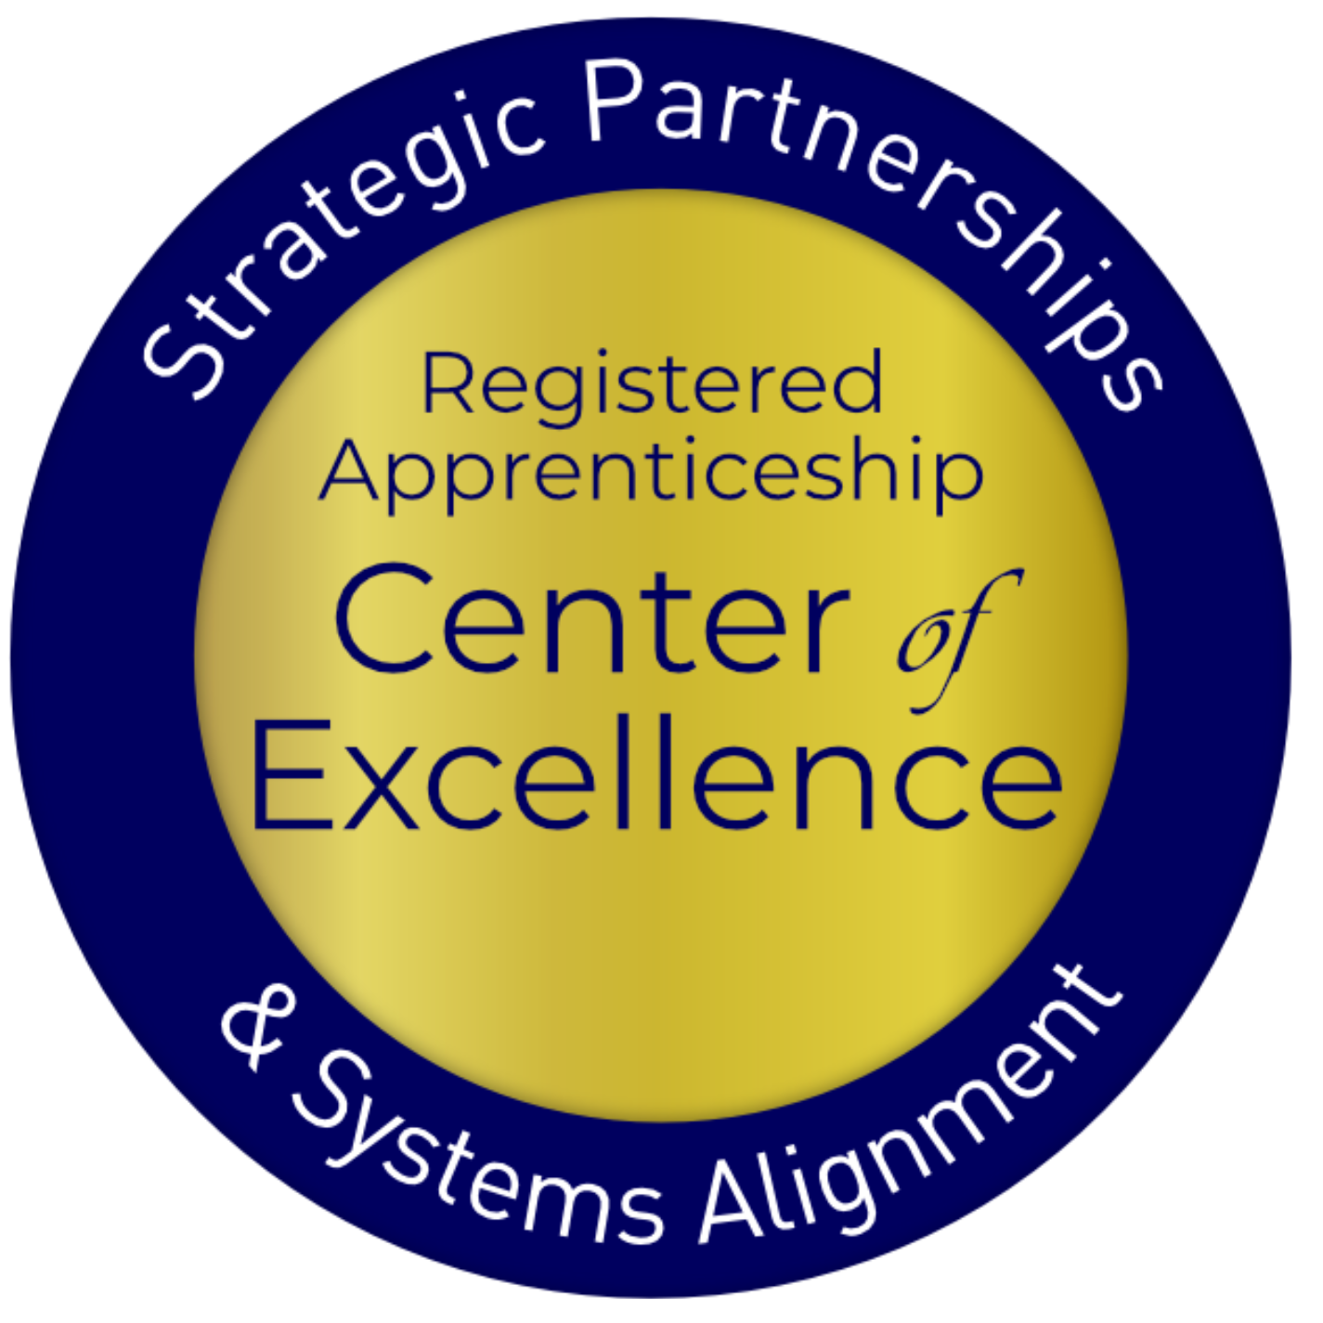
Registered Apprenticeship
Registered apprenticeship is:
Registered apprenticeship is
a proven model of job preparation
that combines paid on-the-job training (OJT) with related instruction to progressively increase workers’ skill levels and wages;
a proven business-driven model that provides an effective way for businesses to recruit, train, and retain highly skilled workers.

Slide 8
Five Core Components of Apprenticeship
Industry Led
Paid Job
Structured On-the-Job Learning (OJL)/ Mentorship
Supplemental Education
Credentials
Safal Partners © 2025
Notes:
Recently updated verbiage on apprenticeship.gov - https://www.apprenticeship.gov/employers/registered-apprenticeship-program
1. Industry Led – Programs are industry-vetted and approved to ensure alignment with industry standards and that apprentices are trained for highly skilled, high-demand occupations.
2. Paid Job – Registered Apprenticeships are jobs! Apprentices earn progressive wages as their skills and productivity increase.
3.Structured On-the-Job Learning/Mentorship – Programs provide structured on-the-job training to prepare for a successful career, which includes instruction from an experienced mentor.
4.Supplemental Education – Apprentices are provided supplemental classroom education based on employers’ unique training needs to ensure quality and success.
5.Credentials – Apprentices earn a portable, nationally recognized credential within their industry.

Slide 9
A WIDE RANGE OF INDUSTRIES
Agriculture
Healthcare
Cybersecurity
Biotechnology
Transportation
Construction
Energy
Hospitality
Advanced Manufacturing
Critical Supply Chain
Telecommunications
Financial Services
Information Technology
Education
Infrastructure
Engineering

Slide 10
Apprenticeship Stakeholders
Sponsor
RI Provider
Employer
Partner
An organization that agrees to operate an apprenticeship program and in whose name the program is registered.
Entity that provides instruction to apprentices in the designated occupation’s core knowledge, skills, and abilities.
Hires and provides paid on-the-job learning (OJL) for apprentices under
supervision of a designated mentor who is a skilled professional in
that occupation.
Organizations
committed to assisting RA programs. They can play one or more roles.
Safal Partners © 2024

Slide 11
Six Key Components of Workforce System Alignment with RA
Notes:
JF

Slide 12
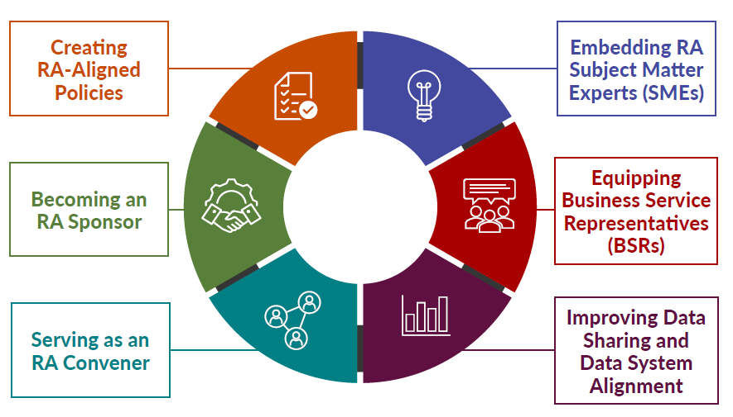
New Tool
Key Components of Workforce System Alignment with Registered Apprenticeship
Safal Partners © 2025
Notes:
There are six essential areas where workforce systems can align with RA: policy, staff, business engagement, data, partnerships, and funding. This framework will guide the rest of today’s session.
We’ve developed a practical tool to help workforce boards assess alignment across those six areas. It’s adaptable for local, regional, or state-level strategy development.

Slide 13
Creating RA-Aligned Policies
State and Local WDBs often have state and local policies and procedure frameworks that align and guide development of work to support RA program implementation.
Criteria and policies for board membership ensure appropriate representation for RA
Policies/procedures prioritize the use of RA as a service strategy for WIOA Title I and may provide funding to support RA programs
Local WDBs’ AJC operators have clear policies/procedures and support for RA and WIOA/RA co-enrollment processes and training towards frontline case managers
Funding-related policies ensure use of available funds to support RA expansion
ETPL policy/procedures provide automatic inclusion of RA programs on ETPLs
Business services policies/procedures include implementation of RA through OJT/IWT
Safal Partners © 2025
Notes:
Policy matters. For example, does your ETPL automatically include RA programs? Do your funding guidelines allow use of WIOA funds for RA-related OJT? These choices shape access and scale.

Slide 14
Creating RA-Aligned Policies 3
Actionable Items for Success: What Steps Lead to Strong System Alignment
Seek out Registered Apprenticeship representatives from WDB membership from labor and non-labor
Review and revise policies to ensure Registered Apprenticeship and WIOA alignment and activities internally
Establish state/local Registered Apprenticeship steering committees or connect to committees already established through the SAA or OA
Safal Partners © 2025
Notes:
Policies around board membership, co-enrollment, and RA eligibility criteria can determine whether apprenticeship is central or peripheral in your system. Alignment here ensures it becomes a real option for job seekers.

Slide 15
Creating RA-Aligned Policies 2
Actionable Items for Success: What Steps Lead to Strong System Alignment
Meet with local ATR and OA or SAA state directors to understand RA program approval process and establish streamlined process to include RA programs on state/local ETPLs
Advocate for dedicated funding allocations for RA activities, including dedicated staff in the AJC and institutionalize this practice in policy
Create MOUs with non-traditional partners for targeted population engagement
Safal Partners © 2025
Notes:
State and local boards can institutionalize support for RA by embedding it in procurement, staff roles, training, and MOUs. We’ve seen success where these changes were tied to compliance reviews or performance planning.

Slide 16
Embedding RA SMEs
State/LWDBs embed RA expertise in the AJC frontline staff to actively help engage employers and create RA pipeline.
State/LWDB have RA navigators/SMEs within AJCs or region
Case managers purposefully screen and refer job seekers to RAPs
Co-enrollment procedures are used by case managers and partners
Apprentices are supported throughout the RA program
Partners work with AJCs to engage job seekers in RAPs
Outreach to job seekers showing benefits to RA
Training for case managers on RA
Wagner-Peyser staff share RA info to job seekers and employers
Safal Partners © 2025
Notes:
You can’t scale what you don’t own. Embedding SMEs in AJCs increases apprenticeship referrals, supports co-enrollment, and improves employer engagement. Several states have seen double-digit growth by adding RA navigators.

Slide 17
Embedding RA SMEs 1
Actionable Items for Success: What Steps Lead to Strong System Alignment
Ask a state or local ATR to provide ongoing RA training to AJC staff, particularly those who are customer facing or to hold regular meetings with AJC staff on RA
Explore federal and state funding opportunities to support staffing AJCs with RA expertise
Provide staff with link to the Apprentiveship.gov Partner Finder for info on state and local program sponsors and links to State Apprenticeship Agency websites that have program sponsor info
Ensure that state and/or local case management systems capture WIOA Title I co-enrollment with RA so that the data reported in PIRL Element 931 is an accurate reflection of the level of co-enrollment
Embed an RA SME with offsite mandatory partners to focus on work with job seekers and employers
Safal Partners © 2025

Slide 18
Embedding RA SMEs 3
Actionable Items for Success: What Steps Lead to Strong System Alignment
Ask a state or local ATR to provide ongoing RA training to AJC staff, particularly those who are customer facing or hold regular meetings with AJC staff on RA
Explore federal and state funding opportunities to support staffing AJCs with RA expertise
Provide staff with link to Apprenticeship.gov Partner Finder for info on state and local program sponsors and links to State Apprenticeship Agency websites that have program sponsor info
Safal Partners © 2025
Notes:
Ask yourself: Do your frontline staff know how to explain apprenticeship clearly? Can they talk about funding or direct employers to intermediaries? This is where RA SMEs make the difference.
We’ve seen success where SMEs were embedded not just in AJCs, but also at partner sites—economic development, corrections, and youth-serving organizations. That cross-agency support builds pipelines.

Slide 19
Embedding RA SMEs 2
Actionable Items for Success: What Steps Lead to Strong System Alignment
Ensure that state and/or local case management systems capture WIOA Title I co-enrollment with RA so that the data reported in PIRL Element 931 is an accurate reflection of the level of co-enrollment
Embed an RA SME with offsite mandatory partners to focus on work with job seekers and employers
Safal Partners © 2025
Notes:
RA SMEs aren’t a luxury—they’re infrastructure. With the right funding streams and staff onboarding plans, you can sustain these roles over the long haul and improve outcomes across programs.

Slide 20
Equipping BSRs
Business Services Representatives (BSRs) have the knowledge and expertise to assist employers with adopting RA programs and accessing funding.
BSRs...
Regularly work with ATRs to promote RA programs
Guide employers through the RA process
Create outreach plan based on LMI with RA counterparts
Interact with intermediaries to assist businesses with RA program development
Provide collateral and education to partners
Communicate with case mangers about apprenticeship openings
Assist businesses with leveraging WIOA and other funding
Include in State/Local Rapid Response efforts
Safal Partners © 2025
Notes:
BSRs are critical to apprenticeship scale. But many don’t feel confident discussing RA. With training, tools, and co-developed messaging, BSRs can become apprenticeship ambassadors.

Slide 21
Embedding BSRs
Actionable Items for Success: What Steps Lead to Strong System Alignment
Train BSRs on RA, including using intermediaries and working with local ATRs
Host roundtables and apprenticeship accelerators for businesses to learn about Registered Apprenticeship
Create and share Apprenticeship.gov materials with businesses on the benefits of Registered Apprenticeship
Safal Partners © 2025
Notes:
This alignment only works if everyone is equipped. Think about how often employers ask about skills shortages—now think about how often your BSRs pitch RA as a solution.

Slide 22
Embedding BSRs 1
Actionable Items for Success: What Steps Lead to Strong System Alignment
Host apprenticeship job fairs to fill open positions
Present Registered Apprenticeship information at employer events (e.g., chambers of commerce, economic development)
Use WIOA Title I funds, per WIOA requirements, to support the OJT portion of a Registered Apprenticeship program
Safal Partners © 2025
Notes:
Some boards have developed one-pagers or pitch decks specifically for BSRs to use when talking to employers about apprenticeship. These tools go a long way.

Slide 23
Embedding BSRs 2
Actionable Items for Success: What Steps Lead to Strong System Alignment
Set up regular communication with ATRs and partner organizations regarding Registered Apprenticeship programs
State should encourage and provide guidance on using rapid response/layoff aversion funds for Registered Apprenticeship
Safal Partners © 2025
Notes:
Include BSRs in apprenticeship accelerator events, intermediary meetings, and rapid response planning. When they see RA in action, they’re more likely to lead with it in the field.

Slide 24
Improving Data Sharing and Data System Alignment
State apprenticeship and workforce systems align data systems, enabling sharing of data and improving cross-agency access.
Workforce/apprenticeship systems have formal agreements in place to track, monitor, report and share data related to apprenticeship and WIOA metrics
Co-enrollment data is tracked and shared consistently
BSRs capture real-time data on employers’ supply and demand needs, communicate with their local ATR/AN counterparts consistently
State longitudinal and/or external data systems are used to track, understand and share data trends in apprenticeship populations
Data around WIOA/non-WIOA funding support used to tell the story, helping state leadership make informed decisions regarding policy and funding to expand RA
Safal Partners © 2025
Notes:
Alan
Data alignment ensures we can tell the full story—how many apprentices are being served, how WIOA funds are used, and how co-enrollment boosts retention and wages.

Slide 25
Improving Data Sharing and Data System Alignment 3 1
Actionable Items for Success: What Steps Lead to Strong System Alignment
Establish/modify data sharing agreements to ensure workforce and apprenticeship system inclusion
Ensure that state/local WIOA plans explicitly include WIOA and RA performance metrics for co-enrollment and collaborative strategic partnership efforts regarding employer outreach
Create/refine a process for collaborative cross-agency analysis and sharing of WIOA and RA performance data to determine performance against each required WIOA metric
Notes:
Many states are developing shared dashboards that combine workforce and apprenticeship data. Others have aligned PIRL reporting fields to ensure RA metrics aren’t lost.

Slide 26
Improving Data Sharing and Data System Alignment 2
Actionable Items for Success: What Steps Lead to Strong System Alignment
Develop a state-level working group and data lead on data sharing, system alignment, and co-reporting of workforce and RA collaboration with the development of baseline performance metrics
Offer regular training for case managers and other staff on WIOA/RA programs on co-enrollment data, how it is used, and the importance of accurately reporting data
Notes:
The goal here is simple: make RA visible in your reporting systems. That means tracking co-enrollment, supportive services, and completions alongside traditional WIOA metrics.

Slide 27
Serving as an RA Convener
State/LWDBs engage stakeholders to expand RA, build talent pipelines, address workforce shortages, and increase employment and wages for workers.
Engage with stakeholders to development and implement RA programs that can access funding and resources through workforce system
Sector Strategy initiatives include RA as a strategy for building the talent pipeline
Create and maintain a network (hub) of RA programs to accelerate employer participation and to provide technical assistance
Collaborate on high-demand, industry specific RA programs including technical assistance and funding
Collaborative RA efforts include mandatory partners as part of convening activities
Create concise communication and outreach for RA programs
Safal Partners © 2025
Notes:
Boards play a key role in driving data alignment. That includes developing shared performance goals with apprenticeship offices and making sure data teams are at the table.

Slide 28
Serving as an RA Convener 3
Actionable Items for Success: What Steps Lead to Strong System Alignment
Create Registered Apprenticeship programs that are high-demand industries per local LMI
Engage with ATRs to establish Apprenticeship Accelerator events that bring together apprenticeship stakeholders and resources to accelerate the further use and adoption of Registered Apprenticeship
Collaborate with ATRs to establish processes to develop Registered Apprenticeship standards for businesses at a local level
Notes:
This work takes leadership. When workforce systems step into a convener role, they can build sector strategies with apprenticeship at the center.

Slide 29
Serving as an RA Convener 2
Actionable Items for Success: What Steps Lead to Strong System Alignment
Explore federal and state grant opportunities, philanthropic funding, and potential state funding to support industry-specific Registered Apprenticeship initiatives
Reach out to DOL Industry Intermediaries and state- based Registered Apprenticeship stakeholders

Slide 30
Becoming an RA Sponsor
LWDB becomes a group RA sponsor increasing opportunities for job seekers to access careers in high-demand industries and for businesses to access funding supports for apprentices.
LWDB becomes a RA program sponsor for in-demand occupation(s)
Occupations are regularly added to RA programs based on LMI
Ed system is engaged with LWDB to provide RI
RA sponsorship is sustainable through braided funding
LWDB creates clear path to build pipeline for employers
LWDB provides admin support, training and assistance to employer joining the RA program
LWDB ensures ability to support employers with WIOA funding
Safal Partners © 2025
Notes:
Convening is about more than meeting invites. It’s about aligning funding, employer outreach, and partner roles around a shared workforce vision.

Slide 31
Becoming an RA Sponsor4
Actionable Items for Success: What Steps Lead to Strong System Alignment
Ask your local ATR/state RA director if there are other workforce board RA sponsors in your state so that you can connect with them to gain insight into the program development needs
Using LMI data, determine high-demand occupations/industries to know which occupations to add to your program standards and guide your employer outreach in program development
Reach out to your local ATR to begin the process of developing program standards for your board to become an RA sponsor
Notes:
Some boards are stepping in as sponsors to remove barriers for small and midsize employers. This simplifies program development and accelerates scaling.

Slide 32
Becoming an RA Sponsor44
Actionable Items for Success: What Steps Lead to Strong System Alignment
Engage with DOL Industry Intermediaries to learn how they can potentially support your new program development
Invite local businesses/employers to discuss potential interest in and become involved in RA program design to secure participation agreement
Identify potential high-quality post-secondary educational partners to provide RI and RA program occupations in design phase
Notes:
Sponsors don’t have to do it all alone. Many successful boards leverage intermediaries to manage admin tasks while retaining control over program design and funding alignment.

Slide 33
Action Planning and Next Steps
Notes:
JF Sponsorship allows you to shape the RA experience—embedding it in career pathways, aligning it with local education providers, and expanding access to underserved populations.

Slide 34
Key Questions to Consider
Overall Alignment: Where is your Community?
Does your workforce system have policies in place that promote RA?
What organizations/partners are you already working with? Who else do you need at your table?
What expertise do you have that can be tapped into?
Do you employers understand the benefits of RA? Are there representatives who can convene employers and help them?
How do you intend to work towards alignment? What steps can you take to increase alignment for successful RA program efforts?
What support do you need?
What questions do you have?
Safal Partners © 2025
Notes:
Let’s shift into planning. You’ve seen what alignment looks like—now it’s your turn. What’s one actionable step you can take in your board, region, or agency?

Slide 35
To Move Forward….
Form your own community group and discuss the following:
Overall alignment between the LWDB, AJCs, employers, education, economic development, CBO’s, etc.
Does the workforce system have policies and processes in place to support RA?
How can you work together on alignment? Work groups? Task force? Etc.?
Support / Questions?
Safal Partners © 2025
Notes:
Use these questions to focus your team discussion: What systems do we have? Where is apprenticeship underused? What policy or staffing change would create momentum?

Slide 36
Thank you for joining us
Notes:
Whether it’s forming a working group, updating a local plan, or embedding a new SME—every step you take today moves your system toward stronger alignment and greater impact.

