Slide 1
Creating and Sustaining Momentum Through Registered Apprenticeship Networks
May 2024

Slide 2


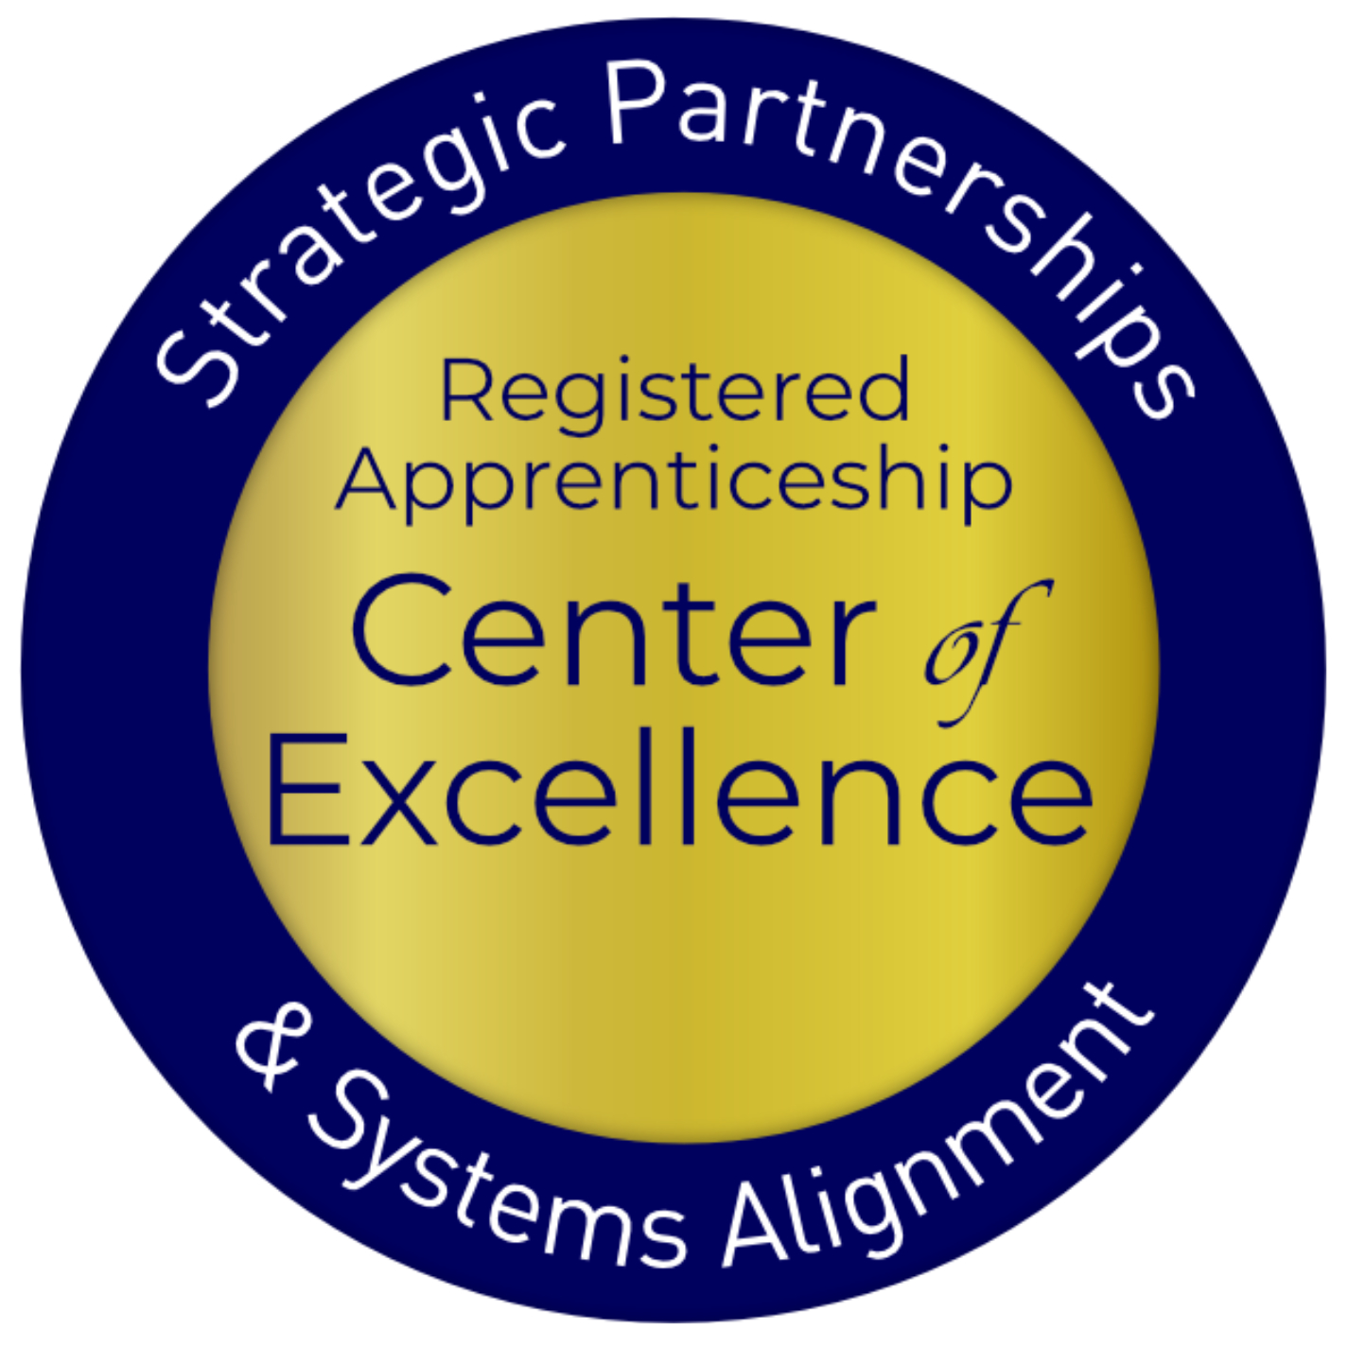
Presenters
Alan D. Dodkowitz
Subject Matter Expert
Safal Partners
Rebecca Ambrose
Director of Training and Apprenticeship
Philadelphia Works
Safal Partners © 2024

Slide 3
Welcome and Agenda
Center of Excellence Overview
Registered Apprenticeship
Strategies on Expanding Apprenticeship Opportunities
Survey Findings on Apprenticeship Networks
Lessons from the Field
Begin Your Apprenticeship Network Action Plan
Questions
Wrap Up
Safal Partners © 2024

Slide 4

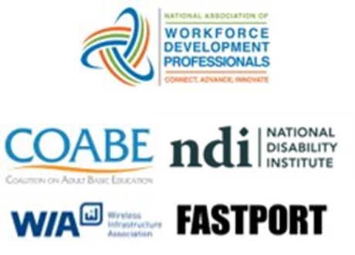

Center of Excellence Overview
U.S. DOL initiative to increase systems alignment across apprenticeship, education, and workforce
Led by Safal Partners; 5 national partners
We provide no-cost technical assistant (TA), including:
  Monthly webinars
  Quarterly virtual office hours
  Individual TA/coaching sessions
  Online resources (desk aids, guides, frameworks, etc.)
Visit our website, request TA

Slide 5
Registered Apprenticeship
Safal Partners © 2024

Slide 6



What Is Registered Apprenticeship?
Five Core Components of Registered Apprenticeship
Employer Involvement
Structured
On-the-Job Learning
(OJL)
Related Instruction
(RI)
Rewards
for
Skill Gains
National Occupational Credential

Slide 7




The Roles in Registered Apprenticeship
Sponsor
An organization that agrees to operate an apprenticeship program, and in whose name the program is registered with the U.S. Department of Labor (DOL) or a State Apprenticeship Agency (SAA).
RI Provider
Entity that provides instruction to apprentices in the designated occupation’s core knowledge, skills, and abilities.
Employer
Hires and provides paid on-the-job learning (OJL) for apprentices under
supervision of a designated mentor who is a skilled professional in
that occupation.
Partner
Organizations
committed to assisting RA programs. They can play one or more roles.
Safal Partners © 2024

Slide 8
Apprenticeship Networks- Understanding Who They Are
Safal Partners © 2024

Slide 9

What Safal Did
Beginning in October 2023, Safal Partners began to identify apprenticeship networks throughout the country to understand:
  Who they were
  What services they provided
  What their membership consisted of
After identifying several networks, the team reached out through social media so networks could self-identify
Safal Partners © 2024

Slide 10
Who Did We Speak To?
Apprenticeship Network | Region
SCAN/ New Way Solutions | Southern California
LAUNCH Apprenticeship Network | Southern California
Northern Virginia Chamber of Commerce | Washington, DC metro area
Chicago Apprenticeship Network | Chicago, Illinois metro area
Greater Boston Chamber of Commerce | Boston, Massachusetts metro area
Program of the Semi Foundation – Michigan Affiliate | Lansing, Michigan metro area
EmployIndy | Indianapolis, Indiana metro area
CareerWise Colorado | Denver, Colorado metro area
ApprenticeshipPhl | Philadelphia, Pennsylvania metro area
Workforce Solutions of Greater Dallas | Dallas, Texas metro area
NCAN | Northern California/Bay Area
Safal Partners © 2024

Slide 11
Apprenticeship Networks- What Did We Learn?
Safal Partners © 2024

Slide 12

What are Apprenticeship Networks?
Apprenticeship networks serve as a platform for organizations to come together, build awareness, and share best practices to expand professional advancement through apprenticeship programs.
Safal Partners © 2024

Slide 13
Two Primary Types of Networks
Private Sector
  Originated in Chicago in August 2017, where Accenture, Aon, and Zurich North America co-founded the Chicago Apprentice Network
  Based out of consortia of businesses, local chambers of commerce, and other business groups
  Seek to build a network for businesses to connect and advance apprenticeship
Public Sector
  Based out of local workforce systems, they view the alignment of registered apprenticeship and workforce development as crucial
  This led them to develop their own apprenticeship networks to promote the utility of registered apprenticeship within the workforce development ecosystem
  Like the Chicago network, these networks also serve as conveners of those in the apprenticeship ecosystem, bringing together the workforce system, employers, RI providers, and other different partners

Slide 14

The Chicago Apprenticeship Network/National Apprenticeship Network
The first formal "apprenticeship network" in the U.S. related to a formal structure of multiple organizations coalesced around advancing apprenticeship
Works with dozens of employers across the Chicago metro area and has created over 1,500 apprenticeships
The National Apprenticeship Network was launched in 2021 to support expansion cities and facilitate sharing ideas, lessons learned, and best practices among peers.
Now operates in 10 areas throughout the U.S.

Slide 15
Lessons from the Field

Slide 16


Goals of Apprenticeship Networks
Varied goals but overarching objectives include expanding both registered and unregistered apprenticeship programs in the communities they serve
Promote apprenticeship opportunities in non-traditional occupations
  LAUNCH seeks to expand apprenticeship into non-traditional industries, making careers more accessible, closing talent gaps, and implementing a proven training model for California employers
  EmployIndy shares a similar goal, aiming to expand apprenticeships to non-traditional industries and reach disconnected populations, such as opportunity youth

Slide 17
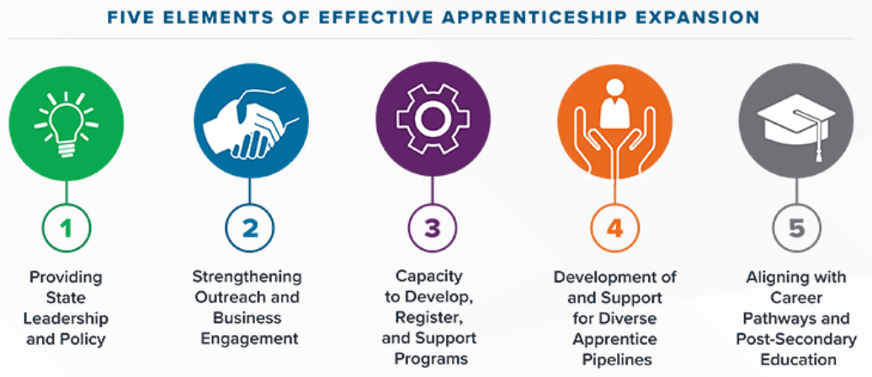
How are they Structured?
Private-sector networks are typically fluid and informal
Public sector is based on the local workforce ecosystem and includes various partners
Staffing is more embedded and formal in public-sector networks
None charge fees for participation
Safal Partners © 2024

Slide 18

Attracting Various Sources of Funding
Federal and state funding are crucial for supporting the work of these networks, private or public sector
CareerWise Colorado, utilizes Youth Apprenticeship Readiness Grants (YARG), Apprenticeship Building America (ABA), as well as state grants to support its network
Private funding also supports apprenticeship networks - even public ones - who receive philanthropic support
Safal Partners © 2024

Slide 19
A Wide Array of Services
Offer regular meetings to educate members on growing and expanding apprenticeships, often held monthly or quarterly
  They include presentations or interactive sessions where members learn about apprenticeships, how to participate in or sponsor a program, and the resources available to support them
Host in-person convenings to connect various facets of the apprenticeship ecosystem
  For example, the Massachusetts network holds quarterly convenings where best practices are shared, and panels of apprentices discuss their experiences and provide feedback on how the networks can better serve them
Develop toolkits, fact sheets, and recorded webinars for members
  Chicago has developed the 85-page "Bridging the Gap Between Talent Opportunity" playbook- a five-step process for developing and implementing an apprenticeship program.
Safal Partners © 2024

Slide 20
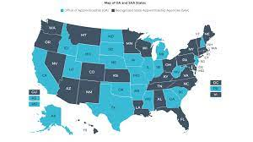
Aligning with the Apprenticeship System
Differing levels of coordination
Public-sector networks, including those that were sponsors, were very closely aligned
All sought to improve their relationship with registration agencies as goals they had established for their networks
Safal Partners © 2024

Slide 21

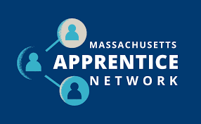
Ambitious Goals
The National Apprentice Network aims to create 10,000 apprenticeships total by 2030
The Southern California Apprentice Network (SCAN), has a goal of placing 3,000 apprentices within five years through 100 different employers
In Massachusetts, the network started with six employers and now works with 17 employers, aiming to place 1,000 apprentices by 2027, a goal they are on pace to achieve
Safal Partners © 2024

Slide 22
ApprenticeshipPHL-A Case Study

Slide 23


ApprenticeshipPHL
Apprenticeship Hub in the Southeastern PA Region

Slide 24
Philadelphia Works: LWDB
As the City’s Workforce Development Board, Philadelphia Works develops and manages smart workforce solutions that respond to business needs and increase economic opportunity for all Philadelphia residents—this is our mission.
Philadelphia Works, Inc. is a proud partner in creating economic opportunities.
Our vision is a thriving Philadelphia workforce and a stronger local economy.

Slide 25
ApprenticeshipPHL 2
ApprenticeshipPHL is a regional public/private collaboration with the overall goal of increasing and aligning registered apprenticeship and pre-apprenticeship programs for the benefit of the area’s residents and employers.

Slide 26







History of APHL
2017
The concept of a regional apprenticeship collaborative was presented to Philadelphia Works leadership
2015
2018
Philadelphia Works was awarded the American Apprenticeship Initiative
ApprenticeshipPHL officially launched during National Apprenticeship Week 2018

Slide 27
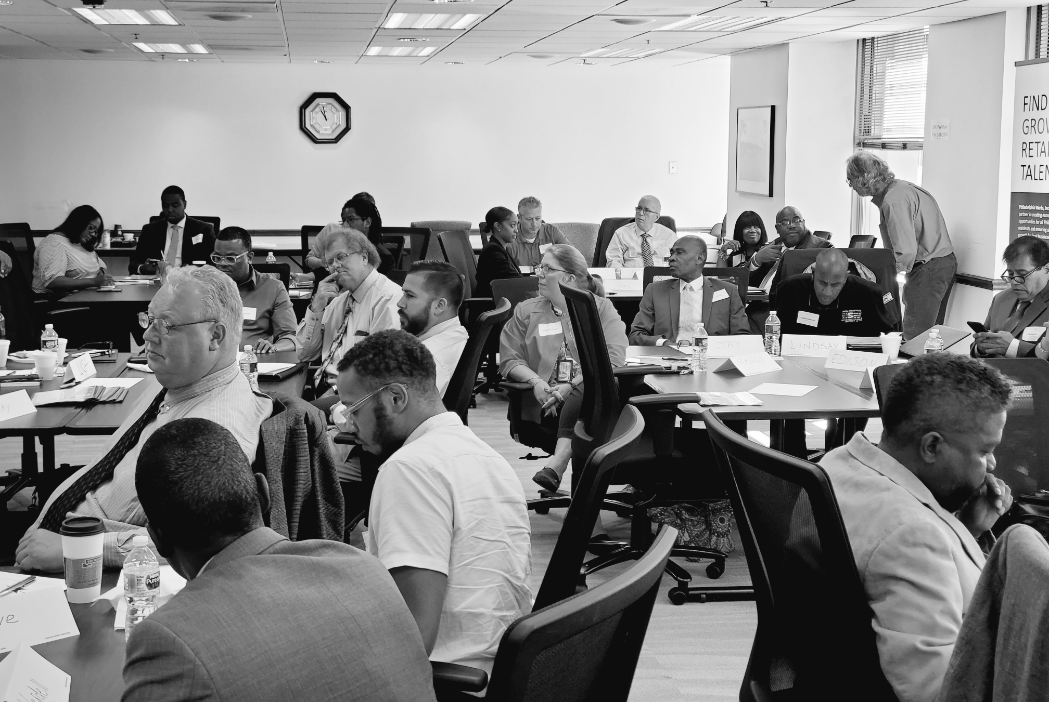
ApprenticeshipPHL 3
Cohort 1 of the Apprenticeship Navigator Registered Apprenticeship
Annual Symposium Events
Strategic Planning Workgroups

Slide 28
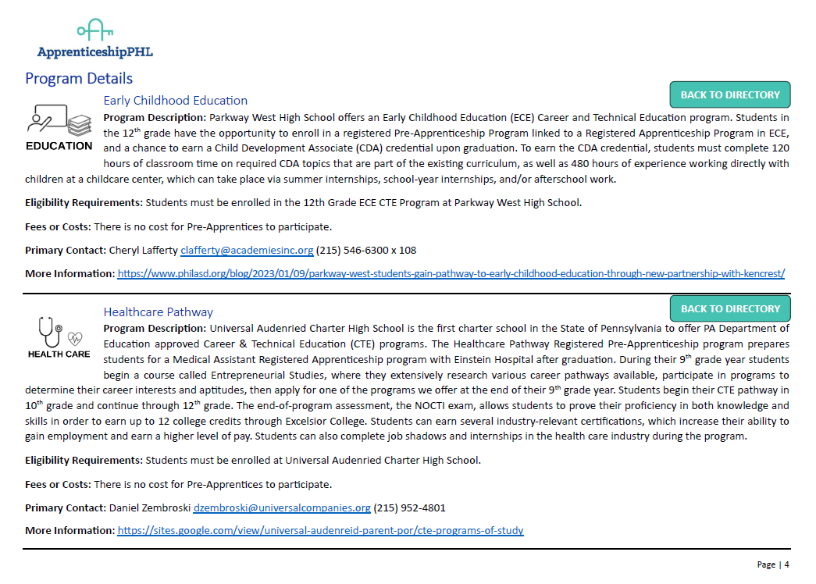
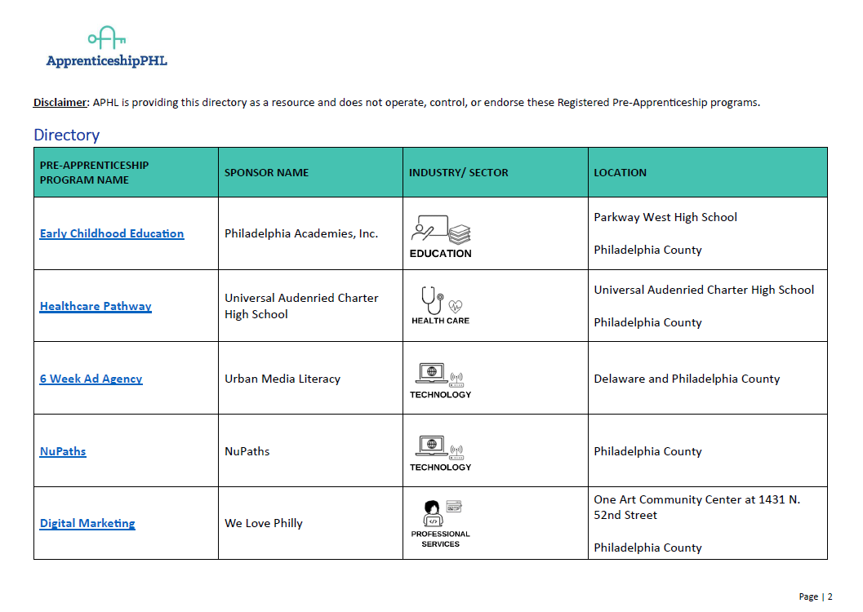
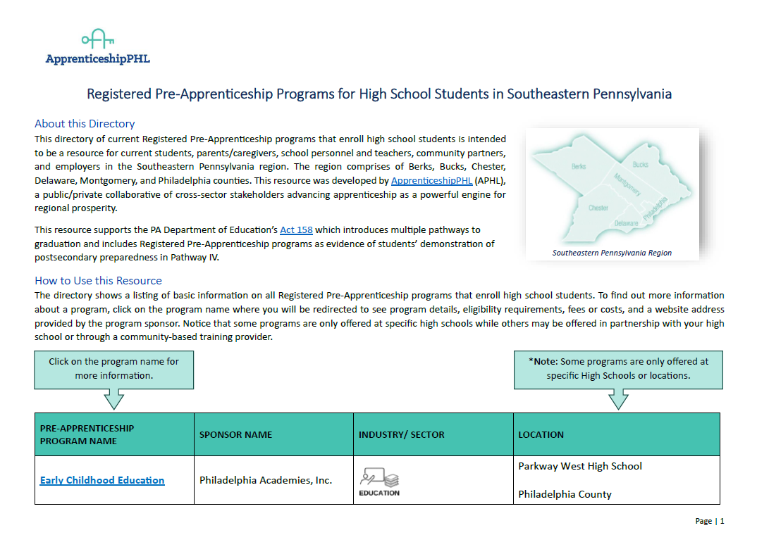
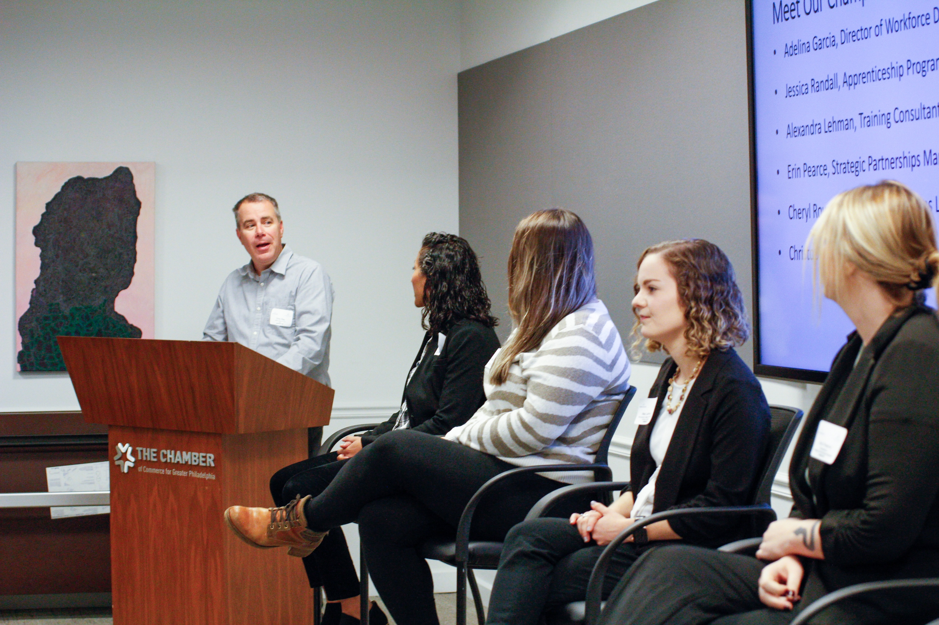
Current Happenings
ApprenticeshipPHL Membership Growth
Apprenticeship Training with the PA CareerLink® Centers in Philadelphia
Apprenticeship Accelerator
Directory of Registered Pre-Apprenticeship Programs for High School Students
APHL Website Refresh: RAP Directory

Slide 29
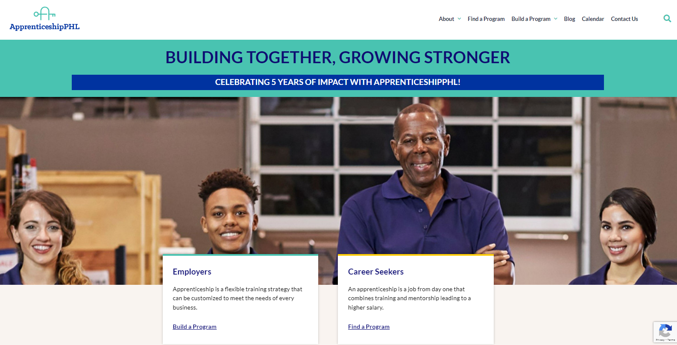
APHL-Building Together, Growing Stronger
Employers
Apprenticeship is a flexible training strategy that can be customized to meet the needs of every business.
Career Seekers
An apprenticeship is a job from day one that combines training and mentorship, leading to a high salary.

Slide 30
APHL Committees
Education
Employer Engagement
Goal: Increase the number of pre-apprenticeship program opportunities for high school students as a pathway to graduation.
22 members, 10 of whom dedicated their time to be on specific planning teams
Committee efforts are collaborative with deciding strategies and achieving goals. People have stepped in/stepped up to do the work!
Some members have been more active, while others have been less engaged. Striking that balance is key as we prioritize hearing everyone’s voices. Some of the actual “tasks” have landed on the same individuals with greater capacity to be involved.
Goal: Develop strategies to increase employer utilization of the apprenticeship model as a long-term training strategy.
15 members, 7 dedicated to Accelerator Planning team
Those involved in accelerator planning have been deeply committed to the work and the committee's overall goal—there has been good momentum, and even more ideas have flowed for future events/accelerators.
Those not part of the accelerator planning team have not been as engaged in the last couple of meetings, during which we rely on everyone's input as a whole committee. Is the lack of participation due to scheduling conflicts, people's full capacity, inability to take on a working group, or something else?

Slide 31

Apprenticeship Building America Grant
Apprenticeship Building America is a $4,704,311 project funded 100% by the US Department of Labor.
Awarded August 2022: Registered Apprenticeship Hubs
Goals:
Re-energize and expand the regional apprenticeship hub in Southeast PA (SEPA)
Increase and align Registered Apprenticeship Programs (RAPs) and Registered Pre-Apprenticeship Program (RPAPs) to the benefit of SEPA residents and employers
The Importance of Partnerships

Slide 32
Shared Vision
PhilaWorks and our partners will work to develop and maintain high-quality RAPs and RPAPs for residents in the region by focusing on:
decreasing the unemployment rate for youth, Black and brown people, and women
leveraging partnerships across the South Eastern Program Alliance (SEPA) to build capacity and systems change for apprenticeship
building registered apprenticeship and pre-apprenticeship programs
collaboratively identifying and implementing career pathways that lead to family-sustaining wages
strategically building capacity to grow a cohesive, streamlined pathway for employers and apprentices to access

Slide 33




Partners

Slide 34
ABA Project Outputs
Through the collaborative efforts and activities of the Apprenticeship Regional Hub, here’s a snapshot of the work we’ll accomplish:
Program Outputs | Targets (4-year total)
Total number of RAPs developed | 6
Total number of RAPs expanded | 7
Total number of pre-apprenticeships developed | 8
Total number of pre-apprenticeships expanded | 10
Total number of stakeholders engaged | 50
Total number of employers receiving incentive funding; Total amount of funds to be awarded in incentive funding | 20 employers $300,000
Total number of technical assistance resources created | 20
Total number of new sponsors | 5
Total number of individuals enrolled in a newly developed RA | 400
Total number of individuals enrolled in a newly developed pre-apprenticeship | 700

Slide 35
Highlights Two Years In
Updated APHL Website: launched during National Apprenticeship Week 2023
Committees: Education and Employer Engagement; started November 2022 – second cohorts started winter 2023.
Hired second program specialist November 2023
BAYADA: Nurse Pathways Grant from the state; leveraging WIOA funding
CCP: Integrated proposed programming with existing programs and collaborated with the college’s Division of Access and Community Engagement to finalize details for HSE coursework.
JEVS: Hosted strategic collaboration meetings with several partners in Philadelphia and Bucks counties on developing and expanding registered pre-apprenticeship and apprenticeship programs.
PAI: Expanding the existing Philly Tech Gateway Afterschool Program into a registered Pre-Apprenticeship in Cybersecurity Technician—the goal is to launch it for the 2024-2025 school year.

Slide 36



Upcoming Events
Apprenticeship Job Fair
Save the Date: Fall 2024
Location: PA CareerLink® Northwest
5847 Germantown Ave, Philadelphia, PA 19144
Apprenticeship Learning Collaborative – Session 3
Date: Wednesday, June 12, 2024
12:00 pm-1:30 pm
Industry Focus: Technology
“Leveraging the Strength of Group Sponsorships”
An Apprenticeship Accelerator Series Event
Date: Thursday, June 20, 2024 – 9:00 am-12:00 pm
Location: Chamber of Commerce for Greater Philadelphia

Slide 37











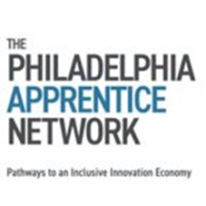











ApprenticeshipPHL Member Organizations

Slide 38





Connect with APHL!
Email ApprenticeshipPHL
Scan here to visit our website!
ApprenticeshipPHL on Linked-In
ApprenticeshipPHL on Facebook
ApprenticeshipPHL Website

Slide 39
Q&A
Thank You!

Slide 40
Join an Apprenticeship Network!

Slide 41

Apprenticeship Networks- How do I get Involved?
Participate as a Member
Leverage Network Resources
Collaborate on Initiatives
Provide Funding and Support
Promote the Network

Slide 42
Beginning Your Apprenticeship Network Action Plan

Slide 43
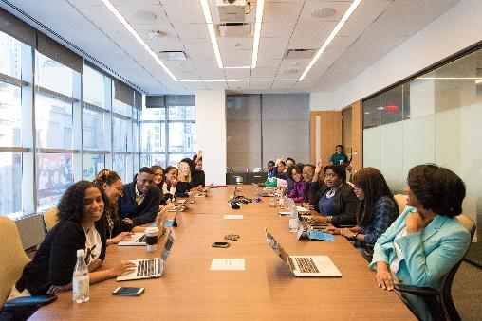
Start Your Own Network
Establish the Network's Goals and Focus Areas
Identify the Network Structure and Membership
Secure Various Funding Sources
Provide Valuable Resources and Services
Connect with Your Workforce System
Measure and Communicate Impact

Slide 44
Questions and Discussion

Slide 45

Contact Us, Become a Partner
Receive no-cost expert TA,
materials, and assistance
Network with potential
partners nationwide
Be nationally recognized for your work
Scan for
Partner Form

Slide 46
Email us your questions at RA_COE@SafalPartners.com
For more information, visit: dolcoe.safalapps.com
Safal Partners © 2024

