Slide 1
Building a School to Apprenticeship Pipeline for Opportunity Youth
NYEC Forum
May 2025
Safal Partners © 2025

Slide 2
Presenter
Alan Dodkowitz
Subject Matter Expert
Safal Partners
Safal Partners © 2025

Slide 3
Welcome and Agenda
Center of Excellence Overview
What are Opportunity Youth?
Why Registered Apprenticeship is a way to engage them
How can we get Opportunity Youth into Registered Apprenticeships?
The Role of the Workforce System
Questions and Wrap-Up
Safal Partners © 2025

Slide 4
Center of Excellence Overview
U.S. DOL initiative to increase systems alignment across apprenticeship, education, and workforce
Led by Safal Partners; 5 national partners
We provide no-cost services including:
Monthly webinars
Quarterly virtual office hours
Individual compliance assistance and services
Online resources (desk aids, guides, frameworks, etc.)
Visit our website, request assistance
Safal Partners © 2025

Slide 5
Quick Pulse Poll #1
Are you a….
Workforce Board Staff
Service Provider Staff
Educational Partner
Vocational Rehabilitation Partner
Employer
Board Member
Registered Apprenticeship Staff
Other
Safal Partners © 2025

Slide 6
Quick Pulse Poll #2
When it comes to Registered Apprenticeship I am…
Just starting out
Somewhat familiar with the basics but don’t utilize it often
Very knowledgeable and often refer people to programs
What is Registered Apprenticeship??
Safal Partners © 2025

Slide 7
Opportunity Youth Meeting Them Where They Are with Innovative Solutions
Safal Partners © 2025

Slide 8
Opportunity Youth Defined
Young people between the ages of 16 and 24 who are neither enrolled in school nor participating in the labor market.
Safal Partners © 2025

Slide 9
Challenges They Face
Disability: Over 16% of disconnected youth have a disability, while only 5% of connected youth face similar challenges.
Expectant and Parenting Youth and Young Adults: Approximately 28% of opportunity youth are expectant or parenting- four times more likely to be mothers than their connected counterparts.
Homelessness: A significant portion of youth experiencing homelessness are also disconnected from school due to substantial disruptions in their education.
Incarceration: Youth with a history of incarceration face an elevated risk of disconnection from their communities, with a higher representation of Black individuals (12%) compared to white peers (7%).
Impoverished: Nearly twice as likely to live in poverty. Individuals from high-poverty areas are significantly more likely (21%) to be opportunity youth compared to their peers from low-poverty areas (6%).
Safal Partners © 2025

Slide 10
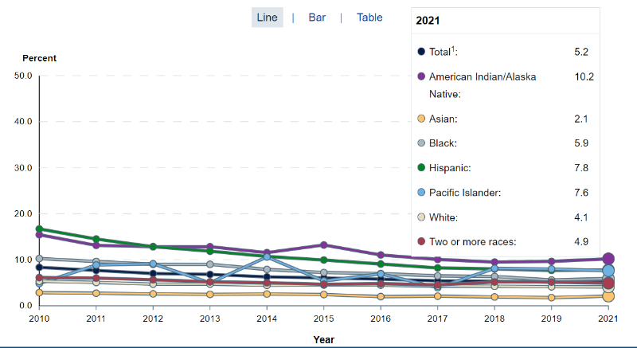
Opportunity Youth – The Numbers
Estimate in 2021: 1.9 million students dropped out of high school (3.46m in 2016)
16-24
year olds
Source: https://nces.ed.gov/
Safal Partners © 2025

Slide 11
Apprenticeship: A Way to Engage Opportunity Youth
Safal Partners © 2025

Slide 12
What is Registered Apprenticeship?
Registered Apprenticeship (RA) is a proven, customizable, and industry-relevant and US Department of Labor-approved model for organizations to find, train and retain new talent as well as upskill current workers in critical occupations.
Safal Partners © 2025

Slide 13
Five Core Components of Apprenticeship
Employer Involvement
Structured On-the-Job Learning (OJL)
Related Instruction (RI)
Rewards for
Skill Gains
National Occupational Credential
Safal Partners © 2025

Slide 14
A WIDE RANGE OF INDUSTRIES
Agriculture
Healthcare
Cybersecurity
Biotechnology
Transportation
Construction
Energy
Hospitality
Advanced Manufacturing
Critical Supply Chain
Telecommunications
Financial Services
Information Technology
Education
Infrastructure
Engineering

Slide 15
Apprenticeships for Opportunity Youth
Connection to employment and education
Career pathway beyond RA Program completion for occupations that provide a family-supporting wage
Roadmap to credential, certification, and degree attainment
Connection to mentors who can offer support and guidance
Linkages to critical supports to assist them in their learning and earning pathway
Safal Partners © 2025

Slide 16
How Can We Get Opportunity Youth Into Apprenticeships?
Safal Partners © 2025

Slide 17
Key Questions
How can we engage the workforce system to recruit Opportunity Youth?
What partnerships do we need? What partners do we already have that can support a program?
How can we bring employers in and support them in employing Opportunity Youth? What occupations are they interested in?
How will we integrate industry needs/occupation requirements into our RI?
What can we do to reduce barriers for Opportunity Youth?
Safal Partners © 2025

Slide 18
Engage the Local Workforce System
Utilize the Local Workforce System: Local Workforce Boards (LWDBs) oversee local workforce agencies, including American Job Centers (AJCs), which manage various programs serving Opportunity Youth.
AJCs administer key initiatives such as:
Workforce Innovation and Opportunity Act (WIOA) Title I Youth Program
YouthBuild
Other state and local workforce initiatives
Recruitment into Registered Apprenticeship (RA) Programs:
AJC staff can actively recruit Opportunity Youth into RA programs.
Safal Partners © 2025

Slide 19
Work with Other Providers
Opportunity Youth are more likely than their peers to rely on public assistance programs such as:
Supplemental Nutrition Assistance Program (SNAP)
Temporary Assistance for Needy Families (TANF)
Medicaid
Work with community organizations, schools, and social service providers including:
Youth shelters
Foster care agencies
Alternative education programs
Workforce development initiatives
Mentorship organizations
Safal Partners © 2025

Slide 20
Recruit Employers
Highlight Business Benefits: Educate employers on how hiring Opportunity Youth can address workforce shortages and increase retention.
Offer Financial Incentives & Support: Inform employers about available tax credits, wage subsidies, grants and funds that offset registered apprenticeship costs.
Provide Training & Mentorship Resources: Assist employers in developing structured mentorship and support systems to help Opportunity Youth succeed in the workplace.
Leverage Community Partnerships: Encourage employers to collaborate with local workforce boards, schools, and community-based organizations that work with Opportunity Youth to create direct recruitment pathways.
Safal Partners © 2025

Slide 21
Gen-Z: Interested in Different Occupations
Sustainable Energy Specialist
Digital Content Creator
Health and Wellness Coach
Cybersecurity Analyst
App Developer
Social Impact Consultant
User Experience (UX) Designer
Remote Work Specialist
E-Sports Professional
Mental Health Professional
Source: LinkedIn
Safal Partners © 2025

Slide 22
But They Are Also The “Toolbelt Generation”
Young adults interested in trades career
Pay increase for new construction hires vs. 2.7% in professional services
Students studying construction trades rose from 2018 to 2024
Vocational-focused community colleges increase in enrollment
More electricians than 2014 - median age fell by 2.9 years
Optimistic about job security and believe they won’t be replaced by AI - Thumbtack
Safal Partners © 2025

Slide 23
Align with CTE Standards and Ensure Hands-On Training
Align Curriculum with Industry Needs: Incorporate CTE standards by aligning the curriculum with current industry needs.
Integrate Work-Based Learning: Embed work-based learning opportunities within CTE programs, allowing students to gain hands-on experience in real-world settings.
Collaborate with Industry Partners: Partner with local businesses to design apprenticeship programs that meet both educational and industry requirements.
Incorporate Industry-Recognized Credentials: Include industry-recognized credentials in apprenticeship programs to validate students' skills and competencies according to CTE standards.
Safal Partners © 2025

Slide 24
Reduce their Barriers through WIOA
Transportation Assistance:
Providing transit passes, ride-share credits, or direct transportation options ensuring youth can commute to RA training sites or workplaces.
Childcare Support or Referrals:
Support for childcare costs and/or referral to childcare programs such as Head Start Early Childhood Learning Centers.
Necessary Work Equipment and Tools:
LWDBs and the local workforce system may utilize WIOA funding to assist with purchasing (or reimburse the cost for) tools and uniforms RA programs require.
Stipends During Pre-Apprenticeship:
The availability of stipends for pre-apprenticeship programs often determines whether an Opportunity Youth will be able to participate.
Emergency Assistance Funds:
LWDBs can ensure WIOA Title I Youth funds are offered to provide immediate financial relief for healthcare needs, car repairs, or housing issues.
Safal Partners © 2025

Slide 25
Other Supports to Reduce Barriers
Housing Assistance:
Refer participants to the U.S. Department of Housing and Urban Development. Additionally, Section 8 housing vouchers are available for those who qualify through their local public housing agency.
Documentation and Paperwork Assistance:
LWDBs can support youth participants with obtaining identification documents, completing forms, and understanding program requirements.
Additional Supports:
Work with other partners including:
Vocational Rehabilitation – WIOA Title IV
Adult Education- WIOA Title II
Safal Partners © 2025

Slide 26
Workforce Boards: The Key Ingredient
Safal Partners © 2025

Slide 27
How Workforce Boards Can Help Education Providers
Provide WIOA Individual Training Account (ITA) funding to support apprentices' RI costs.
Make connections with employers, sponsors.
Host convenings between education and industry.
Provide pipeline of Opportunity Youth to enroll in programs.
Add programs to the Eligible Training Provider List (ETPL).
Support the development of RI curriculum using labor market information and industry standards.
Safal Partners © 2025

Slide 28
How Workforce Boards Can Help Employers/Sponsors
Provide a pipeline of Opportunity Youth Apprentices:
Publicize RA program opening
Screen candidates
Provide pre-apprenticeship training
Provide supportive services to Opportunity Youth.
Provide WIOA OJT contract funding to support percentage of apprentice wages.
Build partnerships w/training providers on ETPL for RI; utilize ITAs to pay for all/portion of apprentices' RI costs.
Support registering and implementing RA programs.
Host convenings (job fairs, recruiting events, etc.) to connect potential apprentices and employers.
Safal Partners © 2025

Slide 29
How Workforce Boards Can Help Community-Based Organizations
Provide education on RA.
Connect potential apprentices with employers.
Provide supportive services to apprentices.
Connect potential apprentices to other resources available within the community.
Leverage funding programs.
Safal Partners © 2025

Slide 30
Get to Know Your Workforce Board
Each Workforce Board has:
Sector strategies: priority occupations and key industries.
Policies on OJT contracts, which WIOA and non-WIOA funding "buckets" and services they will apply to RA.
Funding levels, fiscal year cycle and how quickly they anticipate spending funds.
Supportive services offered and how that maps to your program's needs.
Candidate pool – IS and OS Youth Programs.
ETPL program registration process.
Safal Partners © 2025

Slide 31
Questions and Discussion

Slide 32
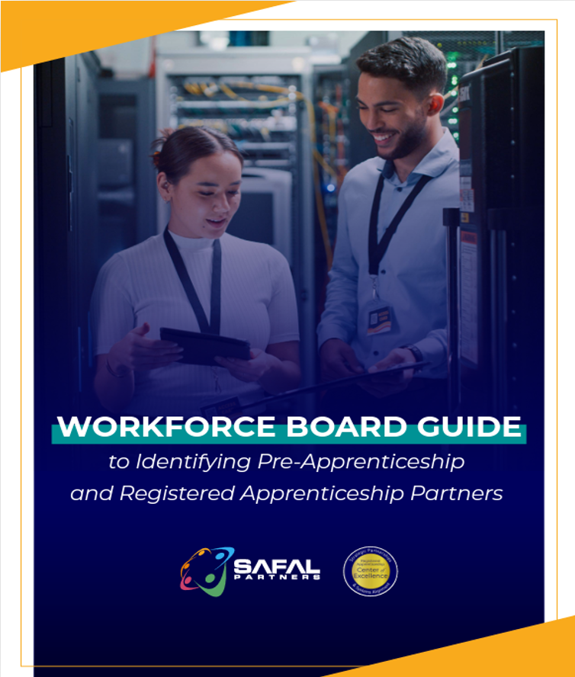
No-Cost Resources
Guide to Identifying Partners
Safal Partners © 2025

Slide 33
Email us your questions at RA_COE@SafalPartners.com
For more information, visit: dolcoe.safalapps.com
Safal Partners © 2025

