Slide 1
Registered Apprenticeship and CTE: How Can We Connect the Two?
PWDA 41st Annual Conference
Thursday, May 1st, 2025
Safal Partners © 2025

Slide 2

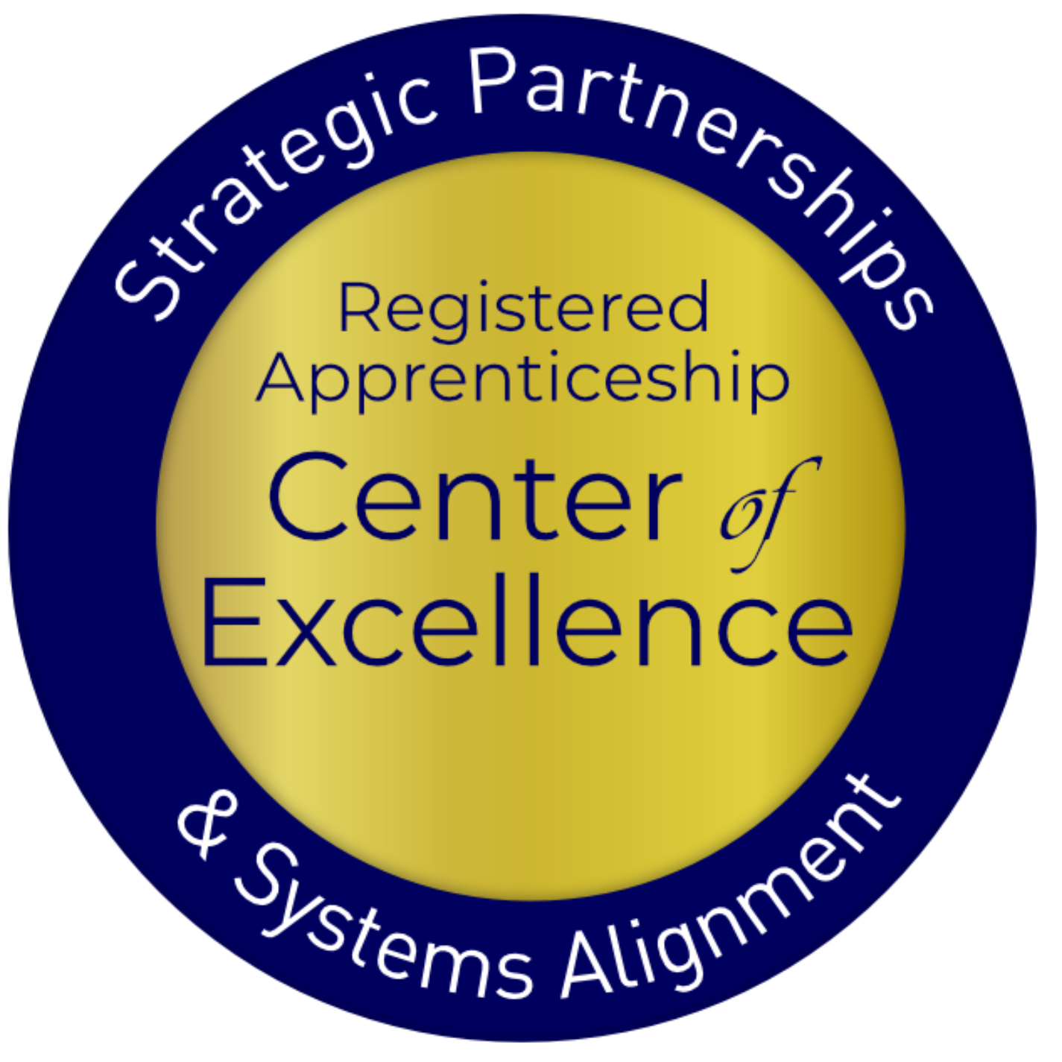
Presenter
Alan Dodkowitz
Subject Matter Expert
Safal Partners
Safal Partners © 2025

Slide 3
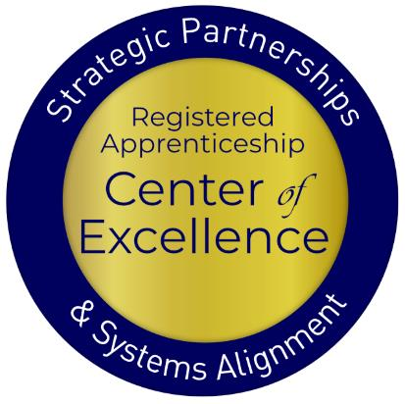
Welcome and Agenda
Center of Excellence Overview
Registered Apprenticeship (RA) Overview
What are the Benefits of RA for Career and Technical Education (CTE) Providers
CTE and Apprenticeship Pathways
Connecting RA and CTE
Workforce Boards- Putting it All Together
Closing Thoughts
Safal Partners © 2025

Slide 4







Center of Excellence Overview
U.S. DOL initiative to increase systems alignment across apprenticeship, education, and workforce
Led by Safal Partners; 5 national partners
We provide no-cost services including:
  Monthly webinars
  Quarterly virtual office hours
  Individual compliance assistance and services
  Online resources (desk aids, guides, frameworks, etc.)
Visit our website, request assistance
Safal Partners © 2025

Slide 5

Quick Pulse Poll #1
Are you a….
  Workforce Board Staff
  Service Provider Staff
  Educational Partner
  Vocational Rehabilitation Partner
  Employer
  Board Member
  Registered Apprenticeship Staff
  Other
Safal Partners © 2025

Slide 6
Registered Apprenticeship Overview
Safal Partners © 2025

Slide 7

What is Registered Apprenticeship?
Registered Apprenticeship (RA)
is a proven, customizable, and industry-relevant and US Department of Labor - approved model for organizations to find, train and retain new talent as
well as upskill current workers
in critical occupations.
Safal Partners © 2025

Slide 8



Five Core Components of Apprenticeship
Industry Led
Paid Job
Structured On-the-Job Learning (OJL)/ Mentorship
Supplemental Education
Credentials
Safal Partners © 2025
Notes:
Recently updated verbiage on apprenticeship.gov - https://www.apprenticeship.gov/employers/registered-apprenticeship-program
1. Industry Led – Programs are industry-vetted and approved to ensure alignment with industry standards and that apprentices are trained for highly skilled, high-demand occupations.
2. Paid Job – Registered Apprenticeships are jobs! Apprentices earn progressive wages as their skills and productivity increase.
3.Structured On-the-Job Learning/Mentorship – Programs provide structured on-the-job training to prepare for a successful career, which includes instruction from an experienced mentor.
4.Supplemental Education – Apprentices are provided supplemental classroom education based on employers’ unique training needs to ensure quality and success.
5.Credentials – Apprentices earn a portable, nationally recognized credential within their industry.

Slide 9
Assessing Your RA Knowledge
Basic
I know what it means, but I don’t know
how to utilize it
and don’t have significant
experience with it.
Intermediate
I understand RA,
I’ve had experience with RA in some capacity, and
I feel comfortable educating internal and external stakeholders about it.
Expert
I have extensive knowledge and relevant experience developing and implementing programs and standards,
recruiting apprentices
and convening stakeholders.
Safal Partners © 2025

Slide 10











A WIDE RANGE OF INDUSTRIES
Agriculture
Healthcare
Cybersecurity
Biotechnology
Transportation
Construction
Energy
Hospitality
Advanced
Manufacturing
Critical
Supply Chain
Telecommunications
Financial
Services
Information
Technology
Education
Infrastructure
Engineering

Slide 11









Growing Apprenticeship
SUCCESSFUL ENGAGEMENT WITH MAJOR EMPLOYERS TO GROW APPRENTICESHIP
Safal Partners © 2025

Slide 12
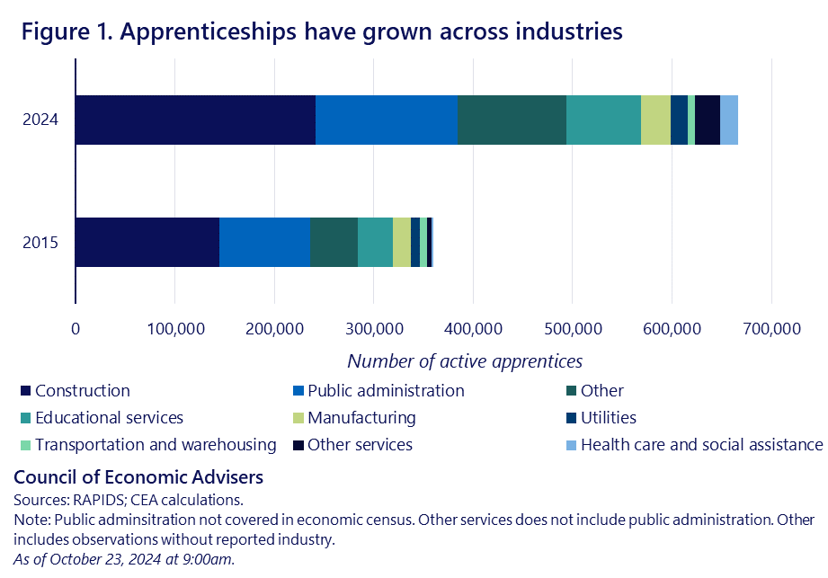
Real Growth in the Non-Trades
Safal Partners © 2025

Slide 13
RA Offers Benefits to Both
Students and Providers
Safal Partners © 2025

Slide 14







RA Offers Clear Benefits for Students
Academically-linked career pathway
“Earn and learn” – training is paid while gaining work experience
Often leads to offer of full-time non-apprentice employment following program completion (94% of completers are retained)
Provides family-support wages, economic mobility: $80,000 average starting salary (U.S. DOL), $300,000 higher lifetime earnings than non-apprentice peers (U.S. DOL)
Increases academic and industry-valued credential attainment
Lowers or eliminates potential student debt for post-secondary education
Safal Partners © 2025
Notes:
Jeremy
Talking Points / Speaker Notes:
For students and job seekers, RA offers multiple advantages:
It’s a paid, structured training model with a strong job placement record.
94% of apprentices retain employment post-completion.
The wage and earnings data speak for themselves: it’s a pathway to upward mobility.
Importantly, RA also reduces or eliminates student debt while delivering credentials of value.
Suggested Group Questions:
How do you communicate the value of RA to job seekers?
How could these benefits influence conversations with youth, parents, or school counselors?

Slide 15



Clear Benefits for CTE Providers
Apprenticeship programs connect students to colleges
Program sponsors, federal and state programs, and/or students can pay for related instruction
Sponsors can provide additional resources beyond tuition to support students and colleges (curriculum development, student supports, additional funding)
Safal Partners © 2025

Slide 16

Federal Funding for RA
Several programs can help pay for Registered Apprenticeship related instruction courses at local colleges, making it more attractive for local employers to participate.
Examples include:
  The Workforce Innovation and Investment Act (WIOA) (through Individual Training Accounts) / On-the-Job Training / Supportive Services )
  Pell Grants (Up to $6,895 per Apprentice)
  Federal Work Study Funds (average of $2,500 per Apprentice)
  State Tax Credits and Tuition Support
  GI Bill Benefits (for approved programs)
Safal Partners © 2025
Notes:
Mention executive order

Slide 17
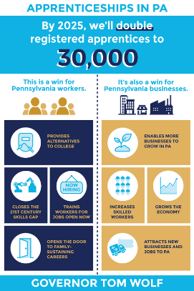
Pennsylvania Funds Apprenticeship Too
Committed an additional $61 million to workforce development initiatives statewide, including apprenticeships, CTE, and vocational-technical programs.
An additional $5 million in grant funding to expand Registered Apprenticeship programs across the Commonwealth.
$2 million in nursing Registered Apprenticeship programs to help fill critical nursing positions across the Commonwealth.
Safal Partners © 2025
Notes:
$3.9 million for pre-apprenticeship and CTE, $4 million for the ABA grant for Penn College

Slide 18
RA and CTE: Why Connect the Two?
Safal Partners © 2025
Notes:
Slide 2: Key Strategies for Alignment
Develop formal articulation agreements between CTE and RA programs
Embed apprenticeship-ready curriculum in high school or community college pathways
Leverage pre-apprenticeship models to prepare students for RA entry
Coordinate with employers to define skill standards and pathways
Use dual credit or credit for prior learning (CPL) to accelerate transitions
Slide 3: Roles of Stakeholders
CTE Providers: Align coursework, prepare students, support career exploration
Apprenticeship Sponsors: Offer structured OJT, mentorship, and career advancement
Employers: Co-design programs, offer placements, and ensure skill relevance
Workforce Boards: Provide funding, wraparound services, and labor market insight
State Agencies: Support policy, coordination, and program approval

Slide 19




Benefits for Schools, Workforce and Industry
Accelerates Workforce Readiness: Students enter the labor market with advanced technical skills, reducing the time and cost to train new employees.
Supports Seamless Transitions: Integration allows students to earn credit toward RA programs while still in high school, easing the shift into postsecondary training or full-time employment.
Addresses Industry Skill Gaps: Employers gain access to a pipeline of young, well-prepared talent trained in high-demand fields.
Builds Cross-System Collaboration: States benefit from stronger ties between education, labor, and industry, leading to better program alignment, funding coordination, and sustainability.
Safal Partners © 2025

Slide 20





Benefits for Students
Enhances Student Engagement: OJL and mentorship increase student motivation and persistence, particularly among those more inclined toward applied learning.
Promotes Economic Mobility: RA leads to higher earnings, credentials, and long-term career advancement for youth.
Reduces Time and Cost to Completion: Students may complete part of the RA requirements while still in high school, shortening the total time needed to finish an apprenticeship.
Expands Career Pathways for Students: Can give high school students a structured pathway into skilled careers.
Safal Partners © 2025

Slide 21
Aligning the Two Systems
Safal Partners © 2025

Slide 22

Key Questions
  What occupations does local labor market
  information show are in high demand and
  what interests youth?
  How will we integrate industry needs /
  occupation requirements into our RI?
  What apprenticeship pathways can we
  develop?
  What partnerships do we need? What
  partners do we already have that can
  support a program?
  How can we ensure proper articulation
  agreements?
Safal Partners © 2025

Slide 23





Gen Z – They’re Interested in Different Occupations
Sustainable Energy Specialist
Digital Content Creator
Health and Wellness Coach
Cybersecurity Analyst
App Developer
Social Impact Consultant
User Experience (UX) Designer
Remote Work Specialist
E-Sports Professional
Mental Health Professional
  Source: LinkedIn
Safal Partners © 2025

Slide 24






But They are Also the “Toolbelt Generation”
Young adults interested in trades career
Pay increase for new construction hires vs. 2.7% in professional services.
Students studying construction trades rose from 2018 to 2024
Vocational-focused community colleges increase in enrollment
More electricians than 2014 - median age fell by 2.9 years.
Optimistic about job security and believe they won’t be replaced by AI - Thumbtack
Safal Partners © 2025

Slide 25

Aligns with CTE Standards and Ensure Hands-On Training
Align Curriculum with Industry Needs: Incorporate CTE standards by aligning the curriculum with current industry needs.
Integrate Work-Based Learning: Embed work-based learning opportunities within CTE programs, allowing students to gain hands-on experience in real-world settings.
Collaborate with Industry Partners: Partner with local businesses to design apprenticeship programs that meet both educational and industry requirements.
Incorporate Industry-Recognized Credentials: Include industry-recognized credentials in apprenticeship programs to validate students' skills and competencies according to CTE standards.
Safal Partners © 2025

Slide 26
Utilizing Pre-Apprenticeship as a Pathway
Foundational Skill-Building: Communication, teamwork, and problem-solving alongside basic technical training.
Career Exploration and Foundational Training: Exposes students to various career paths while developing technical skills.
MOUs with RA Sponsors: Formalized agreements that provide completers with preferential direct entry, ability to apply coursework to RI requirements (through CPL) and hands-on OJL to competency requirements (through CPE).
Partnership Network: Including workforce system, community and faith-based groups, advocacy organizations, labor groups, and educational institutions for supportive services, pathway development.
Paid Work Experience: Fosters engagement, builds commitment, and helps students adapt to workplace expectations.
Safal Partners © 2025
Notes:
A quality pre-apprenticeship program is designed to effectively prepare individuals for success in Registered Apprenticeships and ultimately, skilled employment. Key components include:
1. Industry Alignment and Collaboration:
Employer Involvement: Active participation from employers and apprenticeship sponsors in program design and implementation.
Alignment with RA Standards: Curriculum and training aligned with the requirements and standards of the targeted Registered Apprenticeship programs.
Industry-Recognized Credentials: Incorporation of industry-recognized certifications and credentials that demonstrate relevant skills.
2. Foundational Skills Development:
Basic Skills Remediation: Addressing potential gaps in reading, writing, math, and digital literacy.
Work Readiness Training: Developing essential workplace skills, such as communication, teamwork, problem-solving, and time management.
Safety Training: Providing safety training relevant to the targeted trade or industry.
3. Occupational Skills Introduction:
Hands-On Training: Providing practical, hands-on training that introduces participants to the tools, equipment, and processes used in the trade.
Trade-Specific Knowledge: Introducing participants to the terminology, concepts, and practices of the targeted occupation.
Exposure to Work Environment: Providing opportunities for participants to experience the work environment through site visits, job shadowing, or internships.
4. Mentorship and Support Services:
Mentorship Opportunities: Connecting participants with experienced journeyworkers or apprenticeship graduates for guidance and support.
Support Services: Providing support services to address potential barriers to success, such as transportation, childcare, and financial assistance.
Career Counseling: Offering career counseling and guidance to help participants explore career options and develop career pathways.
5. Program Structure and Delivery:
Structured Curriculum: A well-defined curriculum that outlines learning objectives, training activities, and assessment methods.
Qualified Instructors: Experienced and qualified instructors who can effectively deliver training and provide guidance.
Adequate Resources: Access to appropriate training facilities, equipment, and materials.
Clear Transition Plan: A plan to facilitate a smooth transition from the pre-apprenticeship to a Registered Apprenticeship.
6. Evaluation and Continuous Improvement:
Feedback Mechanisms: Implementing feedback mechanisms to gather input from participants, employers, and instructors.
Data Tracking: Tracking participant outcomes, such as completion rates and placement in Registered Apprenticeships.
Regular Review: Regularly reviewing and updating the program curriculum and delivery methods to ensure alignment with industry needs and best practices.

Slide 27
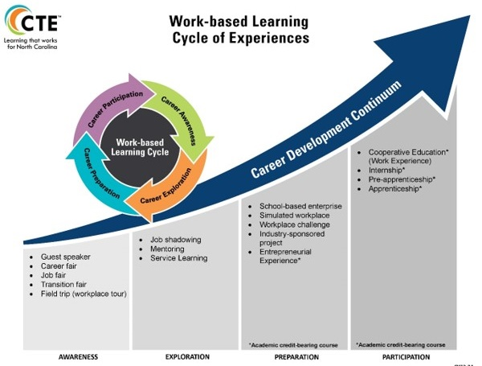
Well-Aligned with CTE
Safal Partners © 2025
Notes:
Description of image found in Alt text
Both focus on practical skills and hands on training, industry-driven training
CTE increasingly incorporates partnerships and input to ensure curriculum and training are aligned with employer needs
Pre-apprenticeship is inherently industry-driven

Slide 28


What Can Each Partner Bring?
Businesses, Trade Organizations, and Chambers of Commerce:
  Identify needed skills
  Provide on-the-job training
  Employ apprentices
Schools:
  Help design curriculum
  Provide classroom instruction
  Facilitate student recruitment
Workforce Boards:
  Can help recruit apprentices
  Offer funding
  Connect partners
Safal Partners © 2025

Slide 29

What Can Each Partner Bring? 1
State Agencies:
  Develop curriculum frameworks
  Provide guidance on laws and regulations
  Offer funding
Community Organizations:
  Assist with student recruitment
  Academic support
  Funding
  Program Oversight
Safal Partners © 2025

Slide 30




Key Organizational Apprenticeship Roles
Sponsor
Employer
RI Provider
Partner
An organization that agrees to operate an apprenticeship program and in whose name the program is registered.
Hires and provides paid OJL for apprentices under supervision of a designated mentor who is a skilled professional in that occupation.
Entity that provides instruction to apprentices in the designated occupation’s core knowledge, skills, and abilities.
Organizations committed to assisting RA programs. They can play one or more roles.

Slide 31

Ensuring Students Receive Credit
Synchronize Curriculum with Graduation Objectives: Collaborate with local school districts to ensure the apprenticeship curriculum meets high school graduation requirements.
Dual Enrollment and Credit Recognition Agreements: Create dual enrollment agreements that allow apprentices to earn credits for both RI and OJL components of their apprenticeship.
Performance-Based Assessments: Integrate assessments
that align with both CTE and apprenticeship standards.
Consistent Tracking: Ensure apprenticeship coordinators, school counselors, and educators track apprentices' progress and ensure all requirements are met.
Safal Partners © 2025

Slide 32
Examples
Safal Partners © 2025

Slide 33

TRACK: Tech Ready Apprentices for Careers in Kentucky
Launched during the 2013-2014 school year
Partnership between state Office of Career and Technical Education and Kentucky Office of Apprenticeship
Provides high school students with pre-apprenticeships and opportunities to transition to Registered Apprenticeship programs.
Employers partner with area technical centers to design the selection process and the program of study sequence, allowing them to tailor the program to their specific need.
Initially trades-focused but now in 16 different career areas.
Has served over 500 youth apprentices in various career pathways and over 90 employers.
Safal Partners © 2025

Slide 34

North Carolina
Serves as a Sponsor of Registered Apprenticeship Programs
Offers apprenticeships in 11 different fields (HVAC, IT, Hospitality, Child Care, Licensed Practice Nurse, etc.) and provides the related instruction for these occupations
Partners with several different employers to provide OJL, including the University of Maryland Medical Center, MedStar Health, Associated Builders & Contractors of Greater Baltimore, Johns Hopkins, and others.
Has a close relationship with the local workforce board and workforce systems
Utilizes funds from employers and local and state grants to support their programs
Safal Partners © 2025

Slide 35
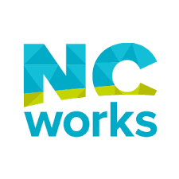
North Carolina 2
Offers both RA and state-recognized pre-apprenticeship programs for high school students.
Students are dually enrolled in CTE and RA, earning credit toward graduation and apprenticeship completion.
Programs are developed in partnership with employers, high schools, and community colleges.
CTE coursework provides the RI, while students gain paid OJL with RA sponsors.
Strong state-level policy support, including guidance documents, NCWorks partnership coordination, and a state-funded apprentice registration subsidy.
Safal Partners © 2025

Slide 36
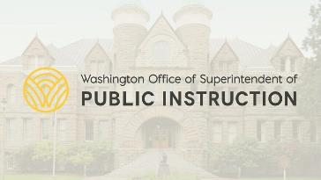
Washington
High school CTE instructors work in collaboration with local employers and sponsors to align curriculum.
The state provides robust TA and outreach to support program start-up and stakeholder engagement.
Washington has created practical tools, including "how-to guides" for employers and student-focused websites promoting RA pathways.
Programs are supported by cross-agency collaboration, with strong roles played by the Education and Labor Departments.
Safal Partners © 2025

Slide 37
Workforce Boards:
The Key Ingredients
Safal Partners © 2025

Slide 38

How Workforce Boards Can Help Education Providers
Provide WIOA Individual Training Account (ITA) funding to support apprentices' RI costs
Make connections with employers, sponsors
Host convenings between education and industry
Provide pipeline of youth to enroll in programs
Add programs to the Eligible Training Provider List (ETPL)
Support the development of RI curriculum using labor market information and industry standards
Safal Partners © 2025

Slide 39

How Workforce Boards Can Help Employers/Sponsors
Provide a pipeline of Youth Apprentices:
  Publicize RA program opening
  Screen candidates
  Provide pre-apprenticeship training
Provide supportive services to youth
Provide WIOA OJL contract funding to support percentage of apprentice wages
Build partnerships with training providers on ETPL for RI; utilize ITAs to pay for all/portion of apprentices' RI costs
Support registering and implementing RA programs
Host convenings (job fairs, recruiting events, etc.) to connect potential apprentices and employers
Safal Partners © 2025

Slide 40

How Workforce Boards Can Help Community-Based Organizations
Provide education on RA
Connect potential apprentices with employers
Provide supportive services to apprentices
Connect potential apprentices to other resources available within the community
Leverage funding programs
Safal Partners © 2025

Slide 41

Get to Know Your Workforce Board
Each Workforce Board has:
  Sector strategies: priority occupations and key industries
  Policies on OJL contracts, which WIOA and non-WIOA funding "buckets" and services they will apply to RA
  Funding levels, fiscal year cycle and how quickly they anticipate spending funds
  Supportive services offered and how that maps to your program's needs
  Candidate pool – In-School and Out-of-School Youth Programs
  ETPL program registration process
Safal Partners © 2025

Slide 42
Questions and Discussion

Slide 43


Become a Center Partner
Scan for Partner Form
Receive no-cost expert services, including materials and support
Network with potential partners nationwide
Be nationally recognized for your work
Safal Partners © 2025

Slide 44
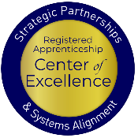
Email us your questions at RA_COE@SafalPartners.com
For more information, visit: dolcoe.safalapps.com
Safal Partners © 2025

