Slide 1
Promoting Registered Apprenticeships: Strategies for Business Service Representatives in the Transportation Industry
Fastport Webinar
Friday, June 6th, 2025
Safal Partners © 2025

Slide 2

Welcome and Agenda
Center of Excellence Overview
The Value of Registered Apprenticeships
Fastport as a Transportation Industry Intermediary
Promoting RA to Transportation Industry Employers
Effective Outreach Strategies
Fastport Successful Case Examples
Q&A and Closing
Safal Partners © 2025

Slide 3







Center of Excellence Overview
U.S. DOL initiative to increase systems alignment across apprenticeship, education, and workforce
Led by Safal Partners; 5 national partners
We provide no-cost services including:
Monthly webinars
Quarterly virtual office hours
Individual compliance assistance and services
Online resources (desk aids, guides, frameworks, etc.)
Visit our website, request assistance
Safal Partners © 2025

Slide 4
Assessing Your RA Knowledge
Basic
I know what it means, but I don’t know how to utilize it and don’t have significant experience with it.
Intermediate
I understand RA, I’ve had experience with RA in some capacity, and I feel comfortable educating internal and external stakeholders about it.
Expert
I have extensive knowledge and relevant experience developing and implementing programs and standards, recruiting apprentices, and convening stakeholders.
Safal Partners © 2025
Notes:
Melissa

Slide 5
The Value of Registered Apprenticeships
Safal Partners © 2025

Slide 6

What is Registered Apprenticeship?
Registered Apprenticeship (RA) is a proven, customizable, and industry-relevant and US Department of Labor-approved model for organizations to find, train and retain new talent as well as upskill current workers in critical occupations.
Safal Partners © 2025

Slide 7



Five Core Components of Apprenticeship
Industry Led
Paid Job
Structured On-the-Job Learning (OJL)/ Mentorship
Supplemental Education
Credentials
Safal Partners © 2025

Slide 8





Benefits of RA to Employers
Proven workforce method
Build a skilled talent pipeline
Reduce recruitment costs
Improved employee retention
May be eligible for tax credits or other financial benefits
Safal Partners © 2025

Slide 9


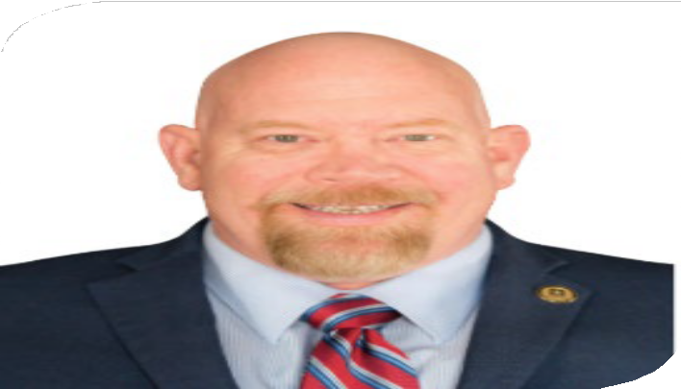
Guest Presenters
Scott Ellsworth
Dave Harrison
Member of the Fastport Team, Principal & Owner
Sherpa Management Solutions
Executive Director of Workforce Development & Government Relations
Fastport

Slide 10
Fastport Transportation Industry Intermediary
Safal Partners © 2025

Slide 11

Introduction to Fastport
Fastport is a U.S. DOL Industry Intermediary
Funded Partner of U.S. DOL, Office of Apprenticeship
Tasked with expanding RA opportunities in Transportation industry
Promotes RA benefits to the Transportation industry
Streamlines process to launch and expand new RA programs
Provides access to resources such as pre-approved, industry-endorsed online instruction and tailored coaching on program set-up and funding opportunities.
Learn more about Fastport
Safal Partners © 2025

Slide 12
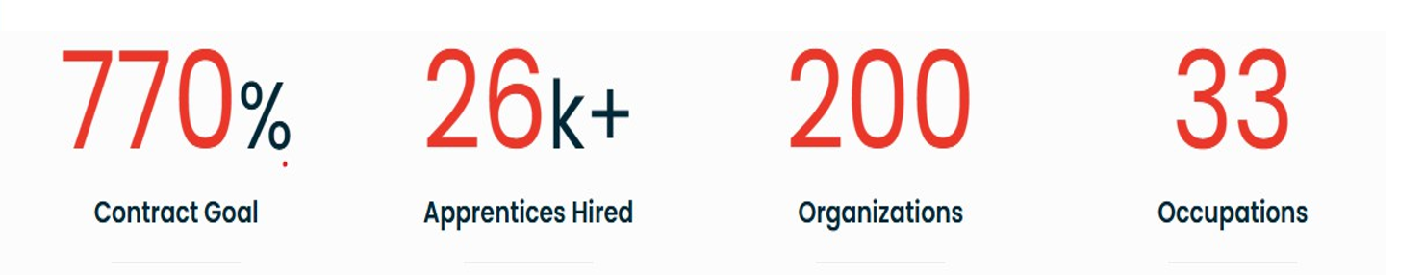
Snapshot of Success
Fastport's achievement to goal ratio for DOL contract deliverable
Fastport's programs have helped to successfully hire over 26,000 Registered Apprentices into TDL occupations
Created Registered Apprenticeship programs through Fastport (includes both associations and employers)
Registered Apprenticeship occupations developed with Fastport
Safal Partners © 2025

Slide 13







Why is the Transportation Industry Unique? 2
Which of these occupations is in the Transportation Industry?
Truck Driver
Pilot
Logistics Analyst
Cybersecurity Worker
Vehicle Maintenance
Forklift Driver
Safal Partners © 2025

Slide 14
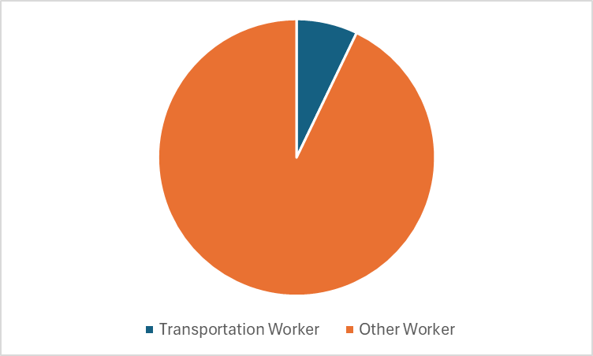
Why is the Transportation Industry Unique? 1
One out of every 14 workers is in the transportation industry.
Source: https://nationalapprenticeship.org/logistics-and-supply-chain
Safal Partners © 2025

Slide 15
Promoting RA to Transportation Industry Employers
Safal Partners © 2025

Slide 16


Key Insights for Transportation Employers
Start-up can be streamlined by partnering with an intermediary:
Working with intermediaries speeds up the Registered Apprenticeship process
The U.S. Department of Labor has access to Subject Matter Experts in both RA and your industry
An intermediary will work directly with your organization and with the U.S. Department of Labor
Understand & communicate the Return on Investment to stakeholders:
Employer ROI: For each $1 invested, $1.47 in return
Public ROI: For each $1 invested, $28 in return
Safal Partners © 2025

Slide 17


Key Insights for Transportation Employers 2
Use RA to fill current needs:
RA programs can be tailored to your company’s unique skill requirements.
Many similar RA programs already exist and can be adjusted to your specifics.
Use RA to fill future needs:
Ensure a highly skilled workforce
Succession planning
Safal Partners © 2025

Slide 18
Effective Outreach Strategies
Safal Partners © 2025

Slide 19






How to Reach Transportation Employers
Industry conferences
Industry RA Accelerators
Targeted Social Media
Adjacent industry events
Safal Partners © 2025

Slide 20
Fastport Successful Case Examples
Safal Partners © 2025

Slide 21


Successful Case Examples
Successfully launched a Department of Labor Registered Apprenticeship program co-sponsored by Fastport and the American Trucking Association in conjunction with the FMCSA’s Safe Driver Apprenticeship Program.
2025 Next Generation in Trucking Association Career Catalyst Award
Driver Registered Apprenticeship Program has 3,123 apprentices currently enrolled and 398 completers.
528 active veteran apprentices reflect Melton’s focus on accessible veteran career pathways.
Melton highlights the strength of its Registered Apprenticeship Program in key events like Fastport’s National Apprenticeship Day webinar with the Military Officers Association of America.
Safal Partners © 2025

Slide 22
Questions & Answers

Slide 23


Share Promising Practices
Submit your promising practice here:
Safal Partners © 2025

Slide 24


Become a Center Partner
Scan for Partner Form
Receive no-cost expert services, including materials and support
Network with potential partners nationwide
Be nationally recognized for your work
Safal Partners © 2025

Slide 25

Email us your questions at RA_COE@SafalPartners.com
For more information, visit: dolcoe.safalapps.com
Safal Partners © 2025

