Slide 1
Growing Your Workforce in America: A U.S. Department of Labor Overview of the Workforce System
SelectUSA Investments Summit
Monday, May 12th
Safal Partners © 2025

Slide 2
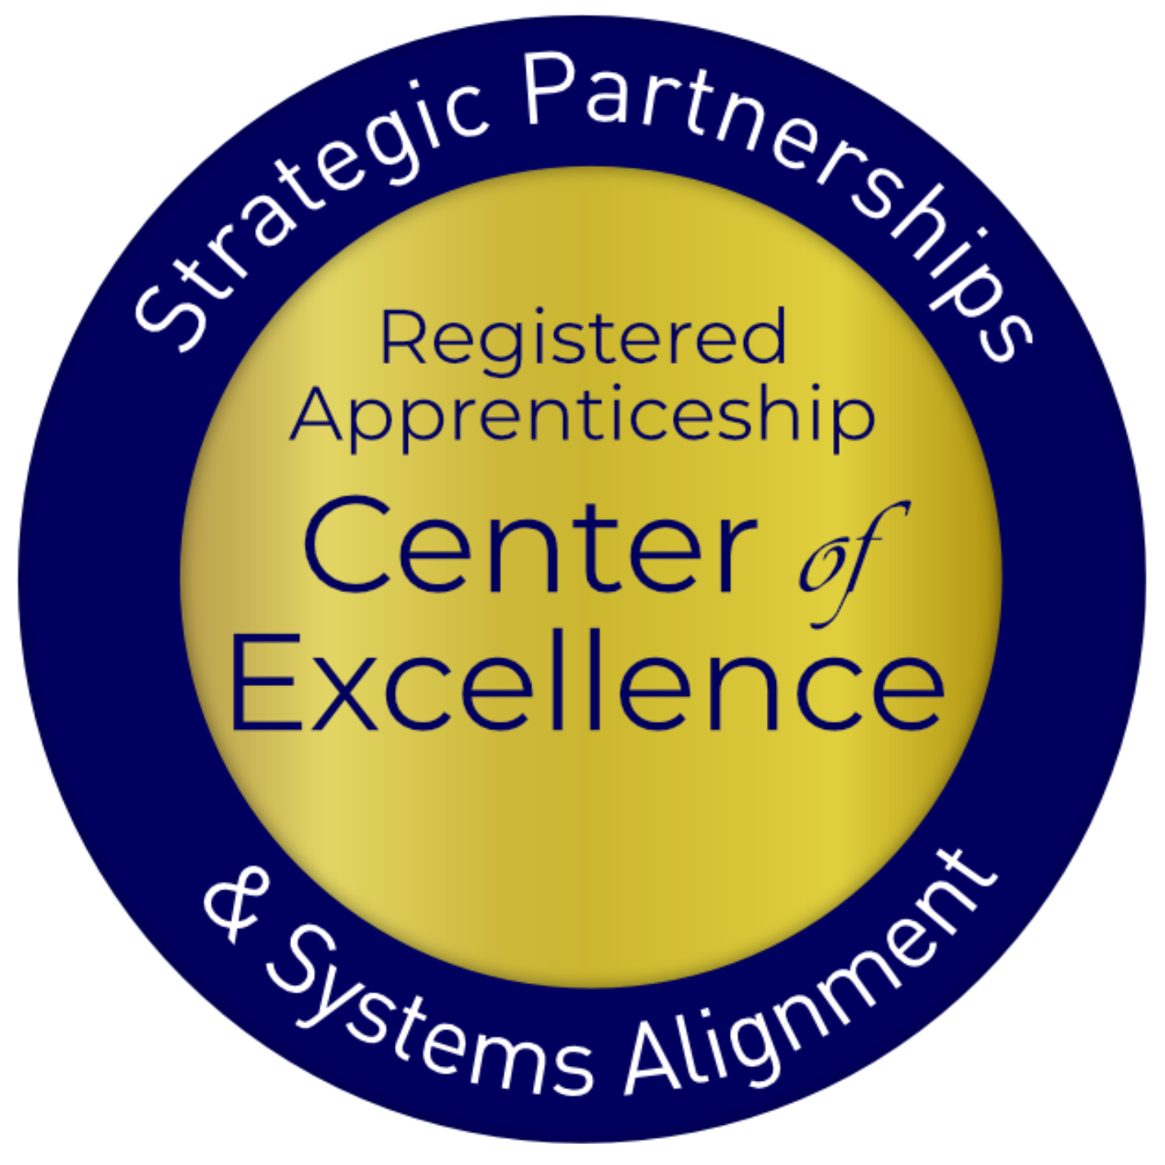
Welcome and Agenda
Center of Excellence Overview
Introduction to the Workforce System
Introduction to Employer Services at a Local Level
Introduction to Registered Apprenticeship
The Business Case for Apprenticeship
Safal Partners © 2025

Slide 3
What is the Public Workforce System
The public workforce system, as defined by the US Department of Labor, is a network of federal, state, and local government-funded agencies and programs that provide services to workers, job seekers, and employers “to support economic expansion and develop the talent of our nation’s workforce."
Safal Partners © 2025

Slide 4
Overview of the Workforce System
US Department of Labor
Oversight
Governor
Appointment Consultation
Oversight
State Workforce Development Board
State Workforce Agency
Consultation
Funding Oversight Policy
Technical Assistance
Consultation
Chief Elected Official
Funding
Appointment Partnership Approvals
One-Stop Delivery System
Joint
Oversight
Vision Oversight Guidance
Local Workforce
Development Board
Safal Partners © 2025

Slide 5
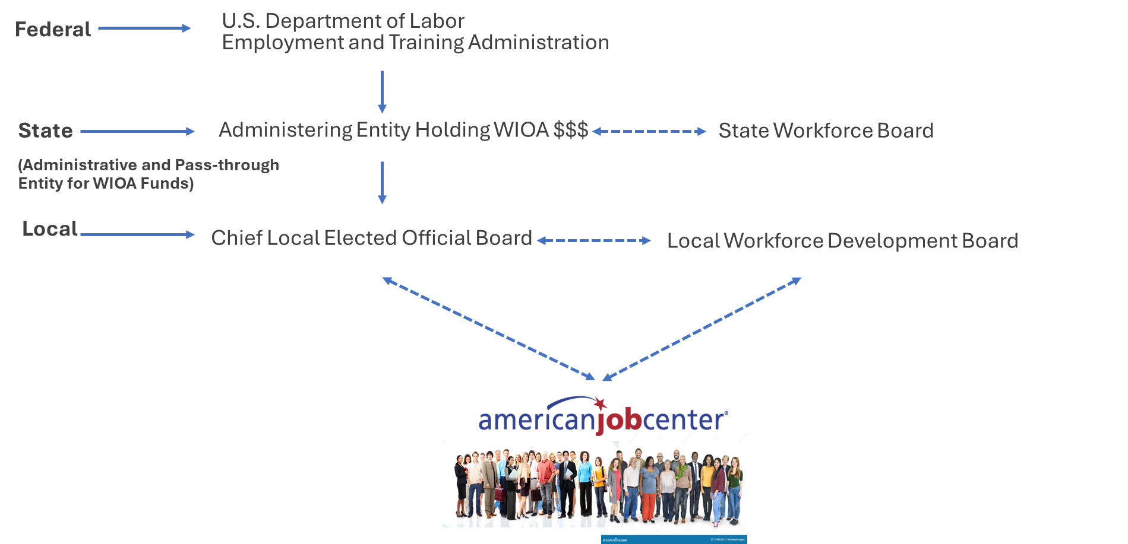
Governing Structure of WIOA's Workforce System
Safal Partners © 2025

Slide 6
Introduction to the Workforce System and WIOA 1
Local Workforce Development Boards (LWDBs) are regional bodies that play a pivotal role in coordinating and overseeing workforce development initiatives within a specific locality or region.
The primary purpose of LWDBs is to align workforce training and education programs with the needs of local employers, industries and job seekers.
LWDBs collaborate with various stakeholders, including businesses, educational institutions, government agencies and community organizations, to strategize and implement workforce development policies and programs.
Safal Partners © 2025

Slide 7
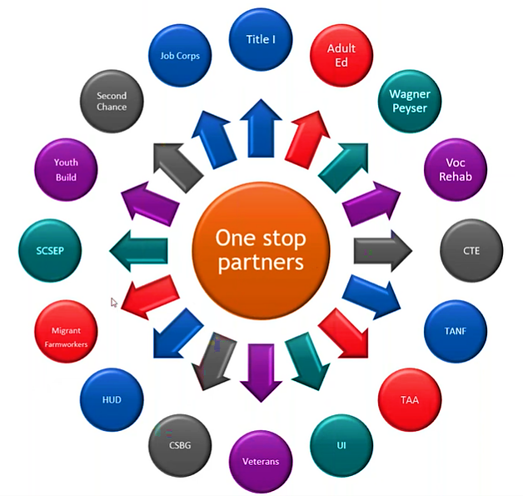
WIOA's American Job Centers
The American Job Center Network is a holistic workforce system preparing job seekers to meet employer needs.
Safal Partners © 2025

Slide 8
Introduction to Employer Services at the Local Level
Safal Partners © 2025

Slide 9
The BSR – Your Critical Connection
While services may vary depending on the organization, region, or specific objectives, a Business Services Representative (BSR) serves as the bridge between employers and workforce development resources, aiming to create mutually beneficial partnerships that enhance employment opportunities and support economic growth.
Safal Partners © 2025

Slide 10
Employer Services & BSR
BSRs meet with businesses to comprehend their talent needs including staffing requirements, skill gaps, and workforce challenges.
Services often include:
Employer Engagement & Relationship Building
Network and Collaboration
Facilitating Access to Funding
Compliance and Documentation
Data Analysis & Reporting
Safal Partners © 2025

Slide 11
Services Offered by BSRs 1
WIOA Required:
Labor Exchange Activities
Provision of labor market information
Establishment of relationships and networks with large and small businesses
Development and implementation of industry or sector partnerships

Slide 12
Services Offered by BSRs 1 1
Additional Services:
Screening and referral of qualified job seekers
Customized recruitment events including targeted job fairs
Customized assistance or referral for assistance in the development of RA programs
Developing and delivering innovative workforce services and strategies
Facilitating access to funding through the workforce system
Assistance to area businesses in managing reductions in force with rapid response and layoff aversion services.

Slide 13
Employer Services 1
Some LWDBs will offer other programs to further serve employer workforce needs such as:
Industry Partnerships and Sector Strategies
Apprenticeship Intermediary Services
Apprenticeship Coordinators
Safal Partners © 2025

Slide 14
Employer Driven Funds 1
Some of the key LWDB funding opportunities for employers may include:
Incumbent Worker Training
Customized Training
On-the-Job Training
Other State and Local Funding:
Subsidized Employment
State Apprenticeship Expansion
Safal Partners © 2025

Slide 15
Employer Referrals & Access 1
Employers interested in leveraging WIOA and other funding sources should engage with their local BSRs to explore available resources, determine eligibility criteria, and referral processes.
Safal Partners © 2025

Slide 16
WIOA and RA – The Big Picture
Job Seeker Services (Case Managers / Career Counselors, Etc. )
Business Services (Business Services Reps that Comprise Business Services Team including ATR, Navigator, etc.)
Registered Apprenticeship (Works with AJC Partners on Behalf of Job Seekers and Businesses to Ensure Talent Pipeline Match)
Safal Partners © 2025

Slide 17
Introduction to Registered Apprenticeship
Safal Partners © 2025

Slide 18
What is Registered Apprenticeship?
Registered Apprenticeship (RA) is a proven, customizable, and industry-relevant and US Department of Labor-approved model for organizations to find, train and retain new talent as well as upskill current workers in critical occupations.
Safal Partners © 2025

Slide 19
Five Core Components of Apprenticeship
Employer Involvement
On-the-Job Learning (OJL)
Related Instruction (RI)
Rewards for Skill Gains
National Occupational Credential
Safal Partners © 2025

Slide 20
A WIDE RANGE OF INDUSTRIES
Agriculture
Healthcare
Cybersecurity
Biotechnology
Transportation
Construction
Energy
Hospitality
Advanced Manufacturing
Critical Supply Chain
Telecommunications
Financial Services
Information Technology
Education
Infrastructure
Engineering

Slide 21
The Business Case for Registered Apprenticeship
Safal Partners © 2025

Slide 22
Making the Business Case for RA
RA offers a proven, high caliber training strategy for workers to learn the skills that employers need for American businesses to grow and thrive in a competitive global environment.
Safal Partners © 2025

Slide 23
Benefits of Apprenticeship – Business Case
Skilled Workforce
Recruit and develop a highly-skilled workforce
Improved Productivity
Improve profitability and positive impact to your bottom line
Reduced Turnover Minimize cost with reduced turnover and liability
Customizable Training
Create flexible training options that ensure workers develop the right skills
Retain Workers
94% of apprentices continue employment after completing an apprenticeship
Safal Partners © 2025

Slide 24
American Apprenticeship Initiative (AAI) Evaluation
Improved company culture
96%
Improved pipeline of skilled workers
91%
Improved employee loyalty
91%
Improved co-worker productivity
87%
Reduced turnover
81%
Product or process innovation
78%
Future manager development
76%
More
on-time delivery
74%
Reduced downtime
68%
Safal Partners © 2025

Slide 25
Federal/State Funding for RA
Several programs can help pay for RA related instruction courses at local colleges, making it more attractive for local employers to participate. Examples include:
The Workforce Innovation and Investment Act (WIOA) (through Individual Training Accounts) / On-the-Job Training / Supportive Services)
Pell Grants (Up to $6,895 per Apprentice)
Federal Work Study Funds (average of $2,500 per Apprentice)
State Tax Credits and Tuition Support
GI Bill Benefits (for approved programs)

Slide 26
Become a Center Partner
Scan for Partner Form
Receive no-cost expert services, including materials and support
Network with potential partners nationwide
Be nationally recognized for your work
Safal Partners © 2025

Slide 27
Email us your questions at RA_COE@SafalPartners.com
For more information, visit: dolcoe.safalapps.com
Safal Partners © 2025

